Slide 1
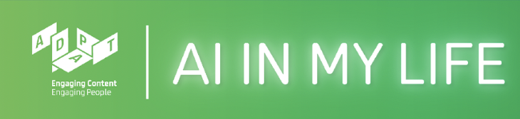
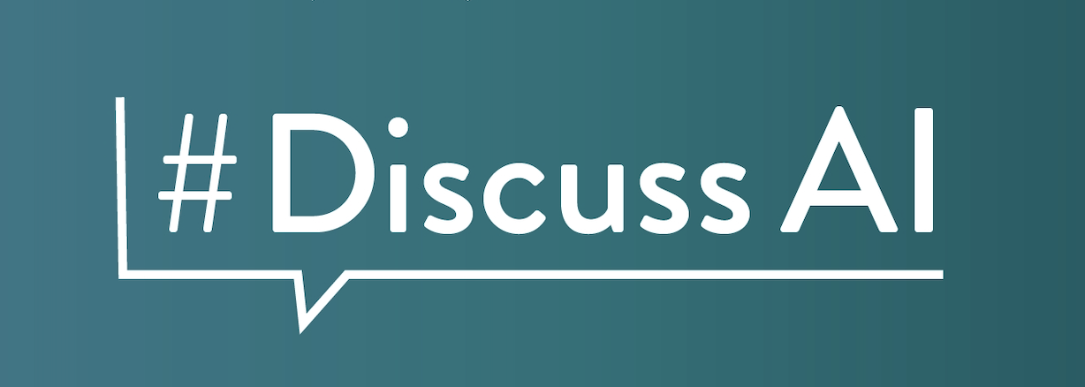
Introduction to AI
An AI in My Life Workshop
V2.1 August 2026

Slide 2

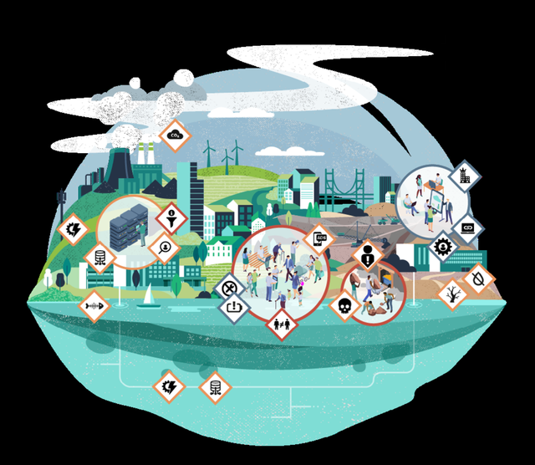

What is AI in My Life?
A 4-part workshop series on
Artificial Intelligence
Developed by the ADAPT research centre at DCU and partners
Designed to help you explore the
role of AI in your life and in society
§
Lone Thomasky & Bits&Bäume / https://betterimagesofai.org / https://creativecommons.org/licenses/by/4.0/
This work is licensed under a Creative Commons Attribution-NonCommercial-ShareAlike 4.0 International License
Notes:
Say:
“This workshop is part of ‘AI in My Life’, a four-part series on Artificial Intelligence.”
“It’s been developed by the Education & Public Engagement team at the Research Ireland ADAPT Centre in DCU with partners.”
“And it’s designed to help you understand AI so you can evaluate its role and make informed decisions about how it affects your life and society.”

Slide 3
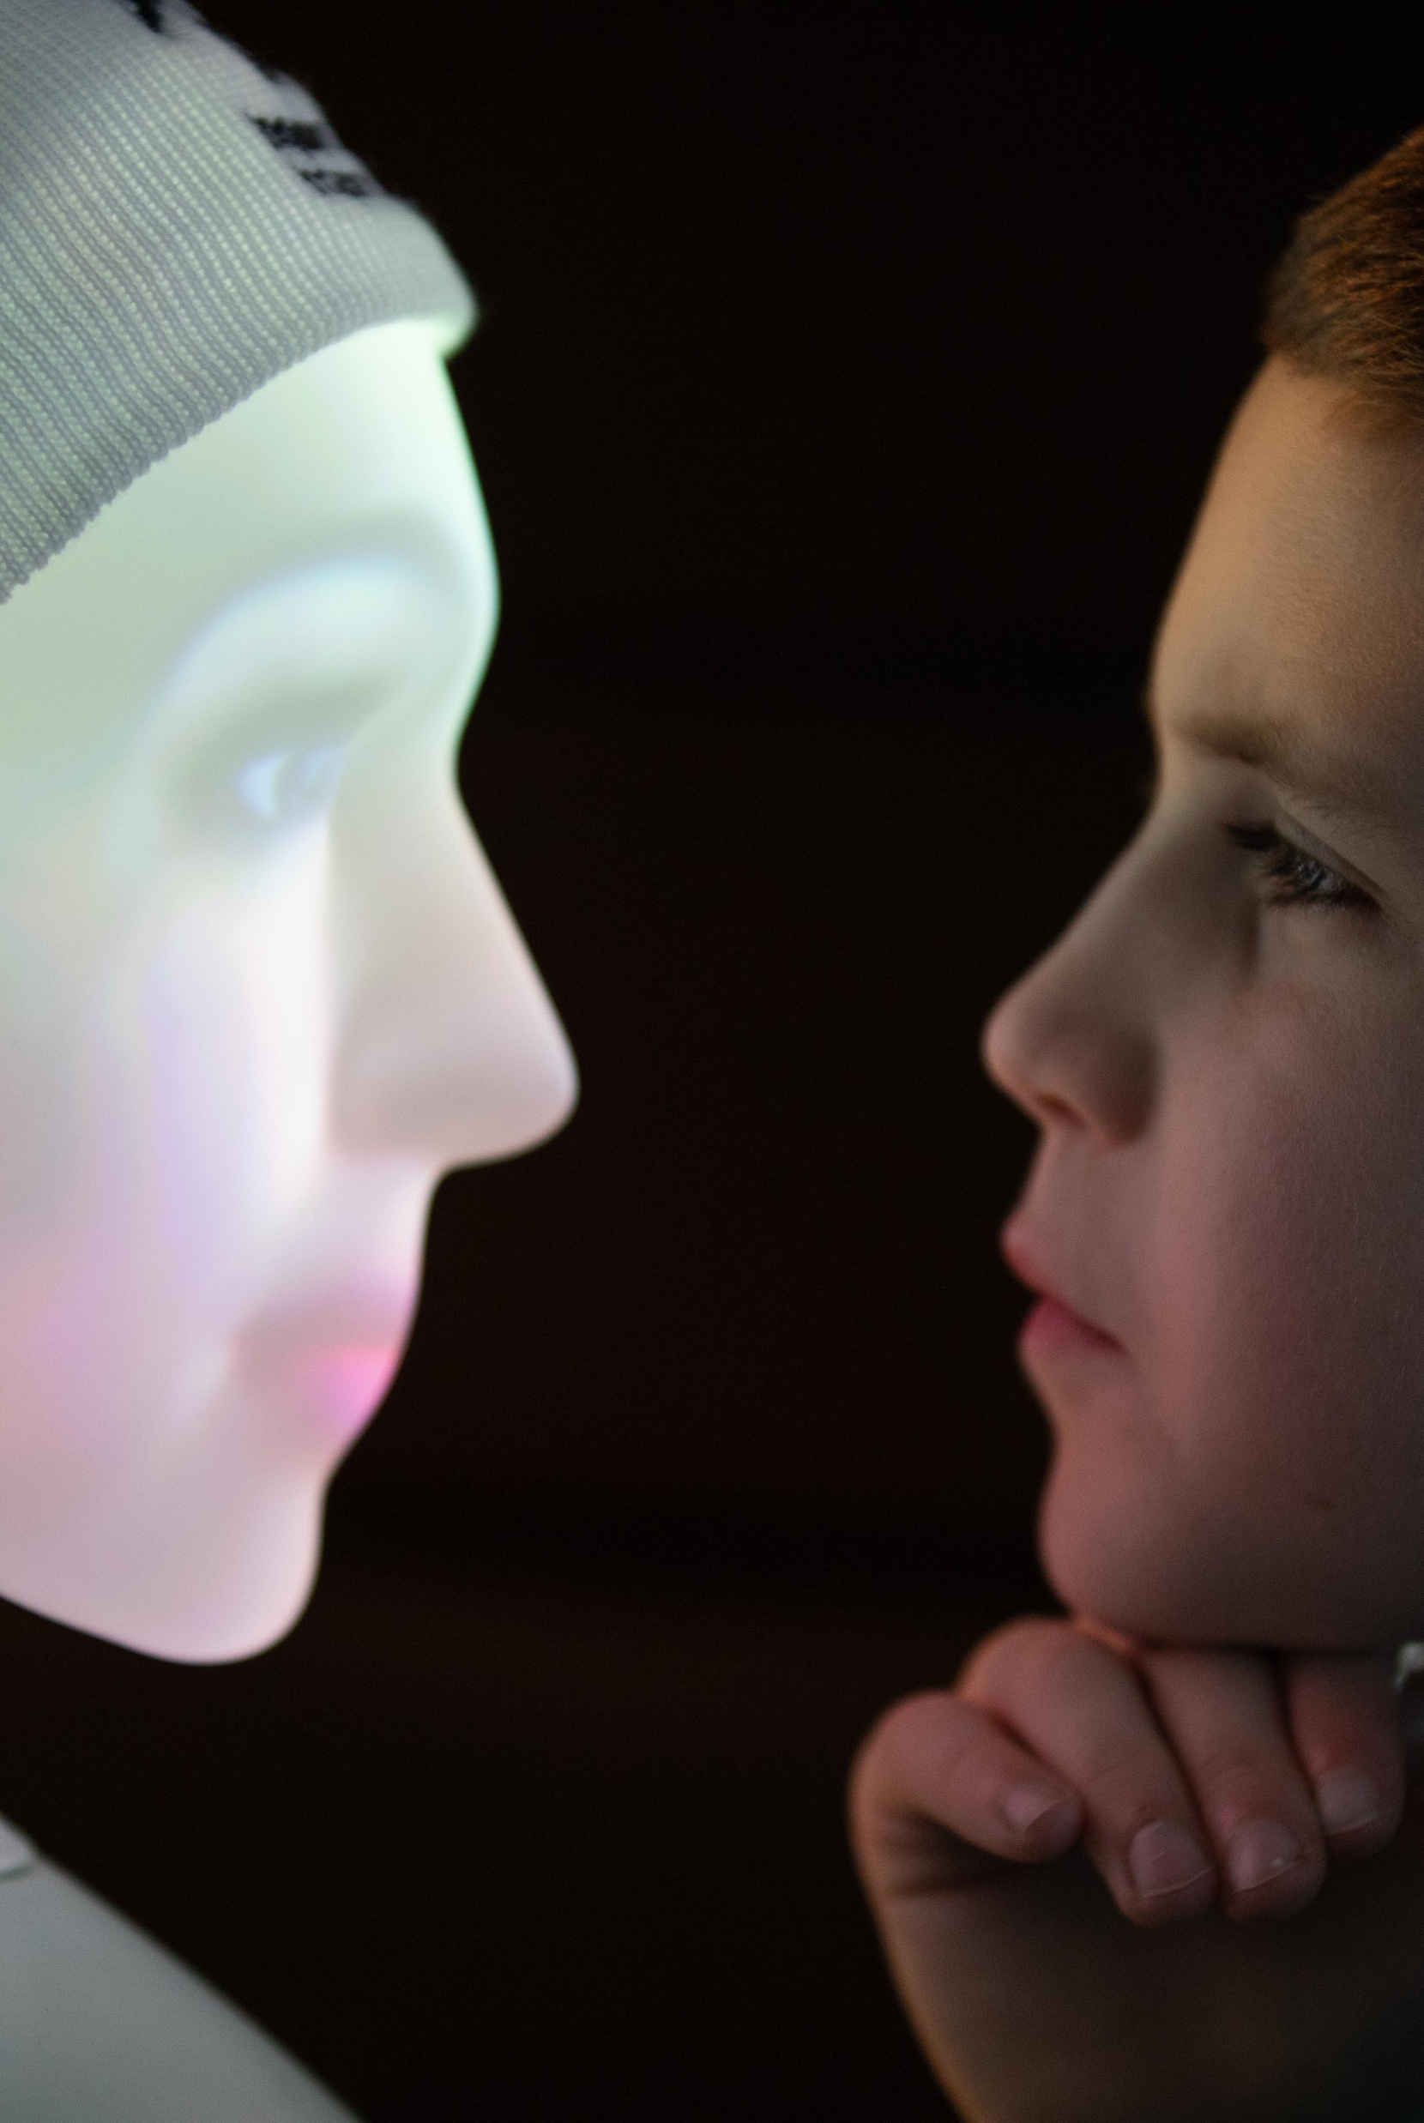
Learning Intentions
By the end of this lesson, you should be able to:
Explain what AI is
Describe simply how AI works
Identify where AI shows up in your daily life
You’ll think critically about its use
This work is licensed under a Creative Commons Attribution-NonCommercial-ShareAlike 4.0 International License
Notes:
Say:
“By the end of this lesson, you should be able to:
explain what AI is,
describe in very simple terms how AI works,
and identify where AI shows up in your daily life.”
“Importantly, we’ll start thinking critically about it (considering the positive and negative aspects of AI), not just using it blindly.”

Slide 4
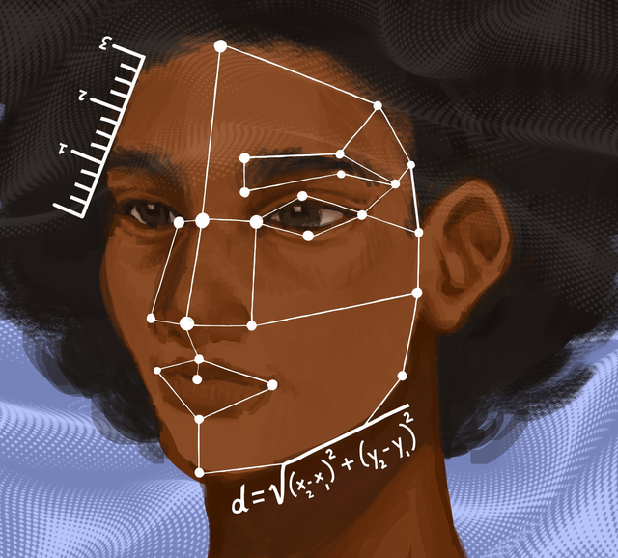
What is AI?
Artificial Intelligence (AI) refers to technologies designed to carry out tasks that normally require human intelligence.
Things like recognising images, understanding language, or solving problems.
Alyssa Chen / https://betterimagesofai.org / https://creativecommons.org/licenses/by/4.0/
This work is licensed under a Creative Commons Attribution-NonCommercial-ShareAlike 4.0 International License
Notes:
Say:
“How might we define AI?”
“AI refers to technologies designed to carry out tasks that normally require human intelligence.”
“Things like recognising images, understanding language, or solving problems.”

Slide 5
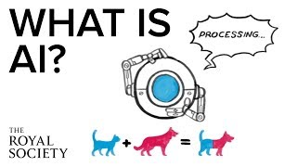
What is AI?
🔵 SKIP FOR 40 MIN WORKSHOP
The Royal Society: https://www.youtube.com/watch?v=nASDYRkbQIY&feature=emb_imp_woyt
This work is licensed under a Creative Commons Attribution-NonCommercial-ShareAlike 4.0 International License
Notes:
Say:
“This short video gives us a simple explanation of AI and highlights some of its uses and limitations.”
“As you watch, think: Where do I encounter AI in my life?”
(Click to launch video on YouTube - it'll typically appear in a new web browser)

Slide 6
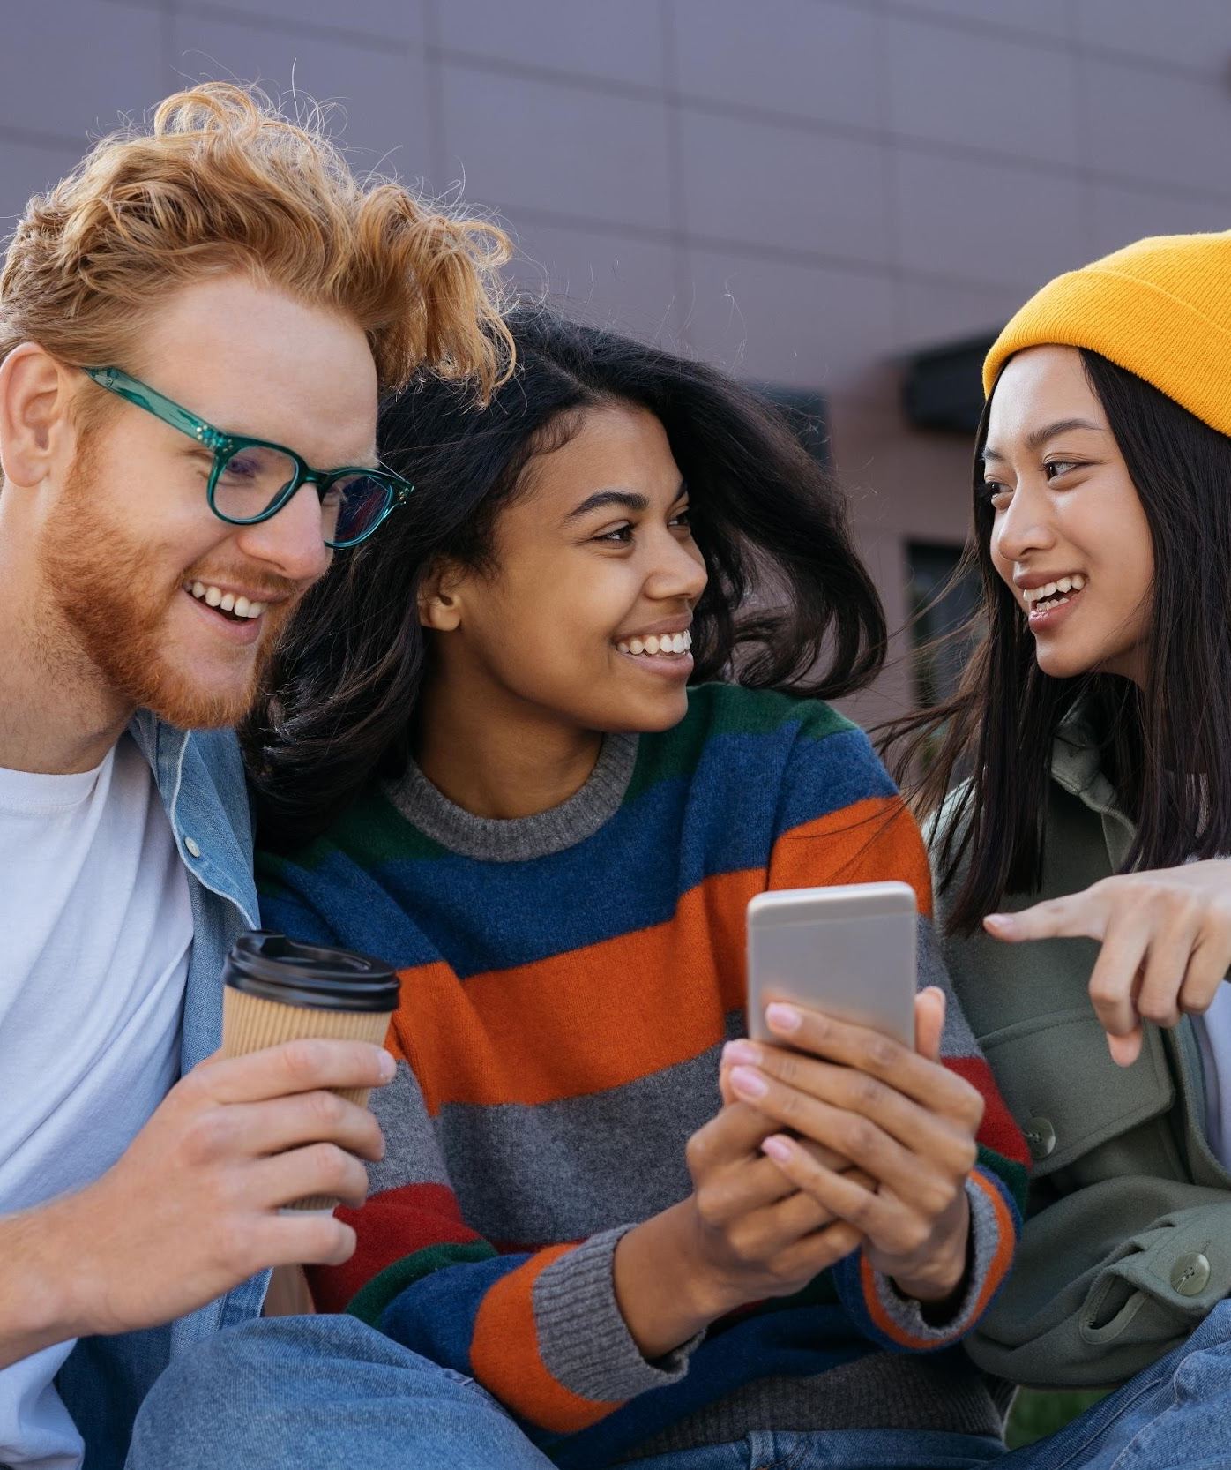
AI in Your Life
Have you used AI today?
Notes:
Say:
“Take 30 seconds. Think about today, from when you woke up until now.”
“Where have you interacted with AI?”
Prompt if needed:
Predictive text on your phone? Google Maps? Netflix recommendations?
“Let’s hear a few examples.”
(Collect 3-5 answers)
Then say:
“What do you notice about these?”
“AI isn’t just one thing; it’s all around us. We say it’s ubiquitous, meaning it appears across many parts of daily life.”

Slide 7
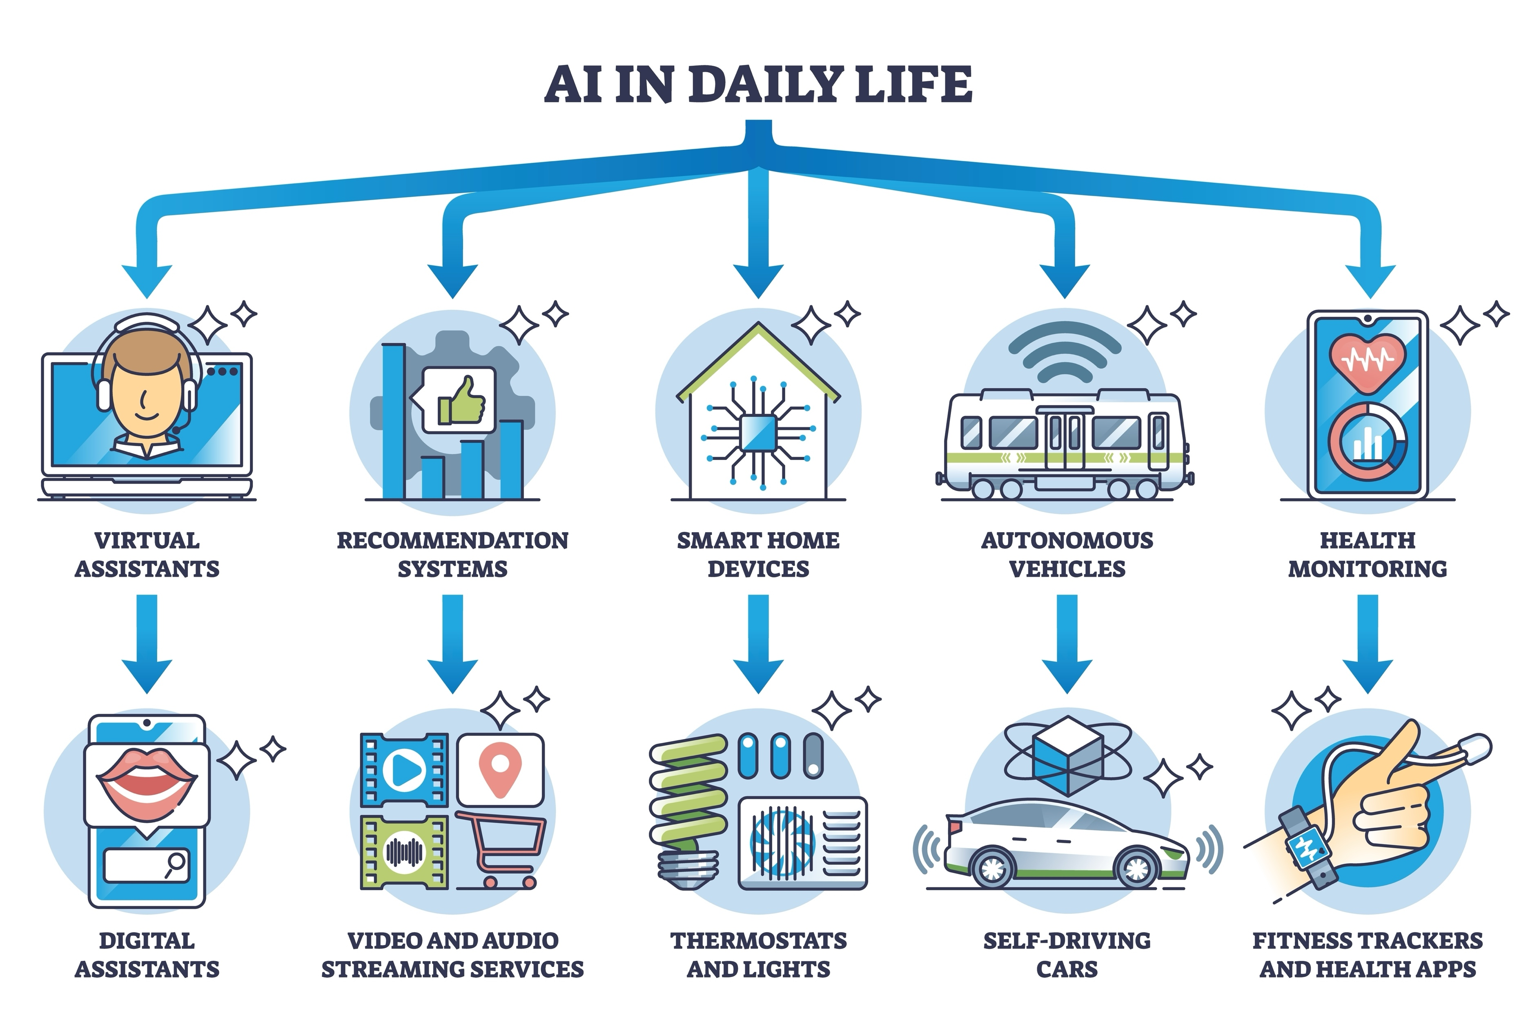
Some Everyday Uses of AI
This work is licensed under a Creative Commons Attribution-NonCommercial-ShareAlike 4.0 International License
Notes:
Say
“Take a look at this image of common uses of AI.”
“What examples do you recognise? Call out 2-3.”
(Take quick responses)
“Now: what do all of these have in common?”
“They all use data to make predictions about you.”
“AI is shaping what you watch, how you travel, even how your home works.”
Final prompt:
“Is that always helpful or could there be downsides?”
(Take 1-2 responses)

Slide 8
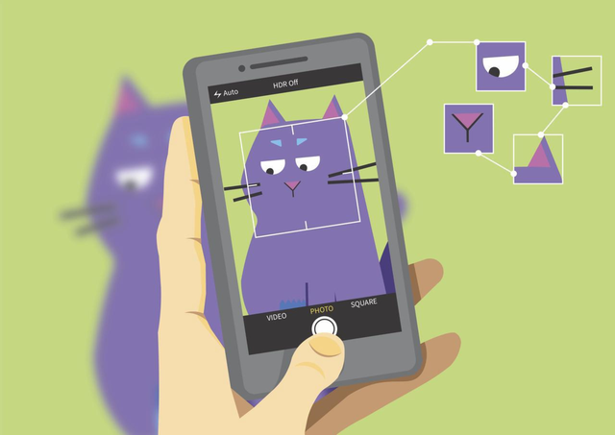
What is AI?
AI systems:
Learn from data
Recognise patterns
Make predictions
They can seem intelligent
but they don’t understand like humans do.
Oleksandra Mukhachova & The Bigger Picture / https://betterimagesofai.org /https://creativecommons.org/licenses/by/4.0/
This work is licensed under a Creative Commons Attribution-NonCommercial-ShareAlike 4.0 International License
Notes:
Say:
“A useful way to think about AI is that AI systems:
learn from data,
recognise patterns,
and make predictions.”
“So, in the image here, for example, AI uses lots of images of cats (data) to recognise patterns in cats (common features like whiskers, pointy ears, fluffy fur) to figure out (or predict) what the image is.
“Important: AI systems can seem intelligent but they don’t understand in the same way humans do.”

Slide 9
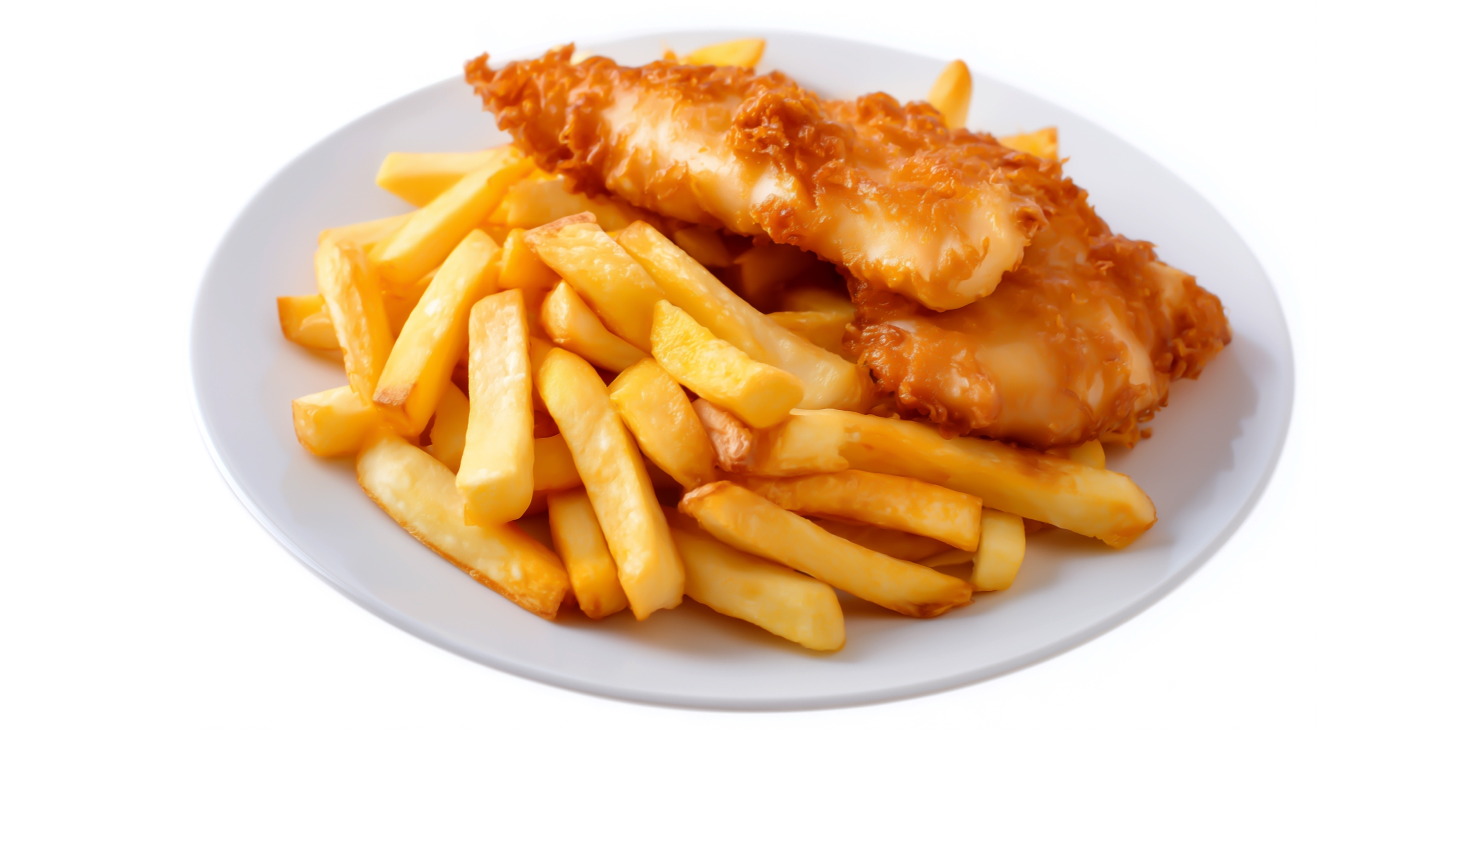
How does AI work?
Input
Data
Pattern
Output
This work is licensed under a Creative Commons Attribution-NonCommercial-ShareAlike 4.0 International License
Notes:
Say:
“Quick test: Finish this sentence:
Fish and chips with salt and…”
(Students: “vinegar”)
“How did you know that?”
(Take 1 answer)
“Exactly. You’ve seen that pattern before.”
“This is how AI works:” (click to reveal the four elements)
Input: ‘Fish and chips with salt and…’
Data: All the examples you’ve seen before
Pattern: ‘This usually ends with vinegar’
Output (prediction or decision): ‘vinegar’
Add:
“AI does this with huge amounts of data.”
“And it keeps learning and improving its patterns as it gets more data over time.”

Slide 10
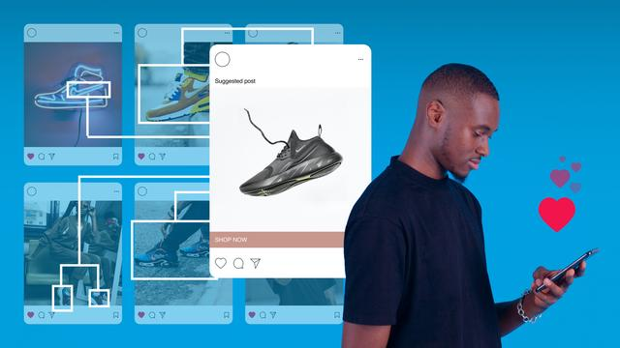
Recommender Systems
e.g., TikTok / Netflix / Amazon
Input: What you watched / bought / liked
Data: Your history + millions of users
Pattern: e.g., “People like you watch this next”
Output: Next video / buying suggestion
Learns as you use it more
Comuzi / https://betterimagesofai.org / © BBC / https://creativecommons.org/licenses/by/4.0/
Filter Bubble
Echo Chamber
This work is licensed under a Creative Commons Attribution-NonCommercial-ShareAlike 4.0 International License
Notes:
Say:
“Now let’s apply that model to real AI systems.”
“First: recommendation systems like TikTok or Netflix.”
“You watch or like something. That’s the input.”
“The AI system compares it to lots of data it has on you and other users of the app or website.”
“It finds patterns, so it knows people like you also watch this.”
“It then predicts the next video and recommends it to you.”
"AI regularly does this also for online shopping - using your browsing and search history to build up a profile for you and recommend products you might like.”
”A recommender system is an example of an algorithm – a step-by-step set of rules or instructions a computer uses to solve a problem or complete a task. With Machine Learning, AI systems can learn as they go, adapting its own rules and making predictions.”
“"When algorithms track what you like, they start showing you only what you like or agree with, creating a filter bubble. Inside that bubble, every opinion echoes your own, making an echo chamber where it feels like everyone in the world sees things the exact same way you do.”
“How might this be a bad thing?”
(Take 2-3 answers)

Slide 11
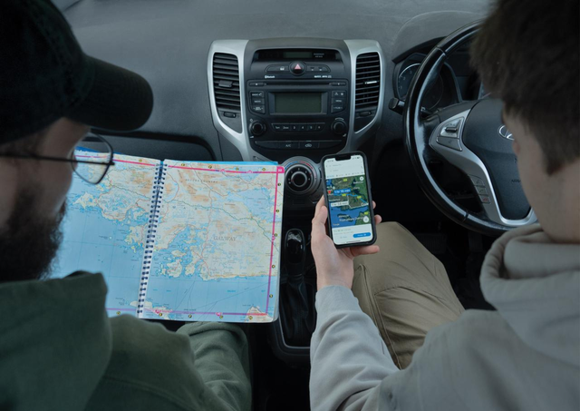
Navigation Systems
🔵 SKIP FOR 40 MIN WORKSHOP
e.g., Google Maps / Waze
Input: Your destination
Data: Traffic + location data
Pattern: “These routes are usually fastest”
Output: ?
Updates in real time
Susan Quin & The Bigger Picture / https://betterimagesofai.org / https://creativecommons.org/licenses/by/4.0/
This work is licensed under a Creative Commons Attribution-NonCommercial-ShareAlike 4.0 International License
Notes:
Say:
“Let’s try one together.”
“You enter your destination into a navigation system like Google Maps. That’s the input.”
“It uses traffic and location data…”
“It finds patterns, like which routes are usually fastest…”
“So what’s the output?”
(Take 1-2 answers: ‘best route’, ‘directions’)
Confirm:
“Exactly. It gives the best route right now.”
"It updates in real time as the traffic conditions change."

Slide 12
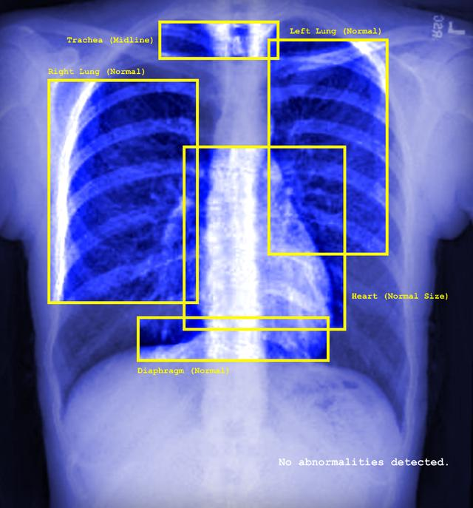
Diagnostic Systems
e.g., Medical AI (scanning for disease)
Input: A patient scan (e.g., X-ray)
Data: Thousands of previous medical scans
Pattern: “This looks similar to known cases”
Output: ?
Improves as it sees more cases
Elise Racine / https://betterimagesofai.org / https://creativecommons.org/licenses/by/4.0/
This work is licensed under a Creative Commons Attribution-NonCommercial-ShareAlike 4.0 International License
Notes:
Say:
“Let’s look at a more serious example: the use of medical AI for diagnosing health problems.”
“A doctor inputs something like an X-ray. That’s the input.”
“It compares it to thousands of previous scans. That’s the data.”
“It looks for patterns, such as what cancer or disease usually looks like.”
“So what’s the output?”
(Take 1 answer: diagnosis / prediction)
Confirm:
“Exactly: a prediction, like whether something might be wrong. The bottom left of the image here says "no abnormalities detected.”
"Again, the system learns the more cases it sees and the more feedback it gets from medical staff."
Finish:
“But remember: unlike a real doctor or radiologist, it’s not understanding the patient…”
“It’s matching patterns from past data.”

Slide 13
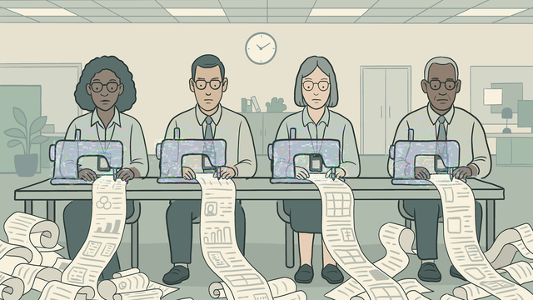
GenAI Systems
e.g., ChatGPT, Gemini
Input: Your question / prompt
Data: Huge amounts of text data
Pattern: ?
Output: Generated response
Improves with training & feedback
Leo Lau & Digit / https://betterimagesofai.org / https://creativecommons.org/licenses/by/4.0/
This work is licensed under a Creative Commons Attribution-NonCommercial-ShareAlike 4.0 International License
Notes:
Say:
“Let’s try a final, harder one.”
“You give a Generative AI tool like ChatGPT or Gemini a question (called a ’prompt’). That’s the input.”
“GenAI is technology that creates new content like text, images or music based on patterns it has learned.”
"A GenAI text generation tool like ChatGPT or Gemini, for example, is trained on huge amounts of text - that’s the data.”
"It's estimated ChatGPT was trained on about 10 trillion words - the equivalent to reading roughly 125 million books.
If a human read 1 book every single day, it would take them over 340,000 years to read what ChatGPT processed during its pre-training phase."
“But what pattern is it using?”
(Take 1-2 answers. Guide if needed)
If stuck, prompt:
“What is it predicting each time it writes?”
Reveal:
“It’s finding patterns in language, like which words usually come next.”
Finish:
“So it’s not thinking…”
“Using its training data, it’s just predicting the most likely next word, again and again, to create new text.”
“But what if the data is limited or inaccurate?”

Slide 14
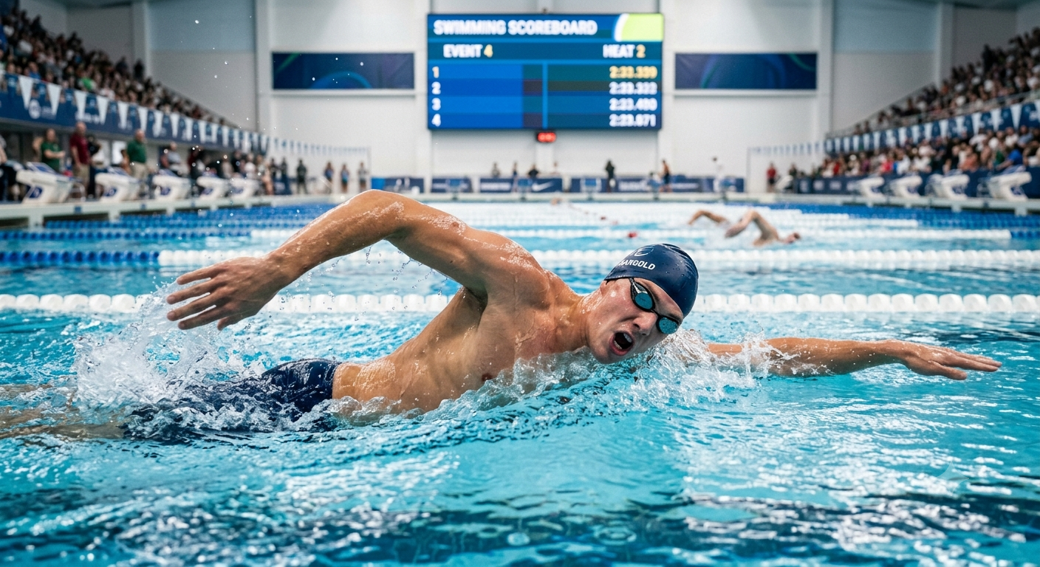
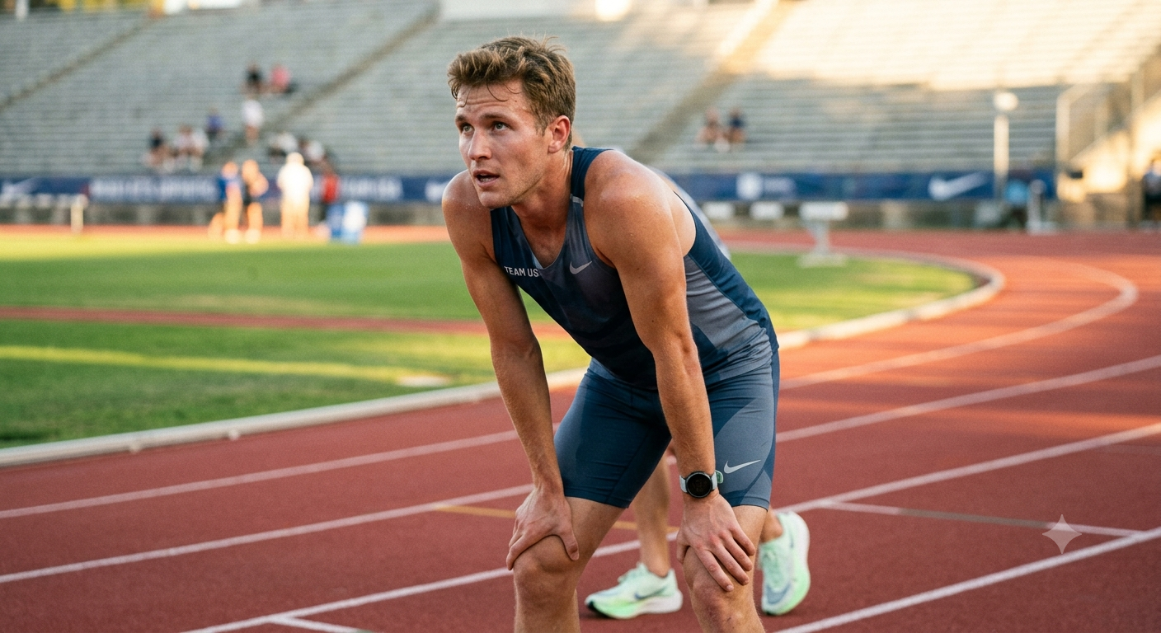
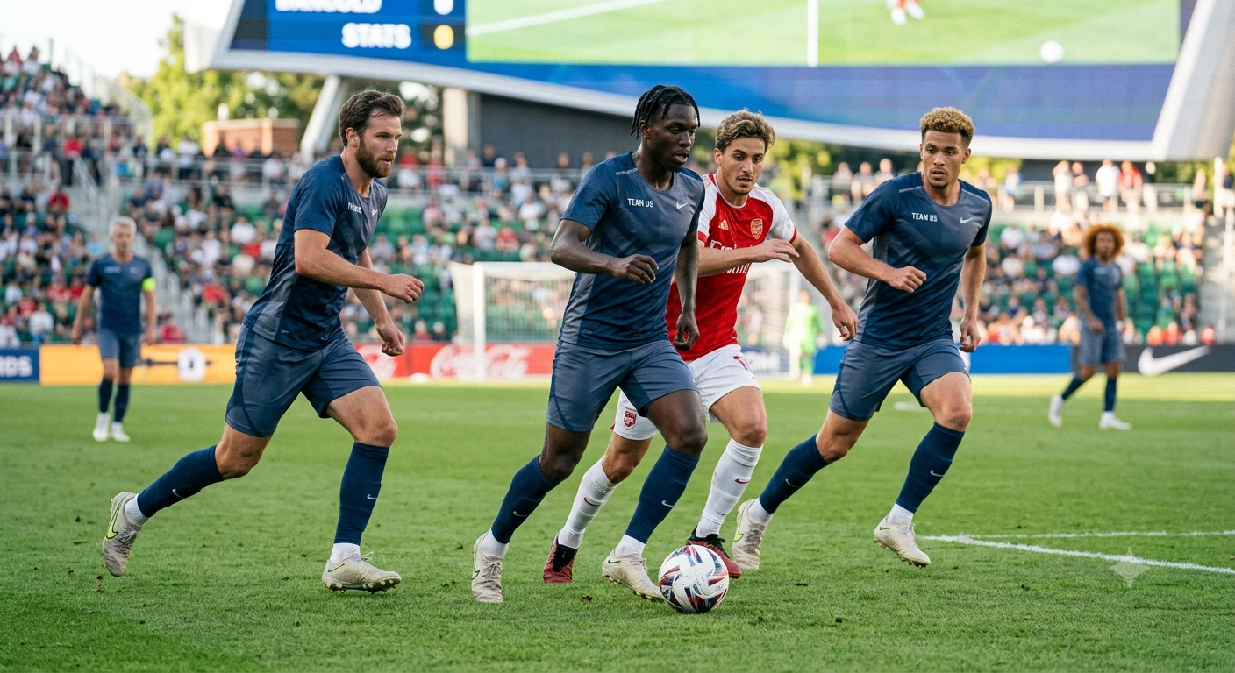
Train the AI
What does an “athlete” look like?
Images created by Gemini
What is your AI’s rule for an “athlete”?
This work is licensed under a Creative Commons Attribution-NonCommercial-ShareAlike 4.0 International License
Notes:
Say:
“To explore this, you’re going to train an image detection AI. Based on what it sees, it will decide what counts as an athlete.”
“Here’s the tiny amount of data your AI is trained on. Look closely.”
(Click to reveal image 1, 2, 3)
“Turn to a partner: what rule would your AI learn from this data?”
(1 min. discussion, then ask class for 3-4 rules)

Slide 15
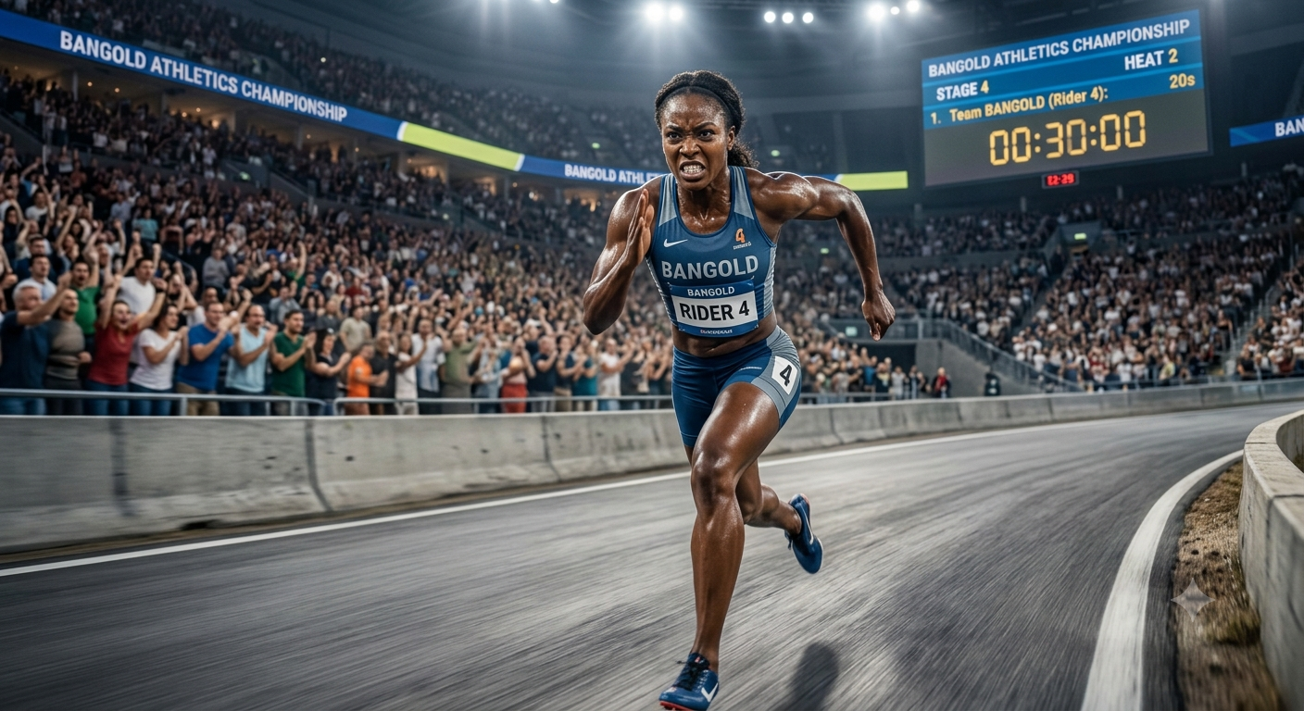
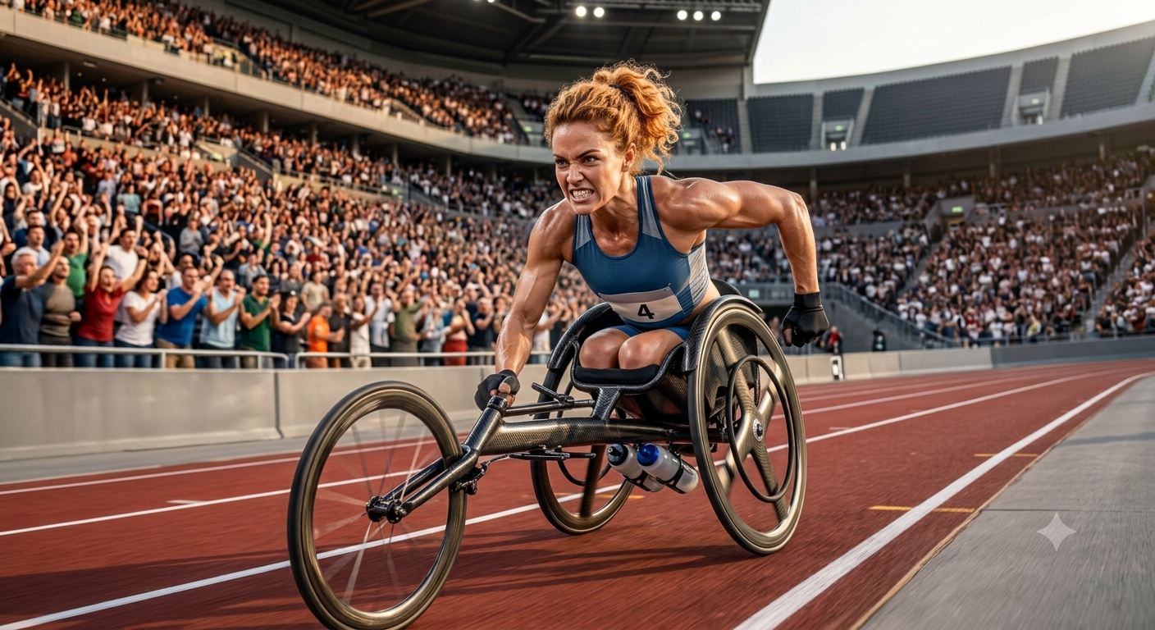
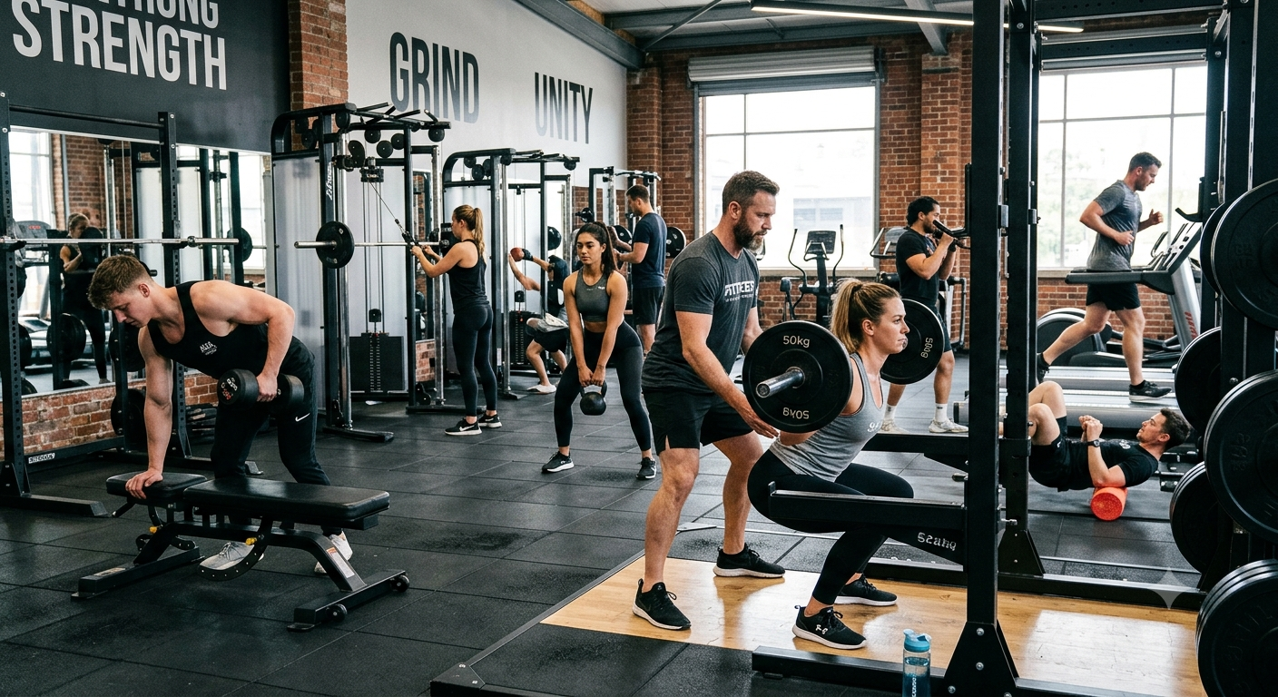
Test the AI
Test: Is this an athlete?
Images created by Gemini
Why might your AI get this wrong?
The data is biased
This work is licensed under a Creative Commons Attribution-NonCommercial-ShareAlike 4.0 International License
Notes:
Say:
“Now let's test your AI.”
“Based on your rules, are these images ”athletes”?
“Would your AI say yes or no?”
(Click 1, 2, 3 to show the images one by one)
(Hands up / quick responses)
(Then, Click 4 to show header Why might your AI get this wrong)
Ask students:
“What just happened to your AI?”
(Students will say:
“It got it wrong”
“It was too narrow”
“It didn’t include everyone”)
Then land it (Click 5):
“That’s exactly what we call bias in AI.”
“The system worked perfectly…”
“But the data was limited”
“So the outcome was biased.”
“If we extend this to the real world, and applications in things like medical AI, hiring and facial recognition, bias in AI has serious implications.”

Slide 16
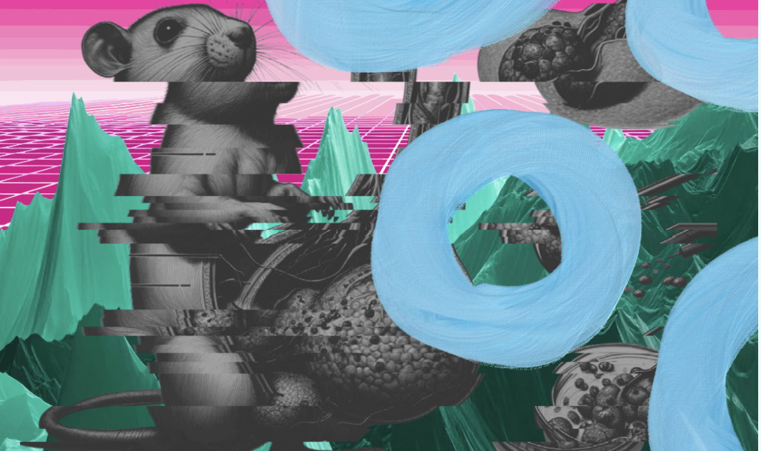
So, can we trust it?
A Hallucination:
A confident answer that isn’t
actually true
Bias = problem with data
Hallucination = problem with prediction
Marcin Wilkowski / https://betterimagesofai.org / https://creativecommons.org/licenses/by/4.0/
This work is licensed under a Creative Commons Attribution-NonCommercial-ShareAlike 4.0 International License
Notes:
Say:
“There’s another issue…”
“AI hates to say it doesn't know something, so sometimes it just makes things up.”
“Sometimes it gives answers that sound confident…”
“…but are actually wrong.”
“That’s called a hallucination.”
“It’s still following patterns;
it’s just predicting something that sounds right, not something that is right.”
“So now we know:
AI can be biased
AI can get things wrong
But it can still look very convincing…”
“So let’s test how good you are at spotting what’s real, and what’s just a very good prediction.”

Slide 17
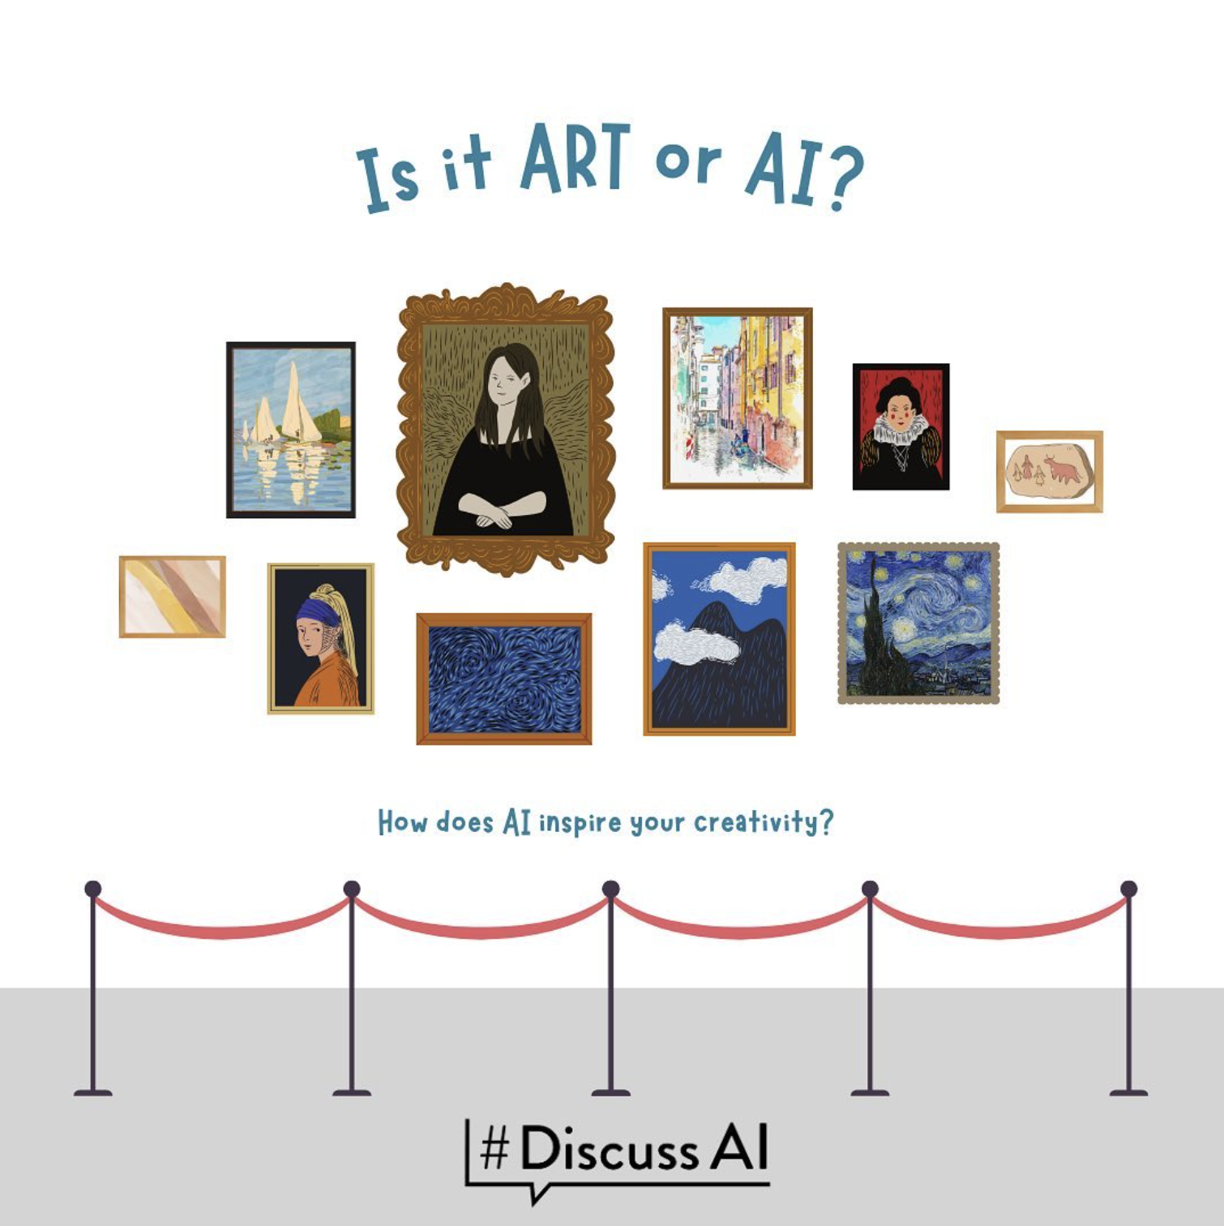
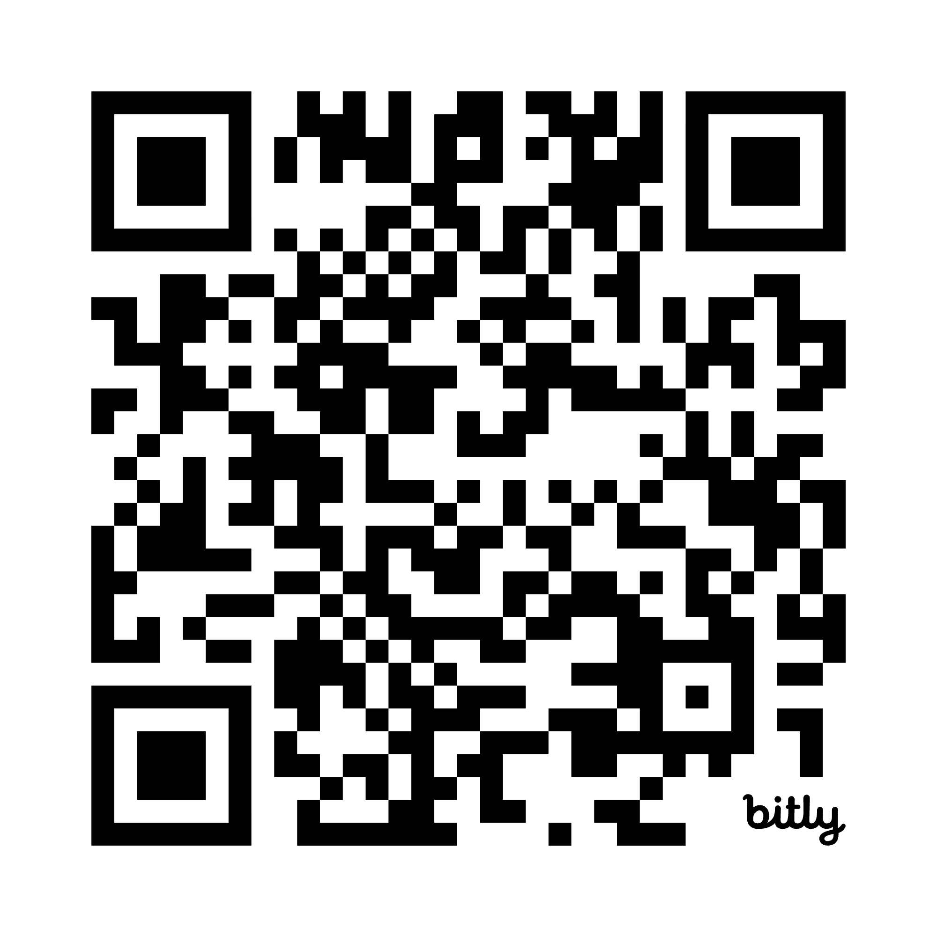
AI or Human? Quiz
Just how good is Generative AI?
Can you tell the difference between real art or AI?
Give it a go:
https://bit.ly/Art-Or-AI
This work is licensed under a Creative Commons Attribution-NonCommercial-ShareAlike 4.0 International License
Notes:
Say:
“We’re going to try a quick challenge called Art or AI?”
“Use your phone or iPad to scan the QR code or go to the link on screen.”
“You’ll see a series of images.”
“For each one, decide: was it made by a human or by AI?”
[Students can work in groups if devices or limited]
“You’ve got 5 minutes.”
“When you’re finished answering all the questions:”
“Click Submit”
“Then click See responses to check your score and learn about each image.”
(After 5 mins, ask students to volunteer their scores).
(Ask how they decided an artwork was human- or AI-generated)
“Were there any tell-tale signs?”
(Give 2-3 mins. for discussion)
“Just so you know: Most people score about 6 out of 10…”
“And even AI experts find this difficult.”
Finish:
“So don’t worry if you didn’t score highly – that’s the point. It can be hard to tell AI outputs from human ones.”

Slide 18
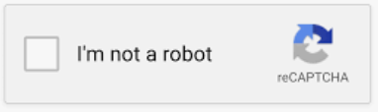
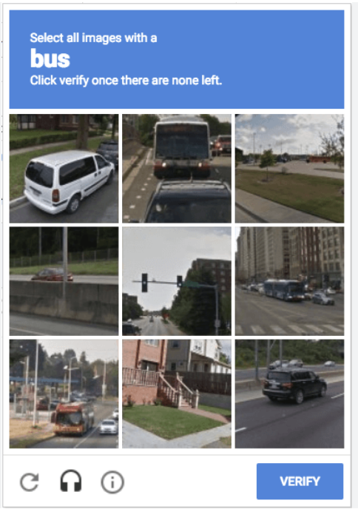
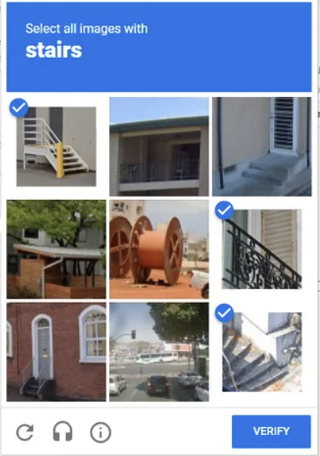
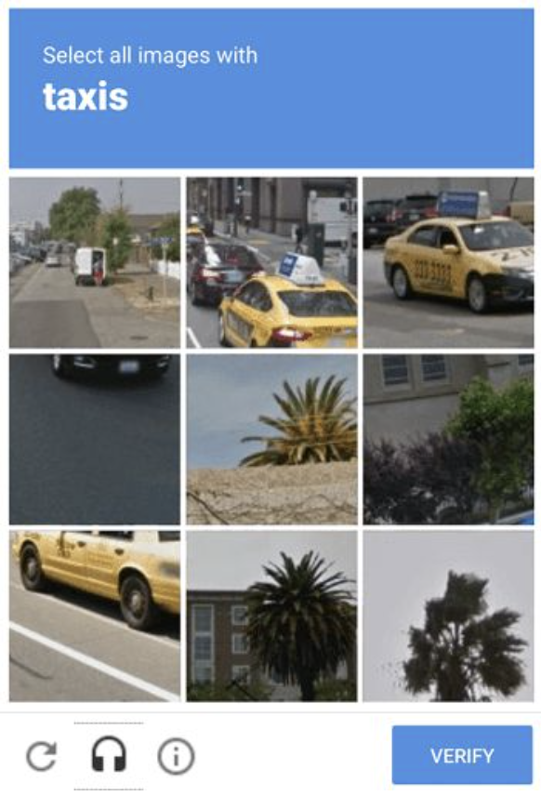
I’m Not a Robot
This work is licensed under a Creative Commons Attribution-NonCommercial-ShareAlike 4.0 International License
Notes:
Say:
“Has anybody seen this before anywhere: ‘I’m not a robot’?”
"Websites and apps use this technology - called CAPTCHA - to ensure that you’re human and not a bot that might try to spam or hack accounts.”
“Did you that when you tick the box, AI is already checking how you behave, like how your mouse moves or how you click?”
“That’s because humans move in slightly messy, uneven ways. We hesitate, move the mouse a bit too far, and adjust.”
“But bots tend to move in straight lines, at perfect speed, almost too precisely.”
(Click 1 to show image reCAPTCHA examples)
“If the system isn’t sure you’re human, it gives you image challenges, like ‘select all the taxis.’”
“Hands up, who’s had to do one of those? Were they always easy?”
(Students will typically say 'no', so ask them to explain why)
“They can be tricky because the images typically aren’t perfect.”
“They might be blurry, taken from weird angles, or only show part of an object.”
“If you see half a taxi, is it still a taxi?”
“Humans are really good at using context like that.”
“But AI mostly relies on patterns it has seen before, so when something is unusual or unclear, it can struggle more than you.”
“Also did you know that every time you use CAPTCHA technology, you’re actually helping train the AI?”
”A final question: why are all the taxis yellow?”
“Do they look like Irish taxis?”
(Explain that the data set most likely is from North America, where taxis are yellow and many of the world's biggest AI tools are developed – again showing us that data sets might not always be diverse or accurate)

Slide 19
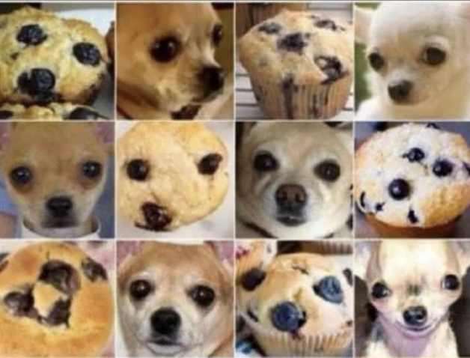

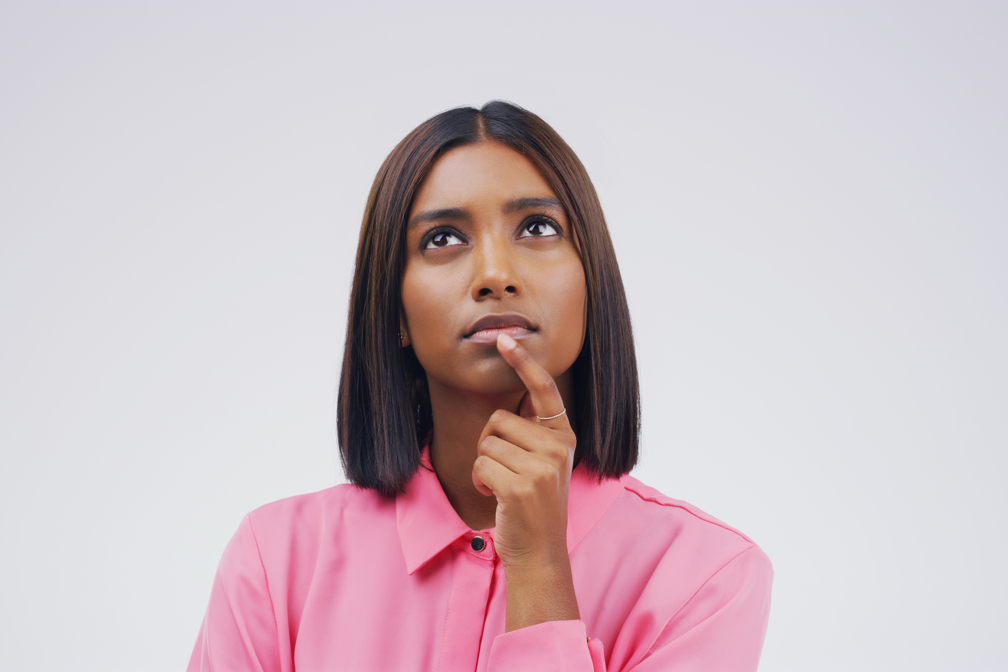

What makes us Human?
We understand context
We feel emotions
AI can process… but humans decide
We make judgements
We take responsibility
This work is licensed under a Creative Commons Attribution-NonCommercial-ShareAlike 4.0 International License
Notes:
Say:
“Throughout this workshop, we’ve seen what AI can do. It can recognise patterns, generate images, and even sound human.”
“But there are still things it doesn’t truly do the way we do.”
“We understand context, like knowing half a taxi is still a taxi.”
“This well-known example of the limits of machine learning shows that some images of dogs look very similar to images of muffins… it’s actually hard to tell.”
“That’s context. Without enough of it, even humans get confused… and AI struggles even more.”
"Humans also feel emotions, which shape our decisions.”
“We make judgements, especially in messy or unclear situations.”
“And most importantly, we take responsibility for the outcomes. AI really doesn't care.”
“So, while AI can support us, it shouldn’t replace us.”
“AI can process…but humans decide.”

Slide 20

Human-in-the-Loop
This work is licensed under a Creative Commons Attribution-NonCommercial-ShareAlike 4.0 International License
Notes:
Say:
“Let’s make this real.”
“If an AI system looks at an X-ray and spots something unusual, who should make the final decision?”
(Pause for answers, guide toward ‘doctor’)
“Exactly. The doctor can use their experience, judgement, and responsibility to check the AI.”
“This idea is called ‘human-in-the-loop.’”
“It means AI doesn’t work alone; instead, humans stay involved to check, question, and ultimately decide.”
“This is key to safe, responsible and ethical use of AI.”

Slide 21

AI in Your Life
What would you do?
AI gives you an answer.
Would you:
1. Trust it
2. Question it
3. Check it
4. Ask a human
Notes:
Say:
“Let's finish with a quick challenge. I'm going to give you three situations. For each one, think about what you would do if AI gave you the answer.”
“Don't shout out your answer. I'll ask about each option separately.”
Scenario 1
“TikTok recommends a video you might like.”
(Hands up – run through the four options)
“Why do you think most of us are happy to let AI make this kind of decision?”
Scenario 2
“ChatGPT gives you an answer for your homework”.
Repeat the four options.
Then: “Has anyone changed their answer from the last question? Why?”
(This gives you a very quick opportunity to reinforce hallucination and fact-checking).
Scenario 3
“An AI system is deciding who gets a job interview”.
Repeat the four options.
Then: “Would you be happy if an AI decided whether YOU got an interview?”
(Hopefully students identify higher stakes, responsibility and the need for human judgement).
Final line
“The more important the decision, the more important it is that a human stays in the loop.”

Slide 22
How’s your AI Literacy now?
Additional AI in My Life modules:
AI and Ethics
AI and the Future of Work
AI Careers
www.adaptcentre.ie/public-engagement/ai-in-my-life-lessons/
Notes:
Say:
“That's it for our introduction to AI!"
“AI literacy is the set of skills, knowledge, and critical thinking needed to understand, use, and evaluate artificial intelligence tools effectively and ethically.”
“It involves knowing how AI systems work, recognising where they are used, evaluating their output for accuracy or bias, and understanding their social and ethical impacts.”
”Nobody has perfect AI literacy, but today you have enhanced yours. Well done!”
(Tell students that they’ll learn more in subsequent modules, if you plan to do them – see the web link for resources)

