Slide 1

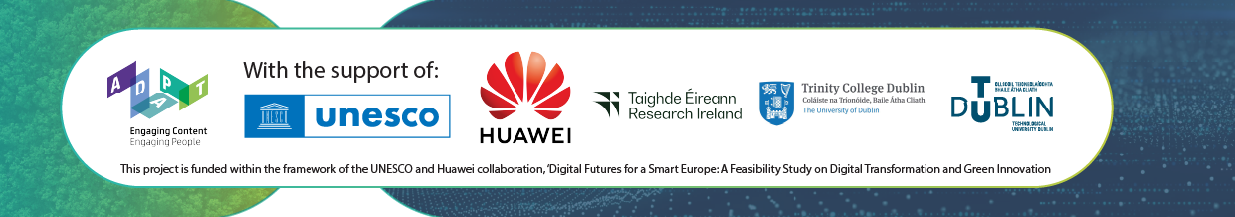
Transition Year Module
September 2026

Slide 2
LESSON 3
Sustainable Systems: Energy, Nature, Food and Cities
How the systems we depend on every day connect to climate action and where AI is already changing them.
UNESCO Greening Curriculum concepts: Ecosystems and Biodiversity · Sustainable Lifestyles · Post-Carbon Economies

Slide 3

What you’ll learn today
GreenFutures — Lesson 3 of 4
1
Describe how energy, nature, food and cities each contribute to climate change
2
Compare renewable and non-renewable energy systems
3
Explain why biodiversity and healthy ecosystems matter as their own crisis, connected to but distinct from climate change
Identify sustainable approaches to food, transport and everyday consumption
4
See how AI supports smarter, more sustainable infrastructure
5

Slide 4

Renewable Energy
SYSTEM ONE
⚡
Fossil fuels (coal, oil, gas) release stored carbon when burned; renewables - wind, solar, hydro and tidal do not
The challenge is not just generating clean energy. It is about storing it and getting it onto the grid reliably
AI-supported smart grids help balance supply and demand in real time and optimise where energy goes
Energy storage (like batteries) is a major area of ongoing innovation
Read more on Smart Meter Deployment
FREMI project (Forecasting Renewable Energy with Machine Intelligence)
Watch an example of AI-driven energy optimisation

Slide 5
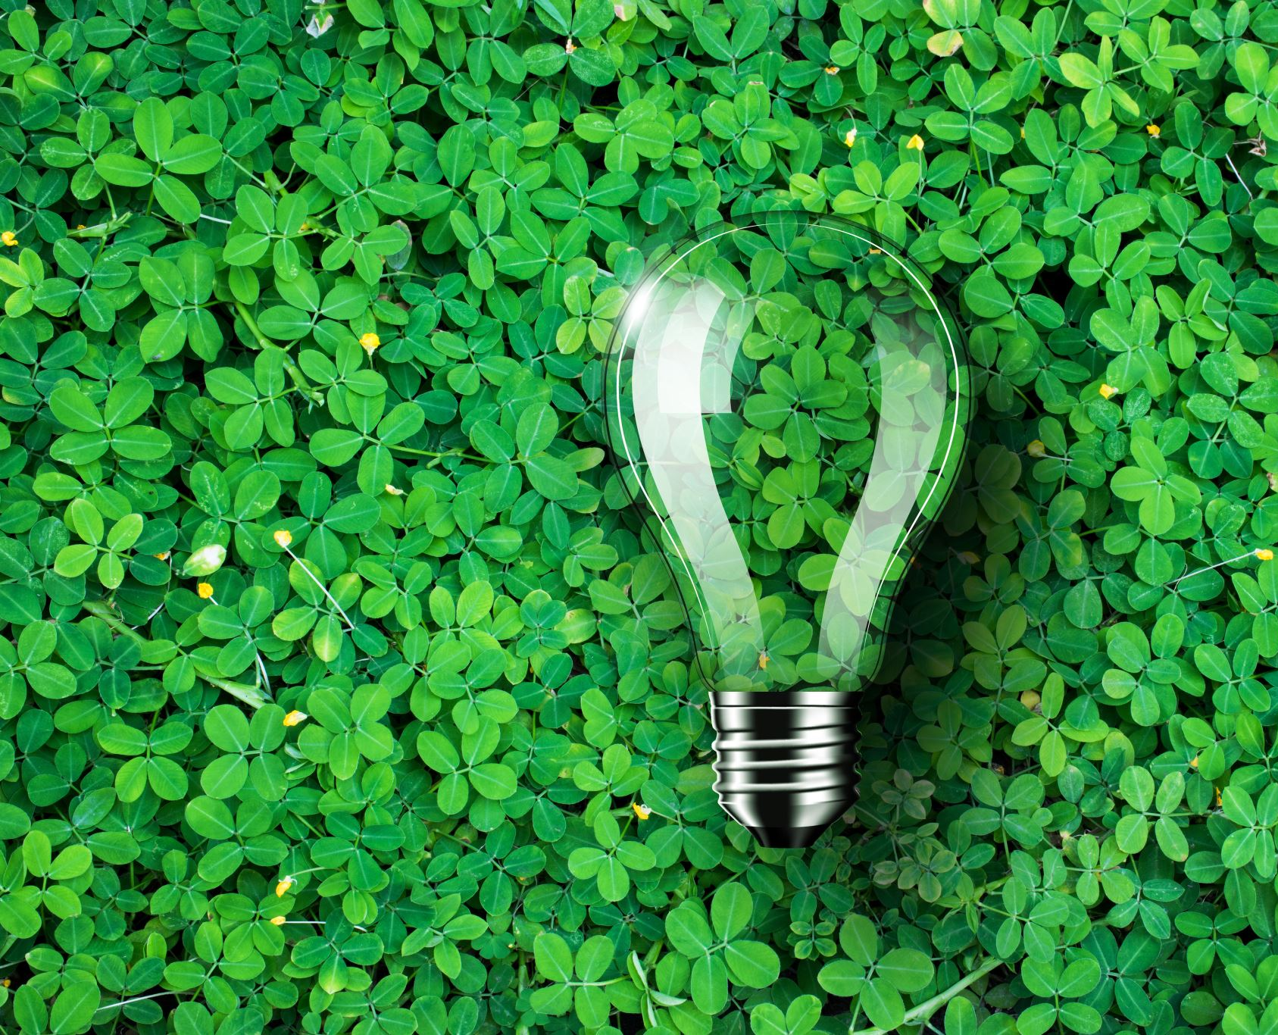
🇮🇪 Irish Example
Wind energy is central to Ireland's electricity mix and its expansion is the subject of a genuine, ongoing national debate about where turbines should go and how quickly to build
Bord na Móna, once one of Ireland's largest peat-cutting companies, has shifted most of its business from peat extraction to renewable wind energy
This is a useful real-world example of what a ‘just transition’ looks like in practice, an economy changing direction, and the people within it adapting
Ireland’s Energy Transition

Slide 6
Biodiversity and Nature
SYSTEM TWO
🌳
Biodiversity loss is a distinct but overlapping crisis to climate change. Driven also by land-use change, invasive species and pollution, not climate alone
Nature-based solutions such as protecting and restoring forests, wetlands and peatlands can absorb carbon while also protecting wildlife
AI supports this work too: satellite imaging and monitoring tools now track deforestation, habitat change and wildlife populations at a scale no human team could manage alone
Watch video here on Using Technology to Protect Global Bee Population (Cork)
Measuring and monitoring biodiversity on and around onshore wind farms: What Nature+Energy project is and how does it work?

Slide 7
🇮🇪 Irish Example
Ireland's peatlands and bogs are internationally significant carbon stores, and distinctive to our landscape
Bord na Móna's peatland restoration programme is actively rewetting and restoring cutaway bogs, turning former industrial sites back into functioning carbon sinks and habitats
This connects the energy story and the biodiversity story: the same organisation, changing direction on two fronts at once
Watch video here on AI2Peat (UCD Research)
Ireland’s Peatlands: A Distinctive Landscape

Slide 8
Agriculture and Food Systems
SYSTEM THREE
⚖️
Food systems are a major source of greenhouse gas emissions worldwide, particularly from livestock and land use
AI is already used in precision agriculture, predicting crop yields, targeting fertiliser use, and reducing food waste
Watch video on Monitoring of Crop Pests HALY.ID (Teagasc)
An example of how a school project came about by students in TU Dublin. Project Micron Agritech uses AI for rapid worm testing to fight antimicrobial resistance in animals
See the project at the Ploughing Championship too
Sustainable farming approaches aim to reduce environmental impact while keeping food systems productive and viable

Slide 9
Farming Fairly: Ireland’s Beef and Dairy Sector
🇮🇪 Irish Example — Handle with Care
Beef and dairy farming is central to rural Ireland's identity and economy and also a major source of national methane emissions
Teagasc (Ireland's agriculture and food development authority) has set sustainability targets that create real tension for many farming communities
This is genuinely complex, not a simple ‘right or wrong’: farmers face pressure from both climate policy and economic survival
Frame this as a question, not a verdict: ‘how do we transition fairly?’ - see the Teagasc AI in agriculture case study for a more hopeful angle on the same sector

Slide 10
AI helps measure and predict where reductions are possible; breeding, feed and management deliver the reduction.
How AI fits into the dairy methane problem
62.5%
1,500+ animals
of Irish agricultural emissions
are enteric methane
19 breeds • 11% of methane differences linked to genetics
1
2
3
Measure
→
Predict
→
Reduce
GreenFeed measures methane (CH₄) and other gases from cattle breath.
Machine-learning models can link milk spectra and animal data to methane output.
Use predictions to support lower-methane breeding, feeding and targeted interventions.
Teagasc Irish winter-milk trial: methane per cow per day
500
447 g/day
400
26%
Key teaching point
g CH₄ / cow / day
330 g/day
The AI output is a prediction. The physical reduction comes from an action such as genetics, diet or a methane inhibitor.
300
reduction
with 3-NOP feed additive
200
100
447 → 330 g CH₄/day
Irish AI example
VistaMilk lists research on predicting methane emissions of individual grazing dairy cows from spectral analysis of milk samples.
0
Control
3-NOP
AI helps identify which cows, diets or interventions are most promising; the intervention itself causes the methane reduction.
Sources: Teagasc GreenFeed and 3-NOP research; ICBF methane evaluations; VistaMilk publications. Figures simplified for teaching.

Slide 11
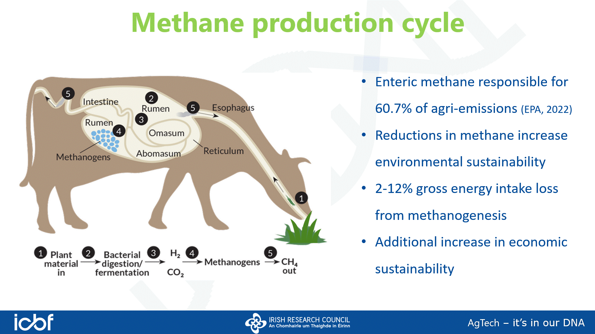

Slide 12
Sustainable Cities and Consumption
SYSTEM FOUR
🏙️
Transport and urban infrastructure are major sources of emissions and major opportunities for change
The circular economy: reduce, reuse, redesign, rethink how we make and use things instead of throwing them away
Our everyday buying choices (clothes, phones, packaging - think fast fashion!) connect directly to circular economy thinking
AI supports smart cities: optimising traffic flow, public transport routing and energy use across a whole city
Examples range from CitySwift, partnering with Bus Éireann, LIFE EMERALD measuring air-pollution to Artificial Intelligence as an Enabler of the Circular Economy

Slide 13
🇮🇪 Irish Example
Dublin has seen a major shift toward cycling infrastructure, Luas expansion and improved bus connections in recent years
Dublin has also piloted AI-powered smart-city traffic systems, working with technology partners to optimise traffic flow in real time.
Together these show a city actively experimenting with both infrastructure and technology to become more sustainable
Watch a video on Dublin’s Travel and Road Safety. AI Smart City
Irish Cities in Transition

Slide 14
Weigh the Trade-Off
ACTIVITY
⏱ ~10 minutes
In small groups, take one system from today's lesson: energy, farming, or transport
List one clear benefit and one clear trade-off/cost of the sustainable option (involving AI) in that system (e.g. wind energy: clean power vs. visual/land-use impact)
Decide as a group: on balance, is it worth it? Be ready to defend your reasoning
Quick self-check: did your group consider more than one perspective (e.g. environmental, economic, and community)?

Slide 15
Improve a System Close to You
APPLY IT
⏱ ~8 minutes
Pick one system - energy, food, transport or waste - in your own school or town. Identify one realistic improvement that could make it more sustainable, and one thing that would need to happen to make it work.
How they show their work: Students sketch or write their proposal in their climate journal - a short paragraph or annotated diagram.

Slide 16
What have we learned?
✓
We've connected energy, nature, food and cities to climate action
✓
We've seen real Irish examples of sustainable transition and the trade-offs involved
✓
We understand where AI already supports smarter, more sustainable systems
✓
We've proposed one realistic improvement to a system close to home
Next lesson: we turn to climate justice, the future, and how we can all be part of the response.

Slide 17
See you in Lesson 4: Climate Justice, Futures Thinking and Green Innovation
GreenFutures
Developed by the ADAPT Research Centre in partnership with Huawei and UNESCO.

