Slide 1
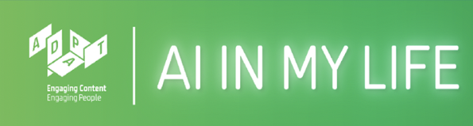
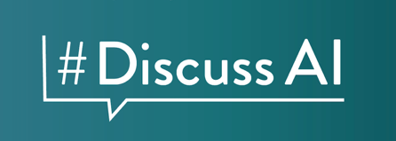
Taster Workshop
An AI in My Life Workshop
V2.1 August 2026
Notes:
Script:
“Welcome to this taster workshop for AI in My Life. This will give you a flavour of the main themes covered across the workshop series.”
"The truth is, everyone – from world-leading tech experts to educators and business leaders – is playing catch-up with the speed of AI development and use. Today’s workshop is about figuring out how we navigate it responsibly together."

Slide 2

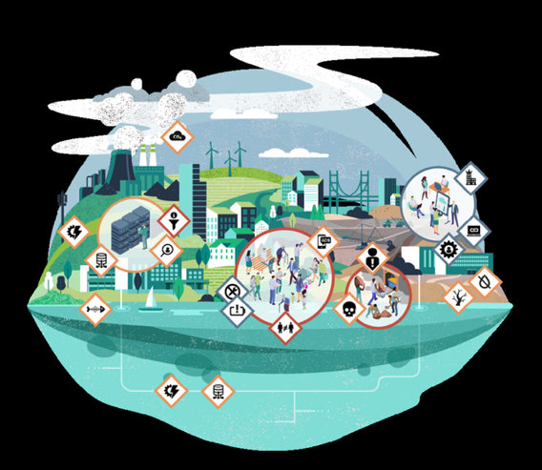
What is AI in My Life?
A 4-part workshop series on
Artificial Intelligence
Developed by the ADAPT research centre at DCU and partners
Designed to help you explore the role of AI in your life and in society
Lone Thomasky & Bits&Bäume / https://betterimagesofai.org / https://creativecommons.org/licenses/by/4.0/
Notes:
Script:
“This workshop is part of ‘AI in My Life’, a four-part series on Artificial Intelligence.”
“It’s been developed by the Education & Public Engagement team at the Research Ireland ADAPT Centre in DCU with partners.”
“And it’s designed to help you understand AI so you can evaluate its role and make informed decisions about how it affects your life and society.”

Slide 3

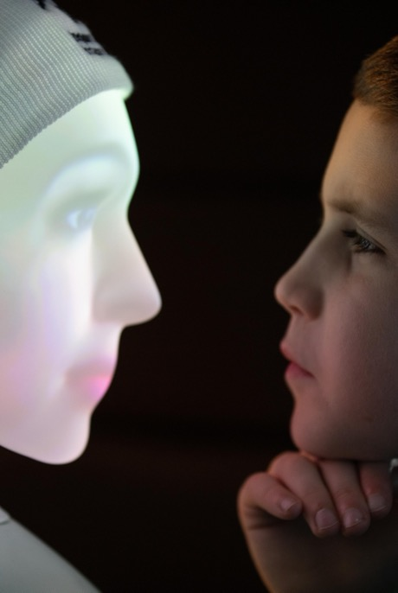

Learning Intentions
By the end of this lesson, you should be able to:
Explain in simple terms what AI is
Identify where AI shows up in your daily life
List some of the ethical and privacy concerns related to AI
You’ll think critically about its use
This work is licensed under a Creative Commons Attribution-NonCommercial-ShareAlike 4.0 International License
Notes:
Script:
“By the end of this lesson, you should be able to:
explain what AI is,
identify where AI shows up in your daily life,
And list some of the ethical and privacy concerns related to AI”
“Importantly, we’ll start thinking critically about it (considering the positive and negative aspects of AI), not just using it blindly.”

Slide 4

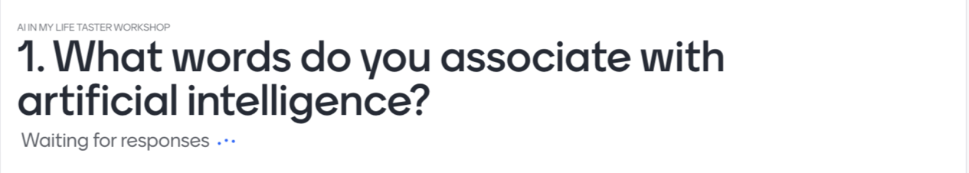
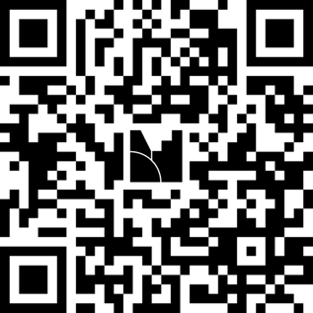
Help us evaluate this workshop
This work is licensed under a Creative Commons Attribution-NonCommercial-ShareAlike 4.0 International License
Notes:
Activity:
“We want to make sure this workshop achieves its learning goals for you today. To help us measure that, please take out your devices, scan the QR code here on screen, and take three minutes to complete a quick initial quiz on Mentimeter. Work through the questions one by one, and then we'll jump right into the material.”
“Note that no personal information will be collected from you.”

Slide 5
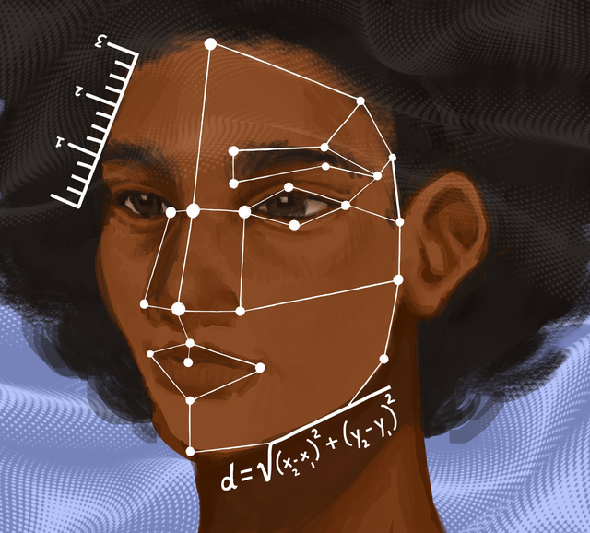
What is AI?
Artificial Intelligence (AI) refers to technologies designed to carry out tasks that normally require human intelligence.
Things like recognising images, understanding language, or solving problems.
Alyssa Chen / https://betterimagesofai.org / https://creativecommons.org/licenses/by/4.0/
This work is licensed under a Creative Commons Attribution-NonCommercial-ShareAlike 4.0 International License
Notes:
Script:
“How might we define AI?”
“AI refers to technologies designed to carry out tasks that normally require human intelligence.”
“Things like recognising images, understanding language, or solving problems.”

Slide 6
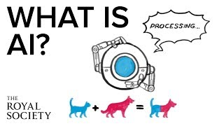
What is AI?
The Royal Society: https://www.youtube.com/watch?v=nASDYRkbQIY&feature=emb_imp_woyt
This work is licensed under a Creative Commons Attribution-NonCommercial-ShareAlike 4.0 International License
Notes:
Activity:
“This short video gives us a simple explanation of AI and highlights some of its uses and limitations.”
“As you watch, think: Where do I encounter AI in my life?”
(Click to launch video on YouTube - it'll typically appear in a new web browser)

Slide 7
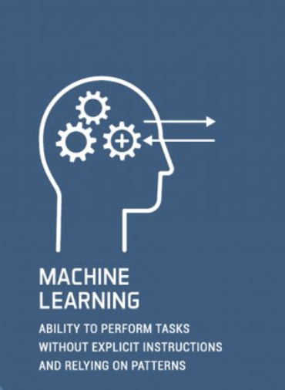
Machine Learning
In the 1950s AI pioneer Arthur Samuel defined Machine Learning as:
“the field of study that gives computers the ability to learn without explicitly being programmed.”
This work is licensed under a Creative Commons Attribution-NonCommercial-ShareAlike 4.0 International License
Notes:
Script:
"A huge part of modern AI relies on Machine Learning.”
“Traditional computer programming requires a developer to write explicit step-by-step rules for every scenario. Machine Learning is different: instead of giving the computer exact rules, we feed it massive datasets and allow the algorithm to learn the rules and patterns on its own.”
”Does anyone know what an 'algorithm' actually is?”
[Pause for student responses]
“Simply put, an algorithm is a step-by-step set of instructions (like a recipe) that a computer follows to solve a problem – like sorting a playlist or calculating the fastest route home.
In traditional programming, humans write every single step of that recipe. But with Machine Learning, it works differently: instead of writing explicit instructions for every single scenario, we feed the algorithm massive datasets and allow the computer to discover the patterns and learn the rules on its own."

Slide 8
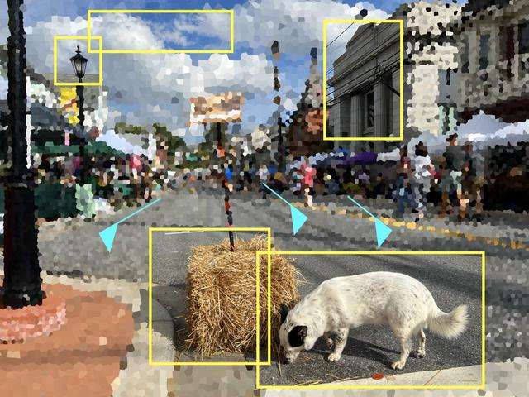
Machine Learning
Where might we use machine learning in our daily lives?
Elise Racine / https://betterimagesofai.org / https://creativecommons.org/licenses/by/4.0/
This work is licensed under a Creative Commons Attribution-NonCommercial-ShareAlike 4.0 International License
Notes:
Activity:
"Where do you think machine learning is working in your life right now? Shout out a few places. Think about your phones, the apps you open every day, or how you listen to music."
(Take 4-5 responses from students)
"Which apps seem to know what you like before you search?"
(Clues: TikTok's FYP, Spotify's recommendations, or predictive text).

Slide 9
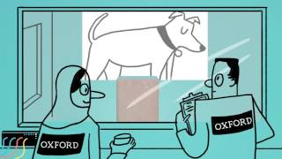
Machine Learning
https://www.youtube.com/watch?v=f_uwKZIAeM0
This work is licensed under a Creative Commons Attribution-NonCommercial-ShareAlike 4.0 International License
Notes:
Activity:
“So, we know that machine learning features in much of the technology we interact with every day.
But how does it work? In this video animation, we’ll take a look at how statistics and computer science can be used to make machines that learn.”
“As you watch it, pay attention to what machine learning needs to improve.”
(Click to play the video. It will launch in YouTube on a web browser)

Slide 10
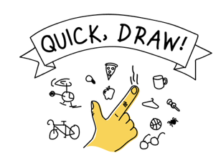
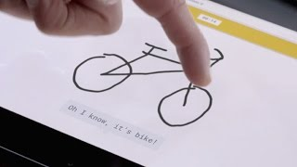
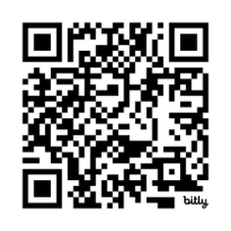
Machine Learning Examples
Short Video Instructions:
On your phones/tablets go to:
https://quickdraw.withgoogle.com/
https://www.youtube.com/watch?v=X8v1GWzZYJ4&t=71s
This work is licensed under a Creative Commons Attribution-NonCommercial-ShareAlike 4.0 International License
Notes:
(If you have time, we recommend you click to play the 1.5-min. explainer video before students try the game. If you’re short on time, we recommend starting straight into the game)
Activity:
"Let's put this into action and test a machine learning model yourselves. Open up the link to Google's 'Quick, Draw!' game on your devices. You'll have 20 seconds to doodle an object, and we'll see if the model can recognise your drawing in real time based on how thousands of other people draw the exact same thing.”
(Tell students to work through drawing the 6 objects and top when they get their score, then ask them how they got on)
“Now click on one of your drawings that the model recognised to see how it recognised the object and what other objects it thought your drawing might be. When you’ve done that, scroll down to see examples drawn by other people from which the model learned to recognise the object.”
(Give students 2 mins. to look through the drawings)
“Quick, Draw! was developed by Google and is the world’s largest doodling dataset. It is shared publicly to help with machine learning research. It shows the importance of data to machine learning systems.”

Slide 11


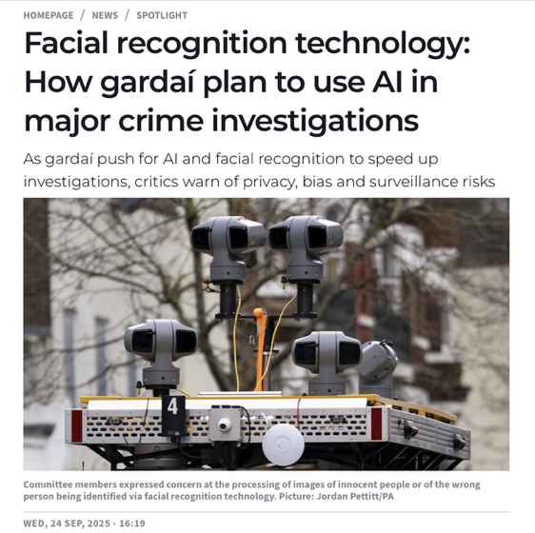

Facial Recognition
This work is licensed under a Creative Commons Attribution-NonCommercial-ShareAlike 4.0 International License
Notes:
Script:
"Now that you've seen how AI recognises shapes, let's look at how it analyses human faces. Facial recognition systems map geometric landmarks, like the distance between your eyes or the shape of your jawline, to verify identities.”
"Where do you interact with facial recognition technology in your everyday life?”
(Take 3-5 answers. If students are stuck, give everyday examples such as unlocking your iPhone with FaceID, tagging photos on social media, or going through digital passport control at an airport)
“Following events like the 2023 Dublin riots, the Gardaí faced calls to use Facial Recognition Technology to identify offenders.”
“What do you think are the benefits of using this technology in policing”
(Take 1-2 answers, highlighting that it helps law enforcement catch criminals faster and protect public spaces).
“What do you think could be the drawbacks of using facial recognition technology in this way?”
(Take 2-3 answers, highlighting that critics argue mass facial scanning creates constant surveillance and risks misidentifying innocent citizens)
“Ultimately, this debate highlights that we need to consider as a society what we feel is an appropriate use of AI.”

Slide 12
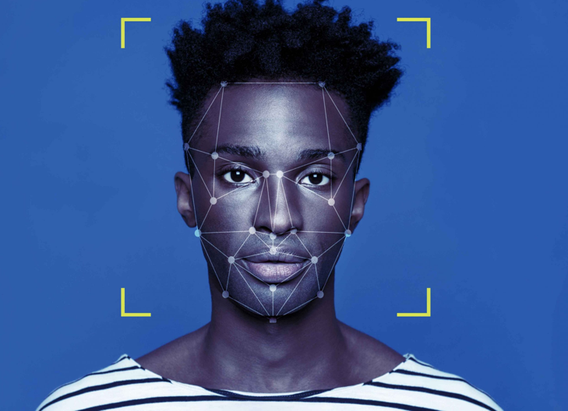
Emotion Detection
This work is licensed under a Creative Commons Attribution-NonCommercial-ShareAlike 4.0 International License
Notes:
Script:
“If AI maps your face, can it read your feelings? Emotion detection maps micro-expressions to guess if you're happy or sad, but can a computer truly get human emotions?"

Slide 13

Emotion Detection
Use the below link on your phone or laptop. Follow the instructions on the webpage.
Financial Times Emotion Detection
https://ig.ft.com/emotion-recognition/
This work is licensed under a Creative Commons Attribution-NonCommercial-ShareAlike 4.0 International License
Notes:
Activity:
"Open the Financial Times link, turn on your camera, and make different faces.
“Note that your facial expressions aren’t recorded or used to enhance or train the model in this activity because the Financial Times is not storing any facial expression data.”
“Go through the questions and note: does it accurately read your mood, or is it just guessing based on facial movements?”
(Give students 2 mins. to go through the game)
“How good was the tool at detecting your emotion? Why do think that is?”
(Students will typically say it was poor)
“AI operates through high-speed pattern matching without actually understanding what anything means. Humans process information using empathy, shared lived experiences, and gut feelings. This distinguishes humans from AI.”
“AI can spot obvious smiles or scowls, but it fails to recognise mixed or subtle emotions like sarcasm, irony, anxious laughter, or pride.”
Think-Pair-Share Activity:
Ask students why they think machines are better at recognising some faces (and emotions) than others.
“Essentially, this is down to the training data lacking diversity. Because models are trained mostly on white adult men, they struggle to accurately identify women, children, older adults, and ethnic minorities.”
“Also, facial expressions, tone of voice, and body language vary widely across cultures. AI trained on Western data often misinterprets expressions in other societies.”
“Removing this bias must be a major ethical priority for developers.”

Slide 14
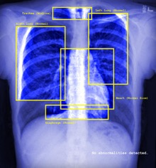



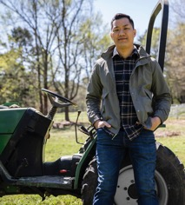
AI for Good
Healthcare & Medicine*
Climate & Environment
Accessibility
* Elise Racine / https://betterimagesofai.org / https://creativecommons.org/licenses/by/4.0/
Personalised Learning
Agriculture & Food Safety
This work is licensed under a Creative Commons Attribution-NonCommercial-ShareAlike 4.0 International License
Notes:
Script:
“AI holds massive potential to improve our world. Here are some key ways AI is benefiting society today:”
”Healthcare & Medicine: AI analyses medical scans to catch diseases like cancer earlier and speeds up the discovery of life-saving drugs.”
“Climate & Environment: Smart algorithms track deforestation, predict natural disasters, and optimise renewable energy grids to reduce carbon emissions. (but AI can also have major negative environmental impacts as it consumes huge amounts of energy!)
“Accessibility: AI powers real-time speech-to-text, live translation, and voice tools that help people with disabilities navigate everyday life independently.”
“Education & Personal Learning: AI can act as a personal tutor, breaking down complex topics and adapting to individual learning styles and paces.
“Agriculture & Food Safety: Farmers can use AI to monitor crop health, reduce water waste, and target pests without spraying unnecessary chemicals.”
"AI is a powerful tool, but like any technology, it isn't inherently good or bad. It entirely depends on who builds it and how it's used. While there are huge potential benefits, there are also serious risks to navigate.”

Slide 15

Is AI always used for good?
Misinformation: Sharing by mistake
Disinformation: Deliberate deception
This work is licensed under a Creative Commons Attribution-NonCommercial-ShareAlike 4.0 International License
Notes:
Script:
"But is AI always used for good?"
"You’ve probably seen this famous viral image of Pope Francis wearing a massive designer puffer coat (often called the 'Balenciaga Pope.’).
“Millions of people believed it was real when it went viral, but it was actually generated entirely by AI using Midjourney.”
“This image is an example of how AI can be used to spread misinformation and disinformation. Anyone know the difference between the two?”
(Take 1-2 answers) (Click 1 and 2 to reveal)
“Misinformation (Sharing by mistake): When people shared this photo thinking it was real, they spread misinformation – false information shared without harmful intent.”
“Disinformation (Deliberate deception): If someone creates or posts a fake image like this specifically to trick, mislead, or manipulate people, it becomes disinformation.”
“Why does it matter? While a fashionable Pope seems harmless, the exact same AI tools are used to create fake news, make up political events, and trick people into believing things that never happened.”

Slide 16
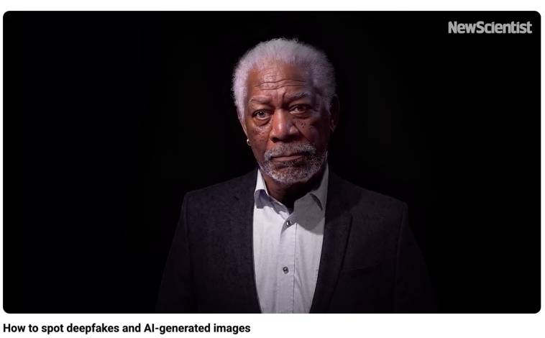
Deepfakes
https://www.youtube.com/watch?v=7akzhpx0EIU
This work is licensed under a Creative Commons Attribution-NonCommercial-ShareAlike 4.0 International License
Notes:
Script:
“Deepfakes use artificial intelligence to manipulate or generate realistic video and audio of real people saying or doing things they never actually did. Let's watch this brief video from New Scientist to see how deepfakes are created and learn how to spot them.”
(Click to launch video in YouTube)

Slide 17
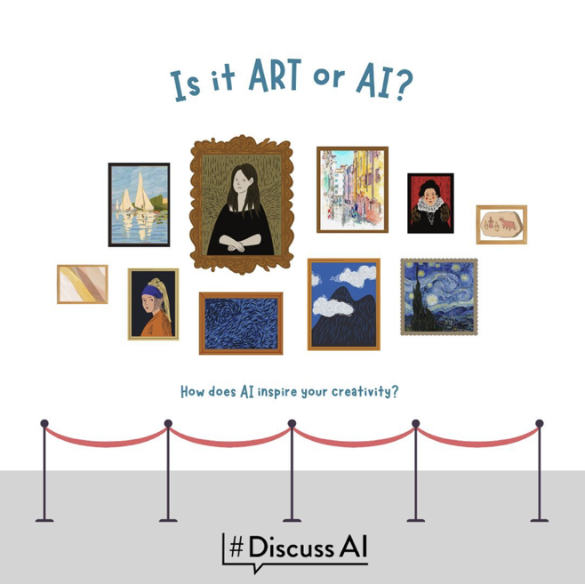
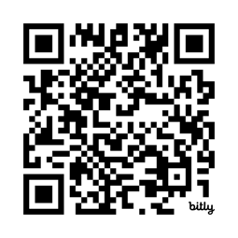
AI or Human? Quiz
Just how good is Generative AI?
Can you tell the difference between real art or AI?
Give it a go:
https://bit.ly/Art-Or-AI
This work is licensed under a Creative Commons Attribution-NonCommercial-ShareAlike 4.0 International License
Notes:
[If you’ve already done the Introduction to AI workshop, we recommend skipping this activity and moving straight to Tips for Identifying AI-generated images]
Activity:
“We’re going to try a quick challenge called Art or AI?”
“Use your phone or iPad to scan the QR code or go to the link on screen.”
“You’ll see a series of images.”
“For each one, decide: was it made by a human or by AI?”
[Students can work in groups if devices or limited]
“You’ve got 5 minutes.”
“When you’re finished answering all the questions:”
“Click Submit”
“Then click See responses to check your score and learn about each image.”
(After 5 mins, ask students to volunteer their scores).
(Ask how they decided an artwork was human- or AI-generated)
“Were there any tell-tale signs?”
(Give 2-3 mins. for discussion)
“Just so you know: Most people score about 6 out of 10…”
“And even AI experts find this difficult.”
Finish:
“So don’t worry if you didn’t score highly – that’s the point. It can be hard to tell AI outputs from human ones.”

Slide 18
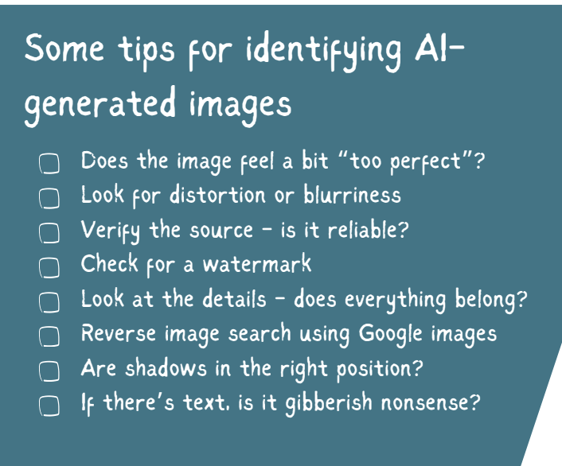
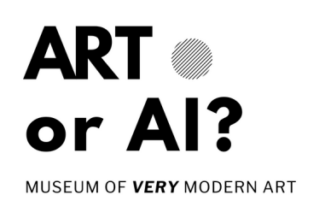
Detecting AI-generated Images
This work is licensed under a Creative Commons Attribution-NonCommercial-ShareAlike 4.0 International License
Notes:
Script:
"To spot AI images, there are some tell-tale signs."
"Train your eye to look for odd details: uncanny 'perfection,' blurry distortions, weird text, or inconsistent shadows. When in doubt, check for watermarks (some AI tools add them), verify the original source of the image (is it reliable?), or run a quick reverse Google image search to see if the image comes up there."

Slide 19
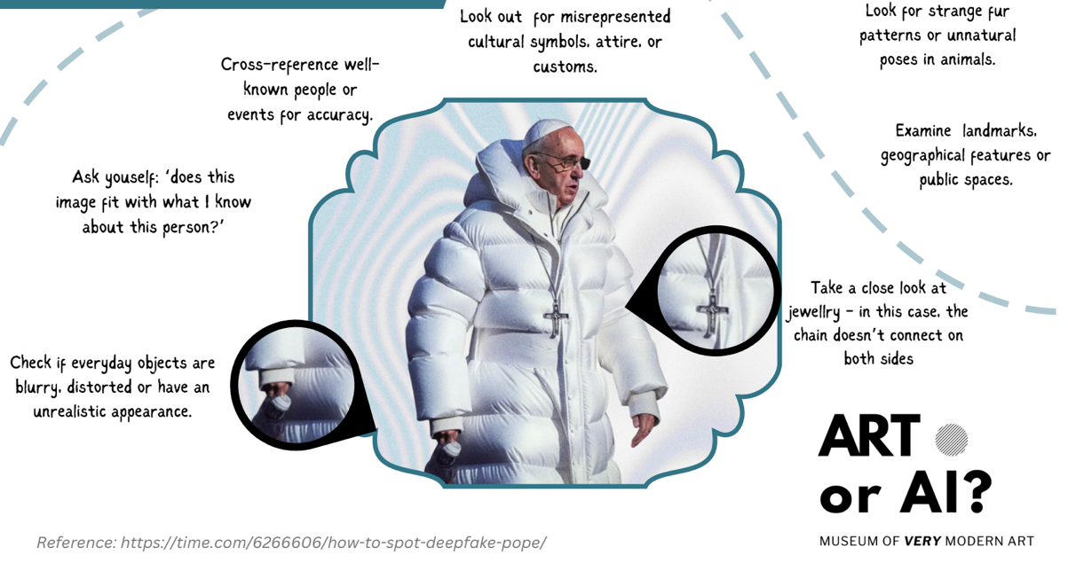
Detecting AI-generated Images
This work is licensed under a Creative Commons Attribution-NonCommercial-ShareAlike 4.0 International License
Notes:
Script:
"When analysing an image like our Balenciaga Pope, zoom in on the fine details. Notice how the chain of the Pope's cross disappears into his coat on one side, and his coffee cup is distorted and blurry."
"Always ask yourself if the context makes sense (would the Pope realistically wear a puffa coat like this?), check cultural or physical details closely, and look for subtle visual flaws before trusting what you see."

Slide 20
Deepfakes
Could Deepfakes be used for good?
This work is licensed under a Creative Commons Attribution-NonCommercial-ShareAlike 4.0 International License
Notes:
Script:
"We usually hear about deepfakes in relation to fake news or scams, but synthetic media isn't purely bad.”
Activity: Short Think-Pair-Share:
“Can you think of any creative or positive ways this technology could actually help people? (Hint: Think about your favourite movies and video games.)”
"Deepfake technology is actually being used for good in some incredible ways:”
”Voice Restoration: People who lose their ability to speak due to illness can use AI voice clones of their own past recordings to keep communicating in their own real voice. An example you might be familiar with is former RTÉ presenter, Charlie Bird, who had Motor Neurone Disease. As the disease progressed and affected his speech, he famously used AI technology – trained on decades of his RTÉ broadcast recordings – to clone his voice so he could continue "speaking" in his own recognisable voice.”
“In Film & TV, actors can have their voices dubbed into other languages while AI adjusts their lip movements to match the new language perfectly.”
”And for education & history, historical figures can be brought to life in museums or classrooms to tell their stories directly to students.”

Slide 21

What’s your data worth?
This work is licensed under a Creative Commons Attribution-NonCommercial-ShareAlike 4.0 International License
Notes:
Script:
”We know that AI systems rely on huge datasets (a structured collection of data) to work effectively.
But have you ever considered what your data is worth? Do you care?”

Slide 22
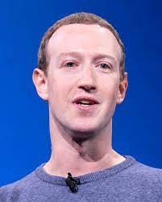
Do you care about your data?
Do you mind that Mark Zuckerberg knows your name?
Do you mind that he can see your Insta/WhatsApp account
(even though you didn’t add him as a friend)?
Do you mind that he knows your top 5 friends?
Do you mind that he knows your top 5 posts?
What about if he knows how you reacted to others’ posts?
What about your DMs?
Sit down when you answer YES
This work is licensed under a Creative Commons Attribution-NonCommercial-ShareAlike 4.0 International License
Notes:
Activity:
"Everyone stand up! We're going to see what your privacy is actually worth to you. I’m going to ask a few questions. The second your answer is 'YES', sit down.”
(Ask students if they know who the person is (they invariably will) – Mark Zuckerberg, CEO of Meta, which owns Instagram, WhatsApp, Facebook, and Threads.))
Question 1: "Do you mind that Mark Zuckerberg knows your name?" (Pause briefly for sits)
(Continue down through all the questions)
Wrap-up: "Look around: everyone [probably!] is sitting down. Most of us really care about who gets to see our private messages, posts, and friend groups. Yet millions of us hand over that exact data to Meta every single day without a second thought. Companies like Meta want your data so they can target you with personalised ads and train their AI models on real human behaviour. Always remember: if you aren’t paying for the product, YOU are the product."

Slide 23

Do you care about your data?
Do you mind that your teacher knows your name?
Do you mind that (s)he can see your Insta/WhatsApp account
(even though you didn’t add him as a friend)?
Do you mind that (s)he knows your top 5 friends?
Do you mind that (s)he knows your top 5 posts?
What about if (s)he knows how you reacted to others’ posts?
What about your DMs?
Sit down when you answer YES
This work is licensed under a Creative Commons Attribution-NonCommercial-ShareAlike 4.0 International License
Notes:
Activity:
“Let’s try this again, but this time think of a teacher.
"Everyone stand up! I’m going to ask the same questions. Again, the second your answer is 'YES', sit down.”
Question 1: "Do you mind that your teacher knows your name?" (Pause briefly for sits)
(Continue down through all the questions)
"Notice how quickly everyone sat down this time? When it’s your teacher, it feels real, personal, and a bit uncomfortable, so you sit down almost immediately. But when it’s Mark Zuckerberg or a massive tech company, it feels invisible, so we ignore it. The reality is that Meta knows far more about your daily life, habits, and messages than any teacher in this school ever will. Keep this in mind when you’re interacting with these platforms."

Slide 24
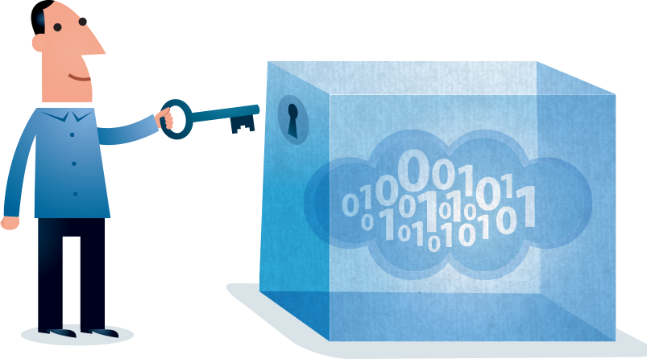
Protecting Your Data while using AI Tools
This work is licensed under a Creative Commons Attribution-NonCommercial-ShareAlike 4.0 International License
Notes:
Script:
“So, how can you begin to protect your data when using AI systems?”

Slide 25
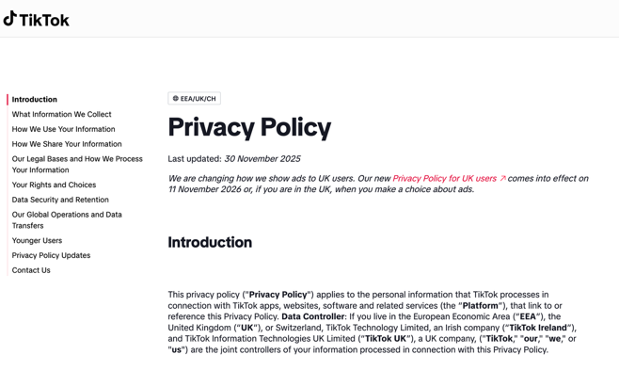

Protecting Your Data while using AI Tools
Always Check the Privacy Policy Before Use
TikTok privacy policy: https://www.tiktok.com/legal/page/eea/privacy-policy/endocs.midjourney.com/docs/privacy-policy
This work is licensed under a Creative Commons Attribution-NonCommercial-ShareAlike 4.0 International License
Notes:
Script:
”Hands up who’s ever clicked ’I Agree’ to ‘I have read the Terms and Conditions’ on an app or website without actually having read them? I think we’ve all done this, mostly because they’re so long. Reading Meta's entire policy, for example, would take over an hour. But you don't need to read pages of legal stuff; you just need to know what to look for.”
“3 quick things to check:
What do they collect? Look for words like location, contacts, microphone, or camera.
Who gets your info? Check if your data is sold to advertisers or used to train AI models. Never click ‘Agree to All’ unless you’ve checked what you’re agreeing to.
Can you delete it? Make sure you can delete your account and wipe your data whenever you want.”
“A tip is to do a quick search on the policy page for words like "sell," "share," "location," or "third party." It takes 30 seconds then to see where your data actually goes.”

Slide 26
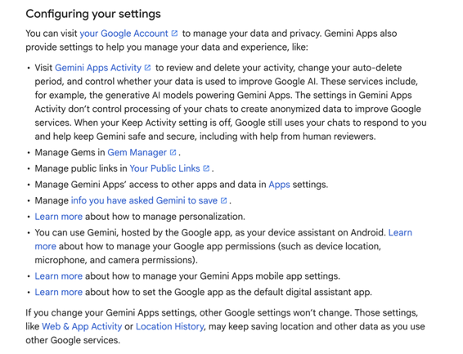

Protecting Your Data while using AI Tools
2. Check your settings
Google privacy policy: https://policies.google.com/u/2/privacy
This work is licensed under a Creative Commons Attribution-NonCommercial-ShareAlike 4.0 International License
Notes:
Script:
“Check your privacy settings.”
“Look at an AI service’s privacy and data settings and understand what happens to your chats, uploads and feedback.”
“Review these settings regularly. They can affect how your information is collected or shared.”
“Change them, if necessary, to protect your data to the greatest extent possible.”
”For example, in GenAI platforms, if you can, opt out of having your data train the AI model, and don’t save chats unless you plan to use them again.”

Slide 27
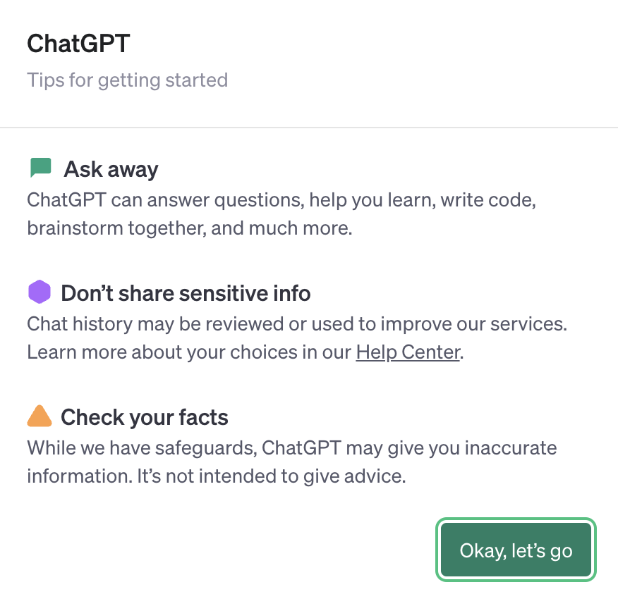

Protecting Your Data while using AI Tools
3. Watch what you share
OpenAI privacy policy: https://openai.com/policies/privacy-policy
This work is licensed under a Creative Commons Attribution-NonCommercial-ShareAlike 4.0 International License
Notes:
Script:
“Always watch what you share. Don’t put private information into an AI chatbot, such as your name, address, phone number, passwords, school details, or private photos. What you share may be stored or used in ways you don’t expect.”
“Protect other people’s privacy too.”
“Before uploading a friend’s photo, message, voice recording or personal story, ask: “Would they be okay with this?” Don't use AI to create or alter someone’s image or voice without their permission.”
“Use the “Would I post this publicly?” test.
Before entering something into an AI tool, imagine it appearing online with your name attached. If you’d be uncomfortable with that, don’t share it. When in doubt, remove identifying details or ask a trusted adult/teacher for advice.”
“Don’t assume AI knows what’s private. Most AI models treat the text, images, or code you give them as training data. That means if you share private messages, family photos, or personal passwords with an AI, that information could easily leak or end up showing up in someone else's answers later."

Slide 28
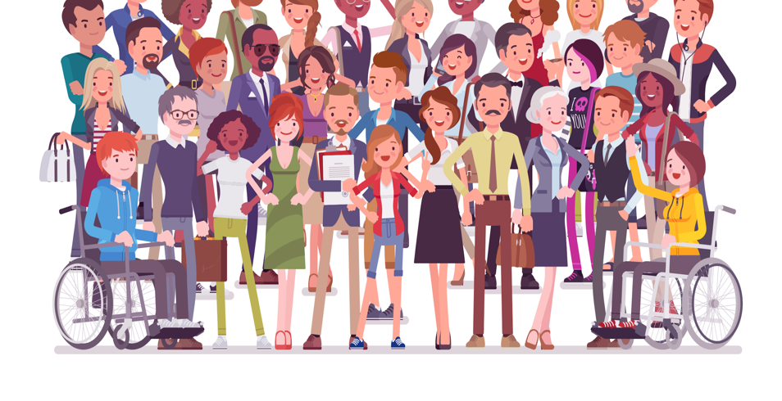
Could AI be biased?
“We don't see things as they are, we see them as we are.”
This work is licensed under a Creative Commons Attribution-NonCommercial-ShareAlike 4.0 International License
Notes:
Script:
"There's a famous phrase: 'We see things not as they are, but as we are.’”
“In simple terms, bias means having a unfair preference for or against something, often based on personal opinions rather than objective facts.”
“AI models don't think independently; they learn exclusively from human data. If the historical data we feed into an AI contains human biases, stereotypes, or missing information, the AI can end up magnifying our existing flaws. This is a real concern.”

Slide 29
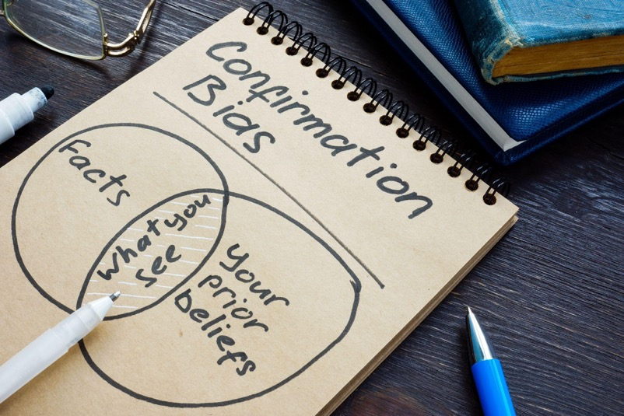
Does Bias really matter?
This work is licensed under a Creative Commons Attribution-NonCommercial-ShareAlike 4.0 International License
Notes:
Activity:
“Does it actually matter in the real world? Let's test that out. Turn to the person sitting next to you, take two minutes, and try to identify three different types of bias. Think about personal opinions, historical patterns, or who might be left out of a dataset.”
(Help students pair up and invite 3-5 groups to give their top-ranked answer)
(Examples might be bias on the grounds of race & ethnicity, gender, age, socioeconomic status, or affinity (preferring people like us))
“When biases such as these get baked into computer code, they aren't just minor tech glitches; they have real-world consequences for real people.”
”In job hiring, if an AI screens CVs using past company data that mostly favoured men, it might automatically filter out qualified female applicants.”
“In law enforcement and justice, facial recognition tools trained mostly on light-skinned faces have much higher error rates for darker skin tones, leading to wrongful identifications or arrests.”
”And in banking and money, if an AI decides who gets a phone contract or a bank loan, it might automatically reject someone just because of where they live or historical income inequalities, making it harder for certain people to get fair financial opportunities.”

Slide 30
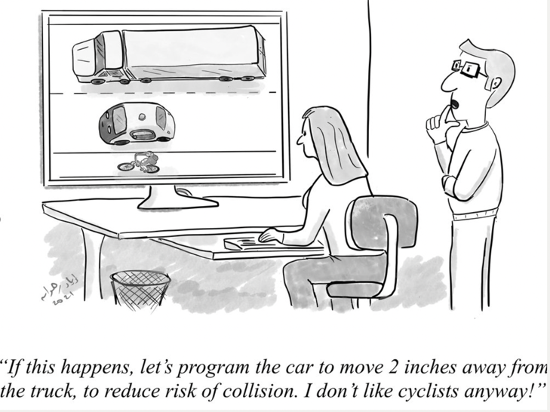
AI and Ethics
Source: https://www.evilaicartoons.com
This work is licensed under a Creative Commons Attribution-NonCommercial-ShareAlike 4.0 International License
Notes:
Script:
"AI is already deciding what we see on our feeds, and how decisions are made about our lives. But just because technology can do something doesn't mean it should.”
“Ethics is simply asking: is this fair, is it safe, and who is being affected? Now, we’re going to look at an example of the hidden rules, risks, and real-world impact behind the AI tools we use.”
“Note that this is what ethicists call an ‘edge case’ or an extreme scenario, but it highlights the kind of ethical issues that AI can raise.”

Slide 31
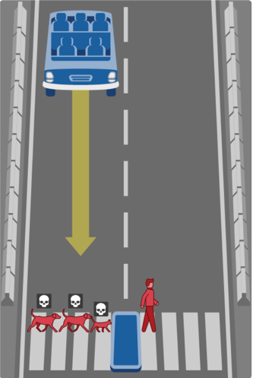
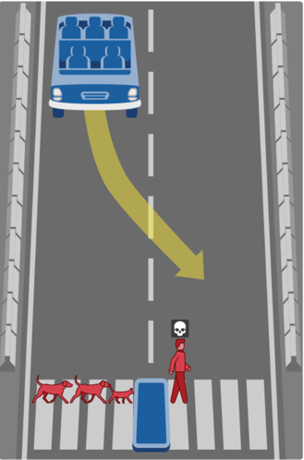
What action should the self-driving car take?
A.
Continue ahead and drive through a pedestrian crossing, resulting in
2 dogs and 1 cat dead?
B.
Swerve and drive through a pedestrian crossing in the other lane, resulting in 1 man dead?
https://www.moralmachine.net
This work is licensed under a Creative Commons Attribution-NonCommercial-ShareAlike 4.0 International License
Notes:
Activity:
"This scenario comes from the Moral Machine, an online experiment run by researchers at the Massachusetts Institute of Technology in the U.S. They built it to gather human opinions from around the world on how AI in self-driving cars should be programmed to make split-second ethical choices when a crash is unavoidable.”
Class Activity: "Take a look at the screen. A self-driving car is heading towards a pedestrian crossing and can't stop in time:
Option A: Stay straight, which results in 2 dogs and 1 cat being killed.
Option B: Swerve into the next lane, which results in 1 human being killed.”
“Let's take a quick vote: Raise your hand for Option A.” (Pause)
“Now raise your hand for Option B”. (Pause)
Discussion prompt: “What made you select your preferred course of action for the car?”
”Do you think people in other countries would make the same choice?”
(Students can look at the Moral Machine website in their own time later and see how selections for actions in crash scenarios vary substantially by country because they’re shaped that that country’s/society’s particular values).
Wrap-up: "Notice how people in this room might disagree. If humans can't even agree on the 'right' choice, how are programmers supposed to code an AI to make that decision in a fraction of a second?”
“This activity highlights how ethics must be central to AI development and use, and it must reflect societal values.”

Slide 32
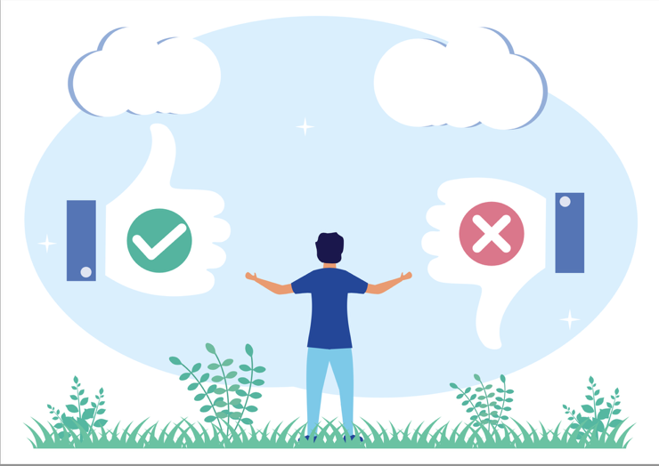
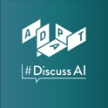
What have we learned?
AI offers substantial benefits to individuals, organisations and society
These benefits must be balanced with the potential ethical implications of AI
www.adapcentre.ie/discussai
This work is licensed under a Creative Commons Attribution-NonCommercial-ShareAlike 4.0 International License
Notes:
Script:
”We’ve learnt today that AI is prevalent in our lives and features in many of the everyday products and services that we and others use.”
“AI brings massive benefits to our everyday lives, businesses, and society, from solving complex problems to saving us time.”
“But those benefits must be balanced with the real ethical risks, like privacy and fairness. That's why AI shouldn't just be shaped by tech companies; it's vital that everyone – including all of you – has a voice in how AI is built and used. The ADAPT Centre’s #DiscussAI campaign is designed to enable a national conversation on AI in Ireland and has already engaged more than 80,000 people in communities across Ireland in conversations on AI since 2021. Keep an eye on its website for upcoming events.”

Slide 33
Help us evaluate this workshop
Note:
Different QR code to the opening one
This work is licensed under a Creative Commons Attribution-NonCommercial-ShareAlike 4.0 International License
Notes:
Activity:
“To wrap up, I'm going to ask you to take a couple of minutes to revisit our Mentimeter quiz. This will help the people at ADAPT check if this workshop achieved its learning goals for you today and make changes for future workshops, if necessary.”
“To help us measure that, please take out your devices, scan the NEW QR code here on screen, and complete the quiz. Thank you.”

Slide 34
How’s your AI Literacy now?
Additional AI in My Life modules:
Introduction to AI
AI and Ethics
AI and the Future of Work
AI Careers
www.adaptcentre.ie/public-engagement/ai-in-my-life-lessons/
Notes:
Script:
“That's it for our taster workshop!"
“AI literacy is the set of skills, knowledge, and critical thinking needed to understand, use, and evaluate artificial intelligence tools effectively and ethically.”
“It involves knowing how AI systems work, recognising where they are used, evaluating their output for accuracy or bias, and understanding their social and ethical impacts.”
”Nobody has perfect AI literacy, but today you have enhanced yours. Well done!”
(Tell students that they’ll learn more in subsequent modules, if you plan to do them – see the web link for resources)

