Slide 1


AI and Ethics
An AI in My Life Workshop
Version 2.1, August 2026
Notes:
Script:
"Welcome, everyone. Today, we’re diving into one of the most critical topics of our time: AI ethics.”
“During this lesson, we’ll explore how artificial intelligence impacts our daily lives, where human values fit into AI system design, and the key principles guiding safe technology."

Slide 2


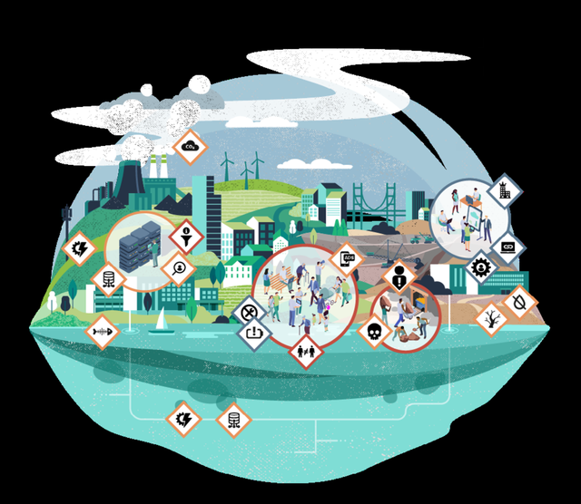

What is AI in My Life?
A 4-part workshop series on
Artificial Intelligence
Developed by the ADAPT research centre
at DCU and partners
Designed to help you explore the
role of AI in your life and in society
§
Lone Thomasky & Bits&Bäume / https://betterimagesofai.org / https://creativecommons.org/licenses/by/4.0/
This work is licensed under a Creative Commons Attribution-NonCommercial-ShareAlike 4.0 International License
Notes:
Script:
“This workshop is part of ‘AI in My Life’, a four-part series on Artificial Intelligence.”
“It’s been developed by the Education & Public Engagement team at the Research Ireland ADAPT Centre in DCU with partners.”
“And it’s designed to help you understand AI so you can evaluate its role and make informed decisions about how it affects your life and society.”

Slide 3
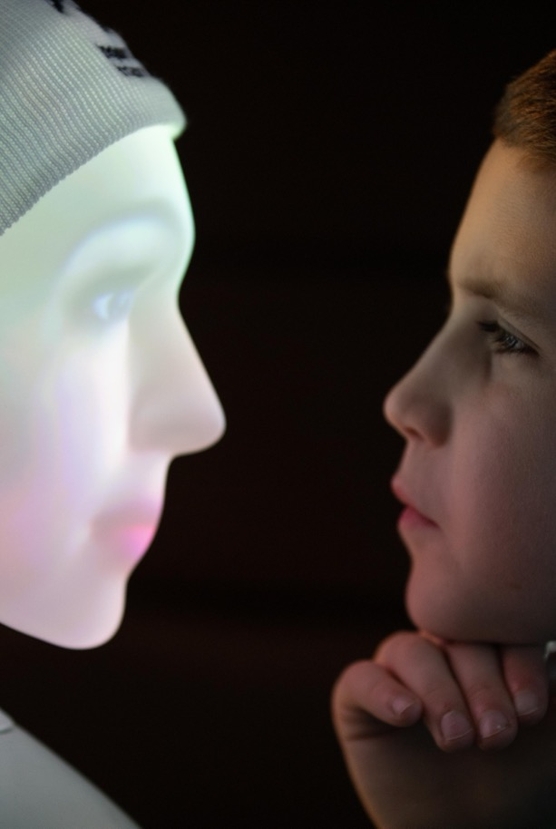
Learning Intentions
By the end of this lesson, you should be able to:
Define AI and give examples of how it’s used
Outline key ethical and privacy implications of AI systems
Evaluate the role AI plays in your life and in society
This work is licensed under a Creative Commons Attribution-NonCommercial-ShareAlike 4.0 International License
Notes:
Script:
"Today we’re setting a strong foundation for AI, moving past the hype to look at real-world applications, ethics, and personal impact."
“You will be able to:
Define AI simply and give examples of where it’s used today
Address crucial ethical considerations around data privacy, bias, and responsible design
Reflect on how AI actively influences our daily routines and societal structures.
”Let’s start with our first objective: defining AI."

Slide 4
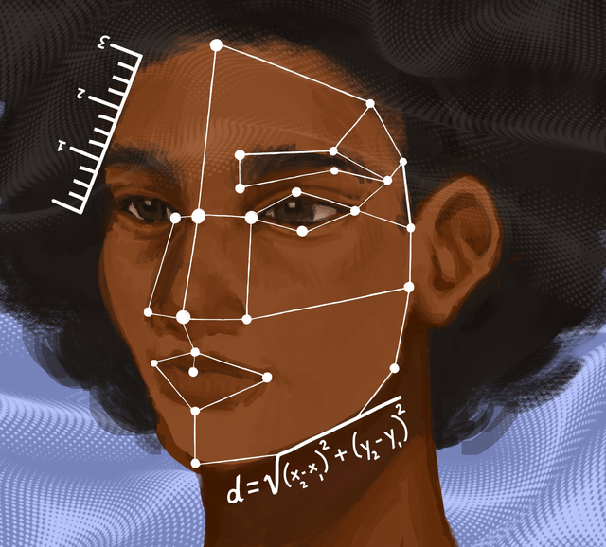
What is AI?
Artificial Intelligence (AI) refers to technologies designed to carry out tasks that normally require human intelligence.
Things like recognising images, understanding language, or solving problems.
Alyssa Chen / https://betterimagesofai.org / https://creativecommons.org/licenses/by/4.0/
This work is licensed under a Creative Commons Attribution-NonCommercial-ShareAlike 4.0 International License
This work is licensed under a Creative Commons Attribution-NonCommercial-ShareAlike 4.0 International License
Notes:
(This’ll be a recap for students who’ve already taken another module)
Script:
“How might we define AI?”
“AI refers to technologies designed to carry out tasks that normally require human intelligence.”
“Things like recognising images, understanding language, or solving problems.”

Slide 5
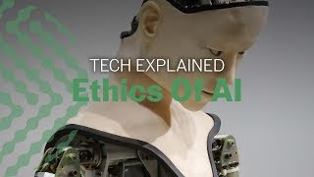
Ethics and AI
https://www.youtube.com/watch?v=1LyacmzB1Og
This work is licensed under a Creative Commons Attribution-NonCommercial-ShareAlike 4.0 International License
Notes:
Activity:
“Watch this short video from the University of Toronto, which introduces us to 3 key ethical concerns relating to AI development and use.”
”Note the 3 key concerns”
(Click to launch the video on YouTube)
(The concerns are: What is AI used for?, who has access to AI?, and AI doesn’t share our values (thereby potentially amplifying bias))

Slide 6
Let’s start
What do we mean by “ethics”?
This work is licensed under a Creative Commons Attribution-NonCommercial-ShareAlike 4.0 International License
Notes:
Activity (Pair & Share):
"Before we talk about AI, let's step back and look at the core concept: ethics. Take 30 seconds to write down three words that define 'ethics' for you." (Pause 30 secs)
"Now, turn to the person next to you. Compare your words and agree on your pair's definitive top three." (Allow 60-90 secs)
"Let's bring it back. Who wants to share their pair's three words so we can build our definition on the board?” (Take 3-4 responses and bring together to form a loose definition)

Slide 7
What do we mean by “ethics”?
Our understanding of what is right and wrong, as well as the rules that individuals and the society should follow.
This work is licensed under a Creative Commons Attribution-NonCommercial-ShareAlike 4.0 International License
Notes:
Script:
“Ethicists define ‘ethics’ as our understanding of what is right and wrong, and the rules that individuals and society should follow”.
“Does that reflect the meaning you suggested?”

Slide 8
What do we mean by “AI ethics”?
Moral principles and values guiding the creation and use of AI systems
Goal: Ensure AI systems benefit society and follow ethical principles
Key Ethical Concerns:
Fairness: Preventing bias
Transparency: Clear decision-making
Privacy: Protecting data
Safety: Preventing harm
This work is licensed under a Creative Commons Attribution-NonCommercial-ShareAlike 4.0 International License
Notes:
Script:
“Ethics isn't just about what technology can do, but what it should do."
“AI ethics refers to the moral principles and values that should guide the development and use of artificial intelligence systems.”
“AI systems should be designed and used in a way that benefits society and follows ethical principles”
“Issues like fairness, transparency, privacy and safety are important ethical considerations.”
“Fairness means ensuring AI treats everyone equitably without repeating or worsening human biases.”
”Transparency means knowing how an AI arrives at its answers or decisions.”
“Privacy and safety mean safeguarding personal data and ensuring systems are secure before deployment.”
"Ask yourselves: Can you think of a tool with AI that you use daily where privacy or fairness might be an issue?"

Slide 9

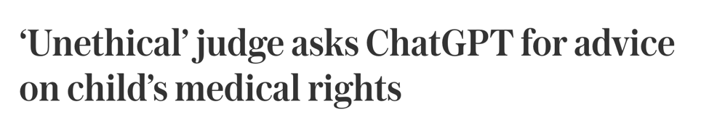

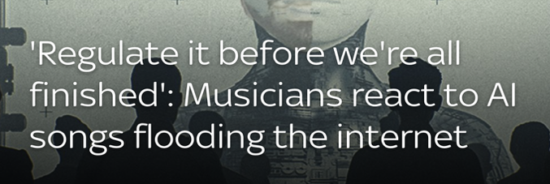

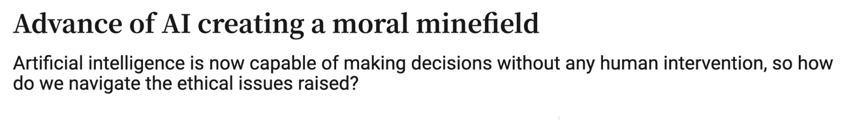
Why does ethics matter for AI?
This work is licensed under a Creative Commons Attribution-NonCommercial-ShareAlike 4.0 International License
Notes:
Script:
“These news stories show AI ethics is already playing out in real time.”
“You see judges using ChatGPT, raising big questions about accountability and fairness.”
“Concern about AI making choices without human oversight.”
“And serious worry that AI music and art threaten artists' livelihoods, copyright, and originality.”
Class Prompt:
"These are just three examples. What other AI controversies or ethical debates have you seen online or in the news?” (Give 30 secs and invite responses)
Quick Teacher Prompts:
Deepfakes and voice cloning scams
Facial recognition and privacy
AI-generated homework and cheating
Environmental impacts of running massive AI data centres

Slide 10



Why does ethics matter for AI?
AI has the potential for immense impact, both positive and negative.
AI systems are increasingly being entrusted with high-stakes decisions that affect human lives and society.
AI learns from data, which can encode human biases and prejudices. Unethical applications could automate or worsen injustice.
This work is licensed under a Creative Commons Attribution-NonCommercial-ShareAlike 4.0 International License
Notes:
Script:
“AI has massive potential impacts, both positive and negative.”
“AI systems are being entrusted more and more with high-stakes decisions – making major, life-altering decisions in areas like hiring, healthcare, and justice.”
“AI learns directly from historical human data, meaning it can absorb and amplify our worst biases at scale.”
“The danger is that unchecked, AI doesn't just reflect unfairness; it automates and accelerates injustice faster than humans can catch it.”

Slide 11


Why does ethics matter for AI?
As AI gets more capable and autonomous, we need to maintain human accountability and control.
Ethical issues around AI use, like privacy invasion or job losses, require careful consideration to avoid public backlash.
Ethics helps ensure AI development and use is guided in a socially responsible direction.
This work is licensed under a Creative Commons Attribution-NonCommercial-ShareAlike 4.0 International License
Notes:
Script:
"As these systems become more autonomous (or capable of acting alone), humans must stay in control. Machines cannot hold moral accountability."
"Without ethics around AI’s potential impact on things like job shifts and privacy, we risk breaking public trust and facing heavy backlash."
"Ethics acts as our moral compass, ensuring that AI progresses in a way that serves society responsibly."

Slide 12
What rules would you consider?
Create a set of rules for a scientist who is creating an AI bot.
This work is licensed under a Creative Commons Attribution-NonCommercial-ShareAlike 4.0 International License
Notes:
Activity:
"Now it’s your turn to play the regulator. Imagine a scientist is building a brand-new, powerful AI bot (think ChatGPT, Gemini, etc.). What ground rules must the scientist follow?”
Prompting Questions:
"Should the bot always have to obey a human, or can it make final decisions?"
"What rules prevent it from causing harm, leaking private data, or acting unfairly?”
Group Share: "Turn to your partner for 60 seconds and draft your top 2 rules for the developer. Let’s see what code of ethics you come up with”
Record Responses: Make a note of 6-8 responses, ideally on a board that you can refer back to.

Slide 13



Ethical Considerations for AI Development (1 of 2)
Privacy and Data Governance
There are strict rules about people's data and how AI is able to use it.
Technical Robustness and Safety
AI tools do not contain errors and their operation does not lead to harm.
Human Agency and Oversight
All decisions are reviewed by humans and humans are the “in charge” of final decisions.
This work is licensed under a Creative Commons Attribution-NonCommercial-ShareAlike 4.0 International License
Notes:
Script:
“Now let’s see if our rules align with the 7 Key Requirements for Trustworthy AI published in the European Commission's Ethics Guidelines for Trustworthy AI.”
"The European Union has defined 7 official requirements for 'Trustworthy AI’. Let’s see how many of these we identified.”
“The first three focus on control, safety, and data.”
“Human Agency and Oversight means that humans must stay in command. AI supports human decision-making, but it doesn't replace final responsibility."
“Robustness means that systems must be secure, accurate, and built with fallbacks so they don't break or cause unintentional harm."
“Data Governance requires strict privacy protections to ensure personal data isn’t misused."

Slide 14




Ethical Considerations for AI Development (2 of 2)
Diversity, Non-Discrimination and Fairness
AI should work equally well for different people and in different contexts. The benefits of AI should be shared equally.
Societal and Environmental Well Being
AI should impact the environment and the society in a positive way
Transparency
It is possible to say what decisions AI makes, what steps led it to those decisions and what data informed them.
Accountability
We know who is responsible for the AI and we can fix problems or enforce sanctions when something goes wrong
This work is licensed under a Creative Commons Attribution-NonCommercial-ShareAlike 4.0 International License
Notes:
Script:
“The final our principles focus on broader societal impact, openness, and responsibility.”
“Fairness means that AI must be accessible to everyone and actively guard bias and discrimination."
“Societal & Environmental Wellbeing means developers must consider the carbon footprint of AI data centres and its effect on democracy and jobs."
“Transparency & Accountability means that users must know when they are interacting with an AI, understand how decisions are made, and know who is legally responsible when things go wrong.”
"What started as voluntary ethical guidelines in 2019 is now law under the EU AI Act. Developers don't just follow these principles because it's nice to do; they do it because violating them can mean multi-million-euro fines.”
”How many of them did we get?”

Slide 15


Scenario A: GenAI and school projects
https://www.youtube.com/watch?v=Fn8jDanbf0c
This work is licensed under a Creative Commons Attribution-NonCommercial-ShareAlike 4.0 International License
Notes:
Script:
“We’re going to watch a video clip from a news show in the U.S. that explores whether it’s ethical to use generative AI systems like ChatGPT for school assignments.”
“The piece was broadcast in January 2023, just a few months after ChatGPT was launched.”
”It’s interesting that the challenges identified then in terms of using AI to cheat in assignments, and the potential impact on students’ learning, are still very much an unresolved ethical issues today.”
“Note that detectors to identify and flag instances of GenAI use have since proved to be largely inaccurate and ineffective, and experts advise against their use.”
(Click to launch the video in YouTube – play the first two minutes only)

Slide 16
Questions for Scenario A
"A student used AI to summarise a book and write their reflection paragraph because they had two other tests to study for.”
Group 1 (The Student): Argues why they used it (stress, time management, tool availability).
Group 2 (The Teacher): Explains why the assessment was set and what learning was missed.
Group 3 (The Ethics Board): Questions both sides and proposes a fair resolution.
Ethical Discussion: Is using AI to save time on schoolwork always unfair, or does it depend on the task?
This work is licensed under a Creative Commons Attribution-NonCommercial-ShareAlike 4.0 International License
Notes:
(We recommend selecting this activity only if you have a manageable class size (fewer than 35 students), to allow for adequate group discussion and report back)
Activity:
The Scenario: A student, Alex, was stressed as he ran out of time, and used ChatGPT for his assignment – summarising a book and writing his reflection paragraph.
Your Task: Split into 3 groups and debate the case (3 mins in-group prep, 5 mins debate).
(If you’ve too many students for each group, double up – 2 each of Group 1, Group 2, and Group 3 below.
Group 1 (Alex): Argue why using AI under pressure was understandable and not malicious.
Group 2 (The Teacher): Argue why it was dishonest and what learning was missed.
Group 3 (The Ethics Board): Listen, ask 1 question to each side, and decide a fair consequence and rule.
Take 2 mins then to discuss the key question: “Is using AI to save time on schoolwork always unfair, or does it depend on the task?”

Slide 17
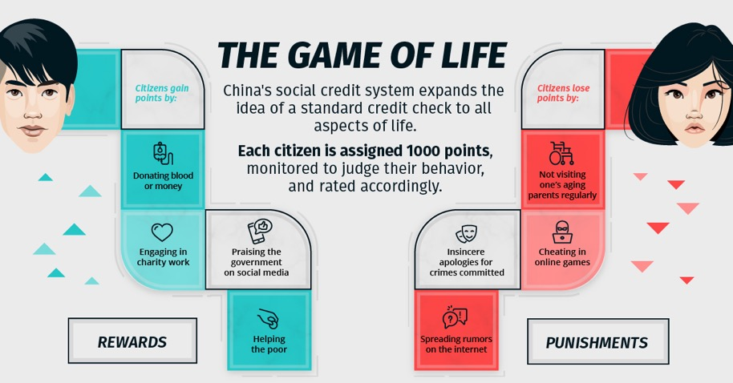
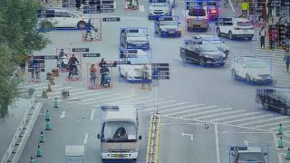
Scenario B China’s Social Credit System
https://www.youtube.com/watch?v=Onm6Sb3Pb2Y
This work is licensed under a Creative Commons Attribution-NonCommercial-ShareAlike 4.0 International License
Notes:
Activity:
”Now let’s look at what ethicists refer to as an “edge case” or an extreme scenario, but it highlights the kind of ethical issues that AI can raise.”
“China’s Social Credit System uses AI to track people’s real-world behaviour, such as using facial recognition cameras and analysing digital records, to rank how "trustworthy" citizens are. Let’s hear a bit about it.”
(Click to launch video in YouTube)

Slide 18
Questions for Scenario B
What are the potential benefits and risks of such a system?
Within months of a separate commercial opt-in ‘social credit’ system being launched in China in 2015, more than 14 million people opted in.
If such a commercial system were introduced in Ireland, would you opt in?
This work is licensed under a Creative Commons Attribution-NonCommercial-ShareAlike 4.0 International License
Notes:
Activity:
“China’s State-run Social Credit System exists as a patchwork of regional trials run by local city governments. Participation is mandatory. Citizens don’t opt in, consent to data collection, or have a way to opt out.”
Instructions: Split the room in two, asking the right side to consider the potential benefits, and the left side to consider the potential risks. Students can work in pairs or small groups for 3 mins. and report back.
(Benefits: Enhanced public safety, greater accountability, rewards for civic and community engagement)
(Risks: State surveillance, restricted freedoms, erosion of privacy, social stigma, glitches could wrongly punish people)
“Ireland is subject to the EU AI Act, which officially bans automated social scoring like this. Overall, are we glad this is the case?”
“14 million people opted into Zhima Credit – a commercial social credit scoring app launched in China by Alibaba in 2015. People signed up for the credit scoring in return for the chance to gain by perks, like skipping travel queues, renting cars without a deposit, or getting fast-tracked travel visas. People can even show their verified social credit score on dating apps to signal trustworthiness to potential partners.”
Instructions: Invite everyone now to stand up
“If such a commercial system were introduced in Ireland, would you sign up in order to access perks? Stay standing if you would.”
(Ask those still standing – if there are any! – why they’d be willing to trade their privacy/data for other gains)
(Ask those sitting why they think people in China were willing to make this trade-off)
“We know that data drives AI systems. Social Credit scoring is an extreme scenario, but if we think about it, we’re making trade-offs between our data (our privacy) and the perceived benefits we get from our use of AI-powered tools and services every day.”

Slide 19
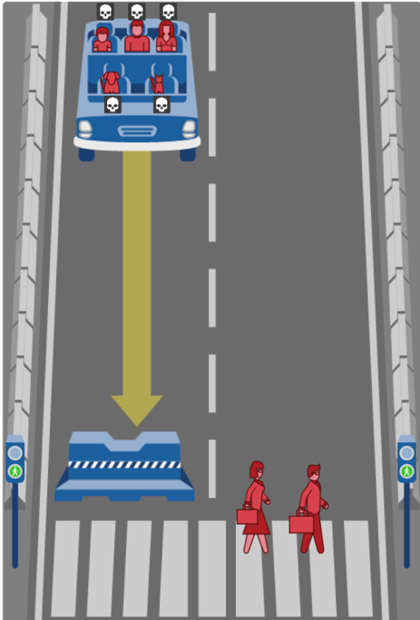
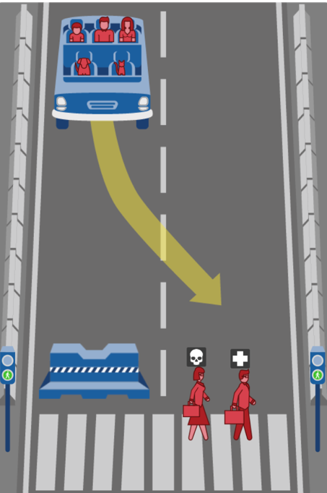
What action should the self-driving car take?
B.
Swerve and drive through a pedestrian crossing in the other lane, resulting in 1 male executive dead?
(The affected pedestrians are crossing on green)
A.
Continue ahead and crash into a concrete barrier, resulting in 1 dead cat, 1 dead dog, 1 dead woman, 1 dead man, and 1 dead boy?
https://www.moralmachine.net
This work is licensed under a Creative Commons Attribution-NonCommercial-ShareAlike 4.0 International License
Notes:
(Note: This is a different scenario to the one in the AI in My Life taster module. However, if you’ve completed that module, we recommend you skip this activity and spend more time on the other scenarios).
Activity:
"This scenario comes from the Moral Machine, an online experiment run by researchers at the Massachusetts Institute of Technology in the U.S. They built it to gather human opinions from around the world on how AI in self-driving cars should be programmed to make split-second ethical choices when a crash is unavoidable.”
Class Activity: "Take a look at the screen. A self-driving car is heading towards a pedestrian crossing and can't stop in time:
Option A: Stay straight, which results in 1 cat, 1 dog, 1 woman, 1 man, and 1 boy being killed.
Option B: Swerve into the next lane, which results in 1 male executive being killed.”
“Let's take a quick vote: Raise your hand for Option A.” (Pause)
“Now raise your hand for Option B”. (Pause)
Discussion prompt: “What made you select your preferred course of action for the car?”
”Do you think people in other countries would make the same choice?”
Wrap-up: "Notice how people in this room might disagree. If humans can't even agree on the 'right' choice, how are programmers supposed to code an AI to make that decision in a fraction of a second?”
“This activity highlights how ethics must be central to AI development and use, and it must reflect societal values.”

Slide 20
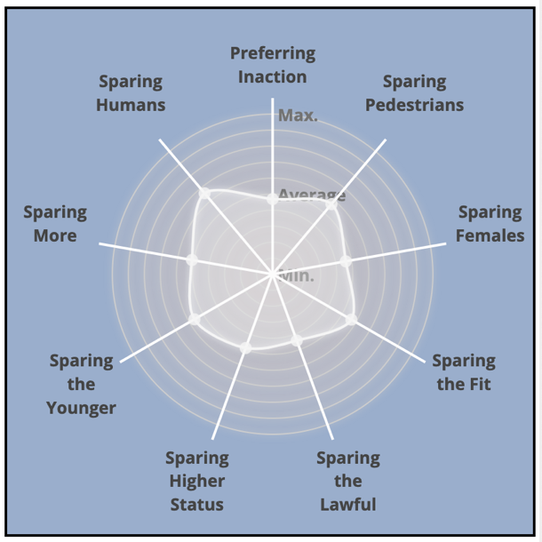
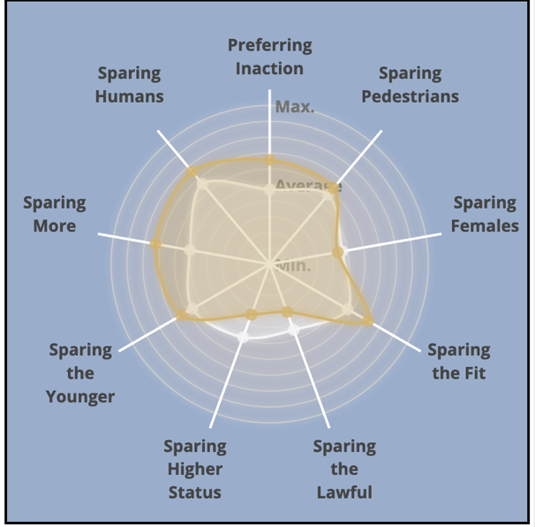
Ethical Decisions of AI: How does Ireland compare?
The grey area is the world average
The grey area is the world average
The yellow area is the average of responses from Ireland
www.moralmachine.net
This work is licensed under a Creative Commons Attribution-NonCommercial-ShareAlike 4.0 International License
Notes:
Script:
”Culture often shapes what we value. MIT’s Moral Machine tested this by asking millions of people worldwide who a self-driving car should save in an unavoidable crash.”
“On the left, the grey shape shows the global average. The further a point reaches toward the edge, the stronger people felt about that preference.”
"On the right, we overlay Ireland in yellow. Notice where our cultural priorities shift:
Compared to the rest of the world, people in Ireland showed a much stronger preference for sparing humans, preferring inaction, and sparing the fit.
On the flip side, we were significantly less inclined to favour people with higher social status or those obeying the law.”
Prompt to Class:
"Looking at where our shape pulls away from the global average, what do you think this tells us about Irish values? And should AI developers design cars that reflect local cultural preferences, or should there be one global standard?"

Slide 21
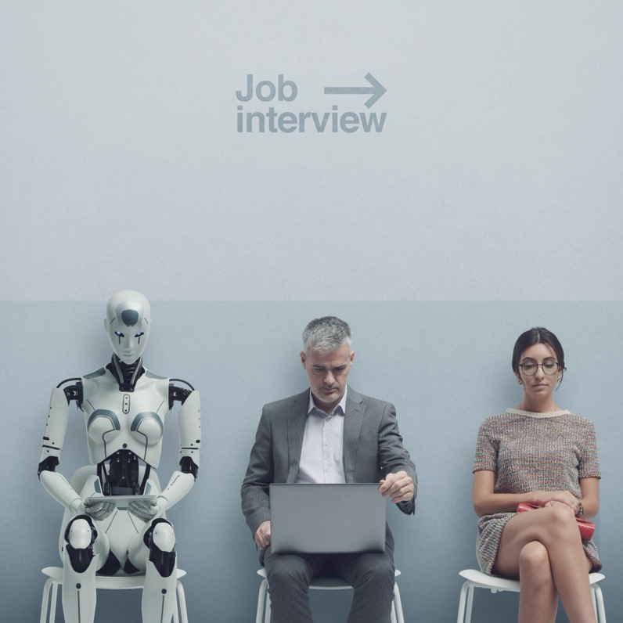
Will we all be able to find work in a world with AI?
Automation is often seen as a threat to manual labour. Robots replace factory workers and farmers, while self-driving cars come after human drivers’ jobs.
But AI is also trained to perform more intellectual tasks such as translation, programming, writing, medical diagnosis or teaching.
How do we make sure that entire professions do not disappear and that we all have a chance at meaningful employment and a decent standard of living?
This work is licensed under a Creative Commons Attribution-NonCommercial-ShareAlike 4.0 International License
Notes:
Script:
“When people used to talk about machines taking jobs, they usually meant physical work, such as robots building cars on a factory line, or self-driving trucks replacing drivers."
"What's different now is that AI is starting to do 'thinking' jobs too. It can write computer code, translate languages, spot illnesses on hospital scans, and even help teach classes. So it's not just hands-on work changing anymore; it’s ‘office jobs’ too."
"This leads to a massive question for us to figure out: as AI makes businesses faster and richer, how do we make sure normal workers and whole towns aren't just left behind?"
"If an AI can do most of someone's job faster and cheaper, is it up to the company to help that worker find a new role, or is that just what happens when technology moves forward?”
“These are new ethical questions we need to address together as a society.”

Slide 22

What about the impact of AI on our planet?
Energy: Data centres accounted for 22% of Ireland’s metered energy consumption in 2024
Water: Server cooling consumes roughly 500ml of water per 5 to 50 prompts
Resources: Hardware manufacturing relies heavily on rare-earth mining, driving local environmental destruction and labour concerns.
Can we justify the rapid expansion of AI in the middle of a climate crisis?
Is it possible to produce the necessary equipment in a sustainable and fair way?
This work is licensed under a Creative Commons Attribution-NonCommercial-ShareAlike 4.0 International License
Notes:
Script:
“The data used by AI is stored and processed in enormous data centres, each made up of millions of servers and computers.:
“In 2024, data centres accounted for 22% of Irish energy consumption. That’s going to grow as our use of AI increases and more data centres are built.”
.
“As the servers require cooling, it is estimated that ChatGPT uses half a litre of water for every 5 to 50 prompts it answers!”
“Minerals and metals used to manufacture the servers are mostly found in developing countries, but their extraction is destructive to the environment and dangerous to the local population.”
“This poses major ethical questions like ‘Can we justify the expansion of AI in the middle of a climate crisis?”
”And can we better leverage the potential of AI to build smarter power grids, optimise renewable energy, and model climate solutions faster than ever?"

Slide 23

Questions to consider
Who should be blamed when decisions made by AI lead to harm?
What are the differences between the rules that should apply to ethical AI and those that govern our own ethical behaviour?
To what extent can we ignore the risks of AI to enjoy the benefits it provides?
What can we do as citizens to influence how AI is used?
This work is licensed under a Creative Commons Attribution-NonCommercial-ShareAlike 4.0 International License
Notes:
Script:
"To wrap up today's session, let’s reflect on four big questions that will shape how technology impacts our society over the coming years."
"First: Who is accountable when AI goes wrong? If a self-driving car crashes or an AI misdiagnoses a patient, who takes the blame: the developer, the company, or the user?"
"Second: Should AI follow human rules? Humans rely on empathy, common sense, and gut feelings to make decisions. Can we program a machine to have a conscience, or does AI need a completely different set of rules?"
"Third: Are the trade-offs worth it? We love the convenience of instant translations, personalised recommendations, and automated tools, but how much privacy, environmental impact, or job security are we willing to give up for that convenience?”
"Finally: What power do we actually have? As citizens and future tech users, how can we shape the way AI is regulated and used, rather than just letting tech companies decide for us?"

Slide 24
What have we learned?
AI presents important ethical questions
Those developing AI need
to think and act ethically
Our use of AI also needs
to be ethical
It is vital for us to balance the advantages and disadvantages of AI
Notes:
Script:
“It’s clear that AI is one of the most powerful tools humanity has ever created. It offers massive potential to help us tackle some of our biggest global challenges, from accelerating medical discoveries to revolutionising personalised learning...”
“But extraordinary power comes with complex ethical questions. The developers and tech companies building these systems have a duty to design them responsibly, safely and fairly."
"At the same time, the responsibility falls on us as users and consumers. How we choose to use AI matters just as much as how it’s built. Ultimately, our goal isn't to reject AI or accept it blindly; it's to balance its incredible benefits while actively managing its risks.”

Slide 25
How’s your AI Literacy now?
Additional AI in My Life modules:
AI and Ethics
AI and the Future of Work
AI Careers
www.adaptcentre.ie/public-engagement/ai-in-my-life-lessons/
Notes:
Script:
“AI literacy is not just about knowing how to type a quick prompt into a tool. True AI literacy means understanding how these systems work, where their limits lie, and critically, recognising the ethical choices built into them."
"Hopefully, after today's session, you feel better informed and more confident in what it means to use AI ethically and responsibly.”
”Nobody has perfect AI literacy, but today you have enhanced yours. Well done!”
(Tell students that they’ll learn more in subsequent modules, if you plan to do them – see the web link for resources)

