Slide 1
AI Careers

Slide 2
What is AI in My Life?
Workshop series on Artificial Intelligence
Developed by ADAPT research centre and partners
Designed to help students navigate the ’Age of AI’
Our Partners:
This work is licensed under a Creative Commons Attribution-NonCommercial-ShareAlike 4.0 International License

Slide 3
What you’ll learn today
Examples of some jobs working with AI
What we mean by ‘multidisciplinary’ and ‘dual skilling’ in the context of AI careers
How to do an initial search for third-level courses relating to AI
Our Partners:
This work is licensed under a Creative Commons Attribution-NonCommercial-ShareAlike 4.0 International License

Slide 4
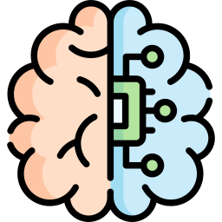
What is AI?
Artificial intelligence refers to many different technologies that are designed to accomplish tasks that can otherwise be only carried out by human minds, for example identifying patterns, recognising images, understanding languages or solving problems.
This work is licensed under a Creative Commons Attribution-NonCommercial-ShareAlike 4.0 International License
Notes:
Comprehend = understand
Sense = detect
Through AI, we can programme machines to plan, learn, reason, solve problems, and make decisions.

Slide 5
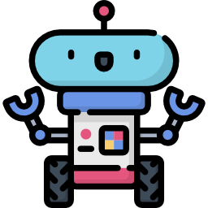
Is AI the career for me?
What do you look for in career?
This work is licensed under a Creative Commons Attribution-NonCommercial-ShareAlike 4.0 International License

Slide 6
Is AI the career for me?
Does the idea of a career in AI appeal to you?
This work is licensed under a Creative Commons Attribution-NonCommercial-ShareAlike 4.0 International License

Slide 7
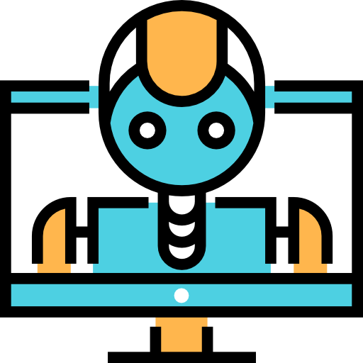
Reasons to Consider a Career in AI
This work is licensed under a Creative Commons Attribution-NonCommercial-ShareAlike 4.0 International License

Slide 8
Why consider a career in AI?
AI offers the ability to work in a variety of fields and with life-changing technology.
You can use AI to make a real difference in the world
This work is licensed under a Creative Commons Attribution-NonCommercial-ShareAlike 4.0 International License

Slide 9
Why consider a career in AI?
2. AI jobs are plentiful
National and international studies show skills related to AI appear to be in demand across almost all sectors of the economy [1]
More than 40 of the world’s leading AI innovators have a presence in Ireland [2]
[1] Demand for AI skills in jobs: Evidence from online job postings, OECD, 2021 3ed32d94-en.pdf (oecd-ilibrary.org) [2] Skillnet Ireland: https://www.irishtimes.com/special-reports/2022/07/21/whats-ai-got-to-do-with-it/
This work is licensed under a Creative Commons Attribution-NonCommercial-ShareAlike 4.0 International License

Slide 10
Why consider a career in AI?
3. There’s a big talent gap, so AI professionals can earn top salaries
There is a shortage of people within areas associated with AI and Data Analytics. This shortage is driving salaries and demand for expertise.[1]
AI is a lucrative area due to the demand for people with relevant skills.
E.g. A Machine Learning Engineer with 5 years of experience typically earns €85-110k in Ireland. [2]
[1] European enterprise survey on the use of technologies based on artificial intelligence [2] https://www.morganmckinley.com/ie/ireland-salary-guide-calculator
This work is licensed under a Creative Commons Attribution-NonCommercial-ShareAlike 4.0 International License

Slide 11
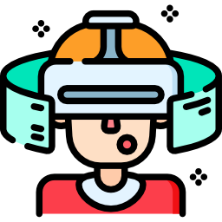
Why consider a career in AI?
4. You can work at the forefront of an emerging field
AI is a relatively new area that is advancing rapidly
An AI career is future-proof because it is a component of so many cutting-edge advancements!
This work is licensed under a Creative Commons Attribution-NonCommercial-ShareAlike 4.0 International License

Slide 12
AI Career Examples
What could a career in AI look like?
This work is licensed under a Creative Commons Attribution-NonCommercial-ShareAlike 4.0 International License

Slide 13
Multidisciplinarity and Dual Skilling
AI is a multidisciplinary field
This means it combines expertise from multiple disciplines
Driverless car development, for example, requires: AI developers, engineers, psychologists, legal and transport experts, and more!
People who are dual- or multi-skilled possess a range of skills and knowledge from different domains
They can apply these skills to tasks outside what’s considered normal for their original training
e.g., Marine biologists using AI to automatically identify whales from images
This work is licensed under a Creative Commons Attribution-NonCommercial-ShareAlike 4.0 International License

Slide 14
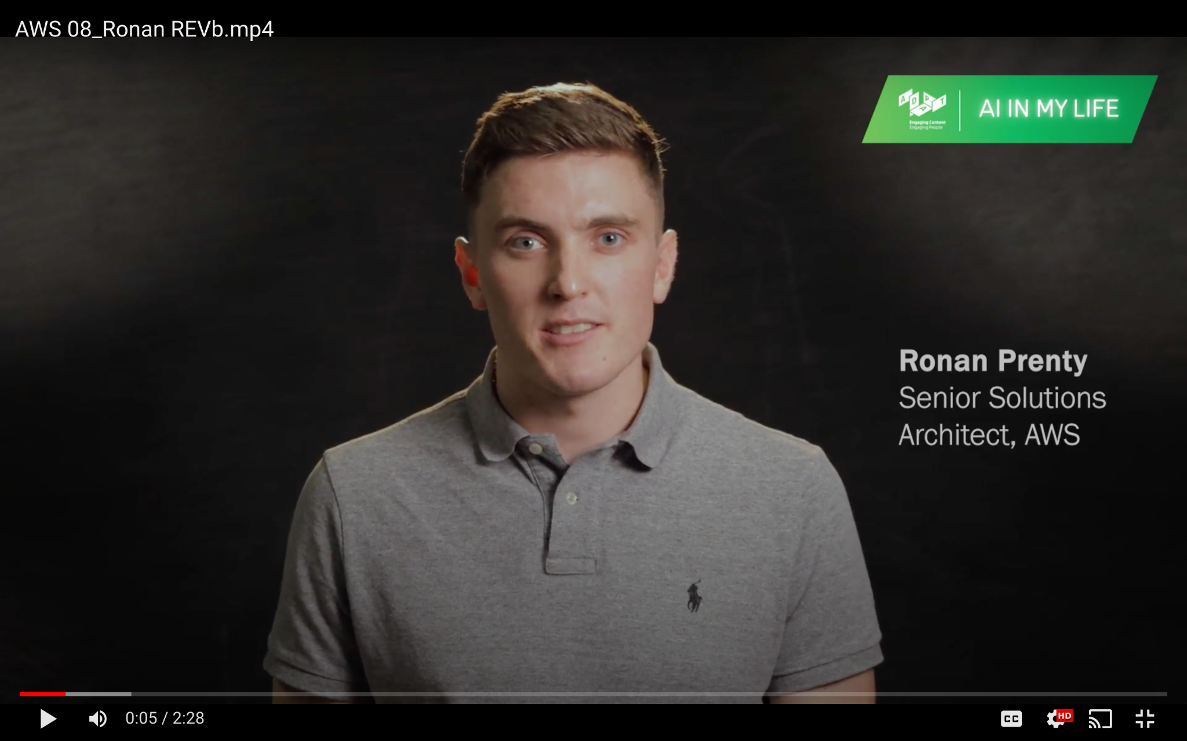
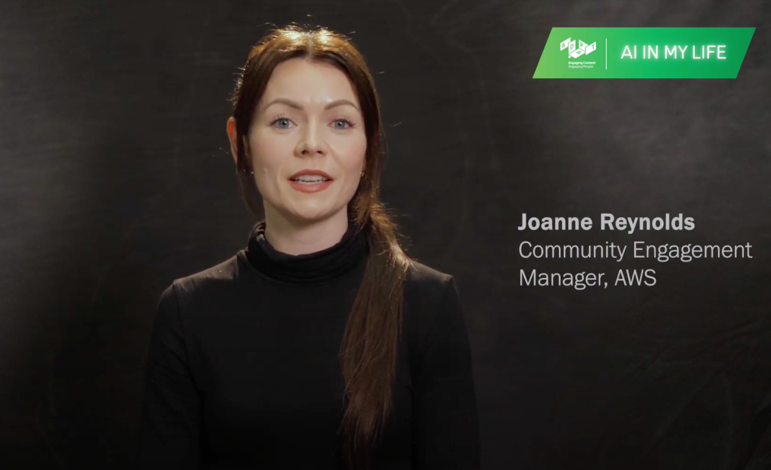
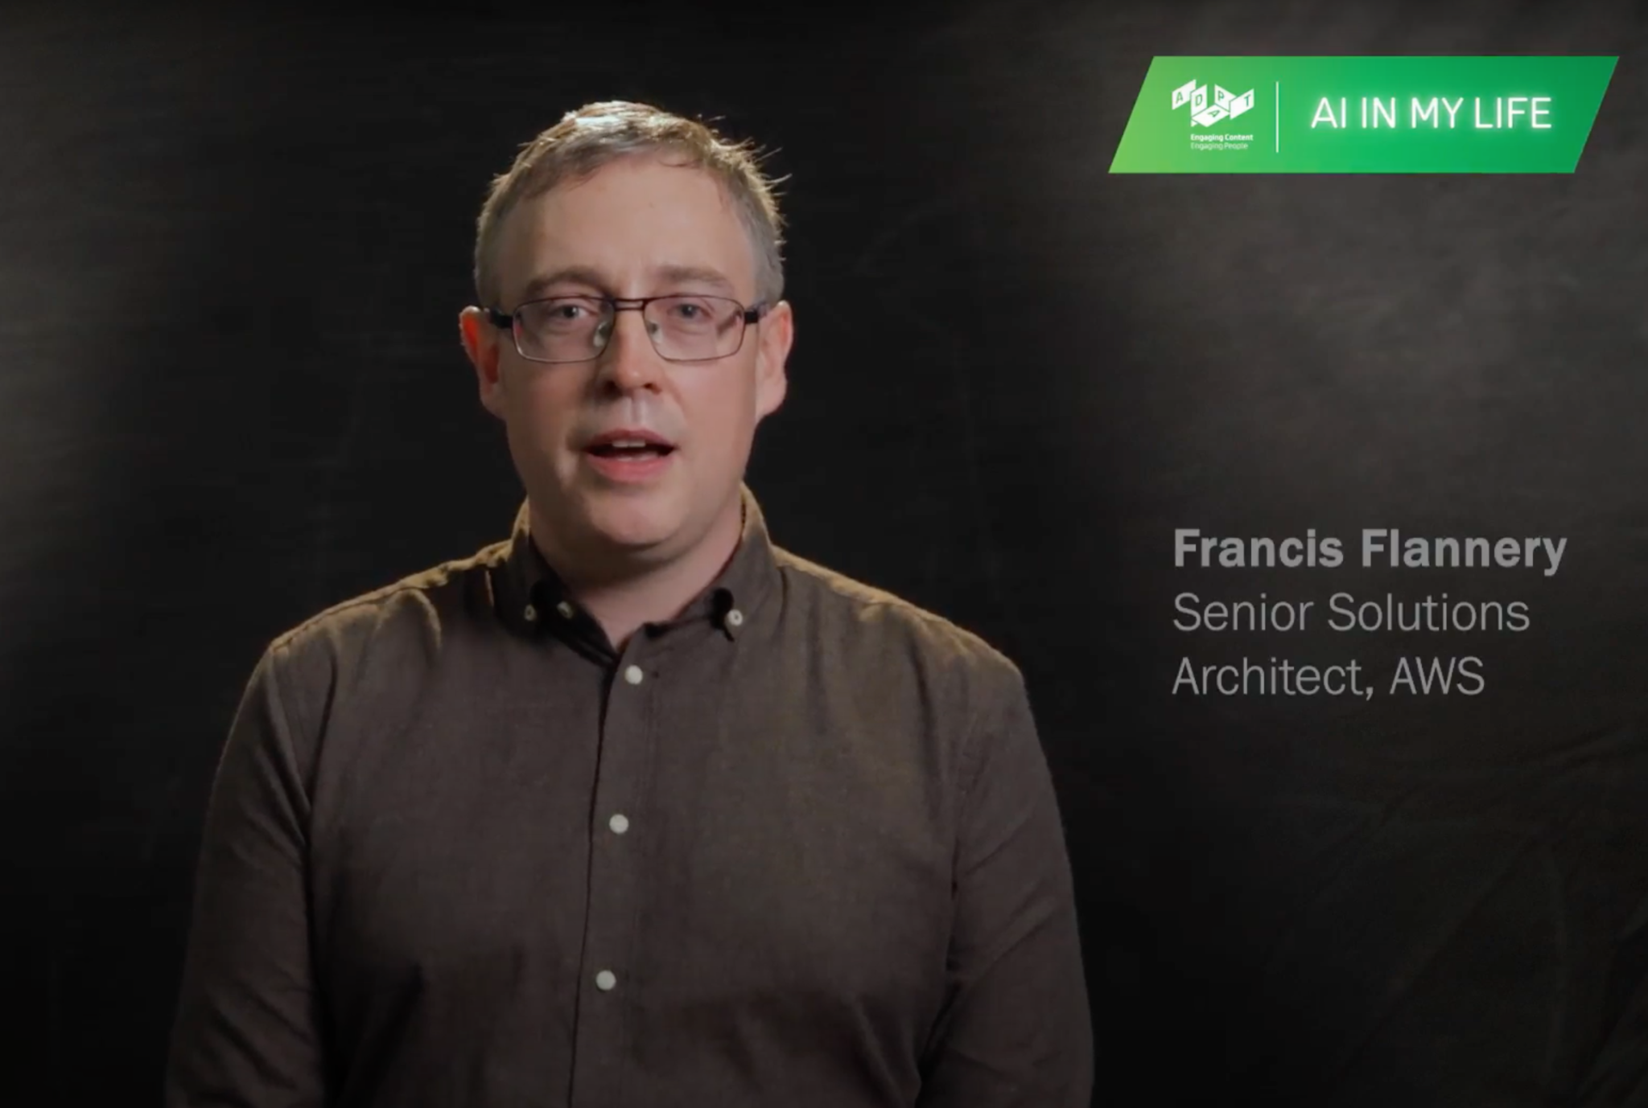
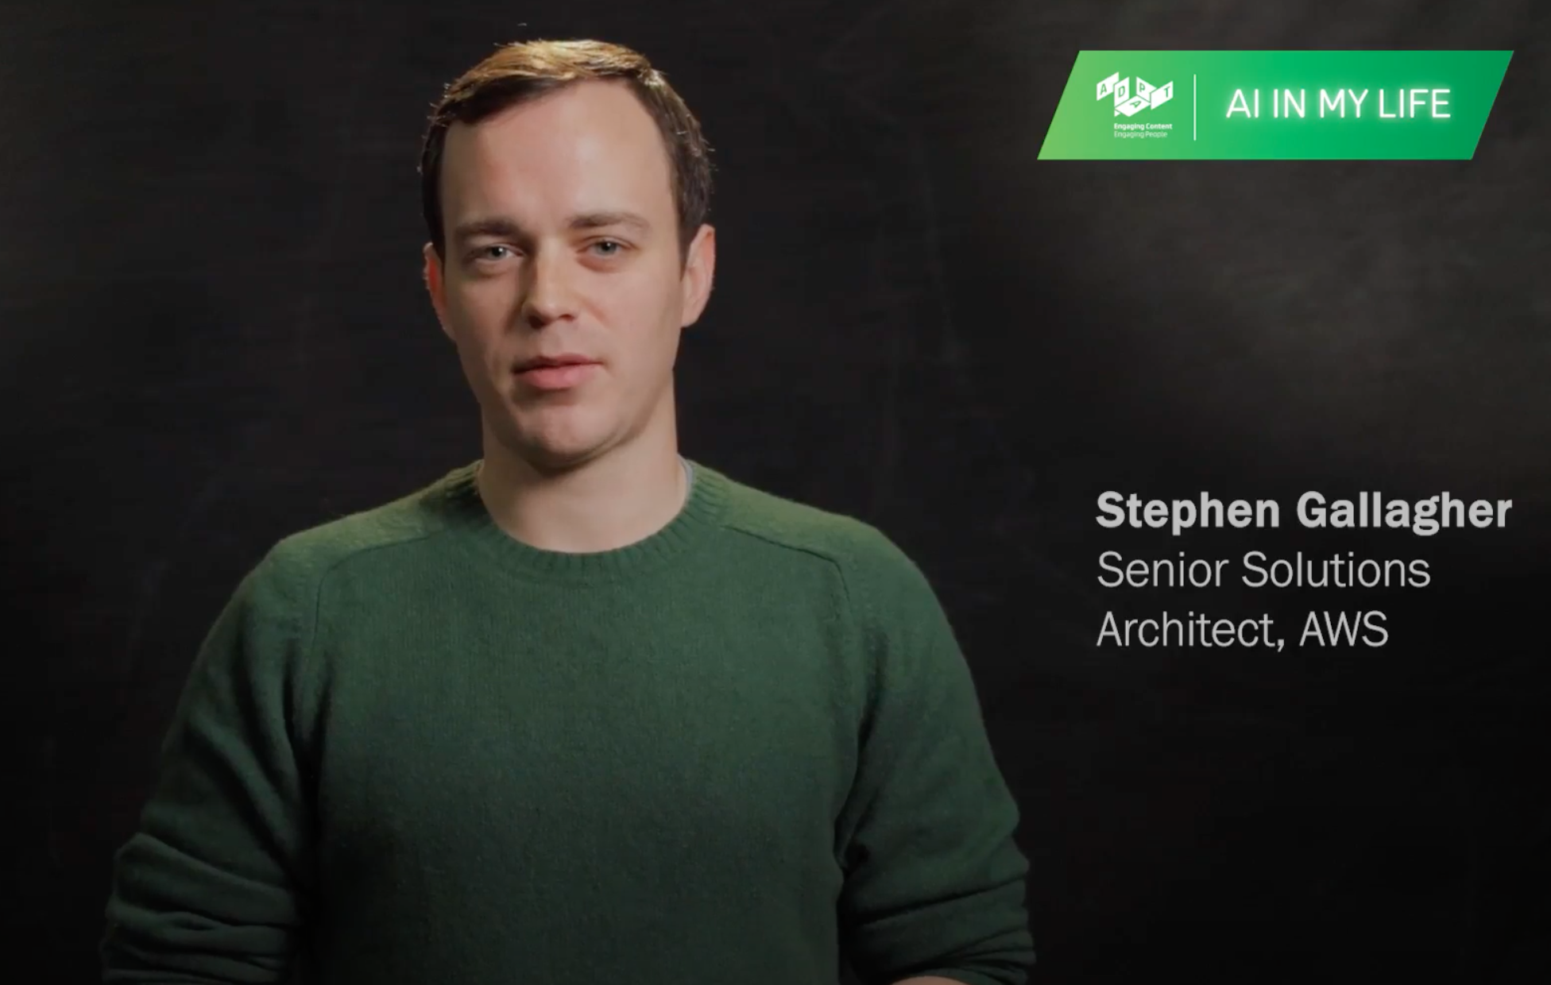
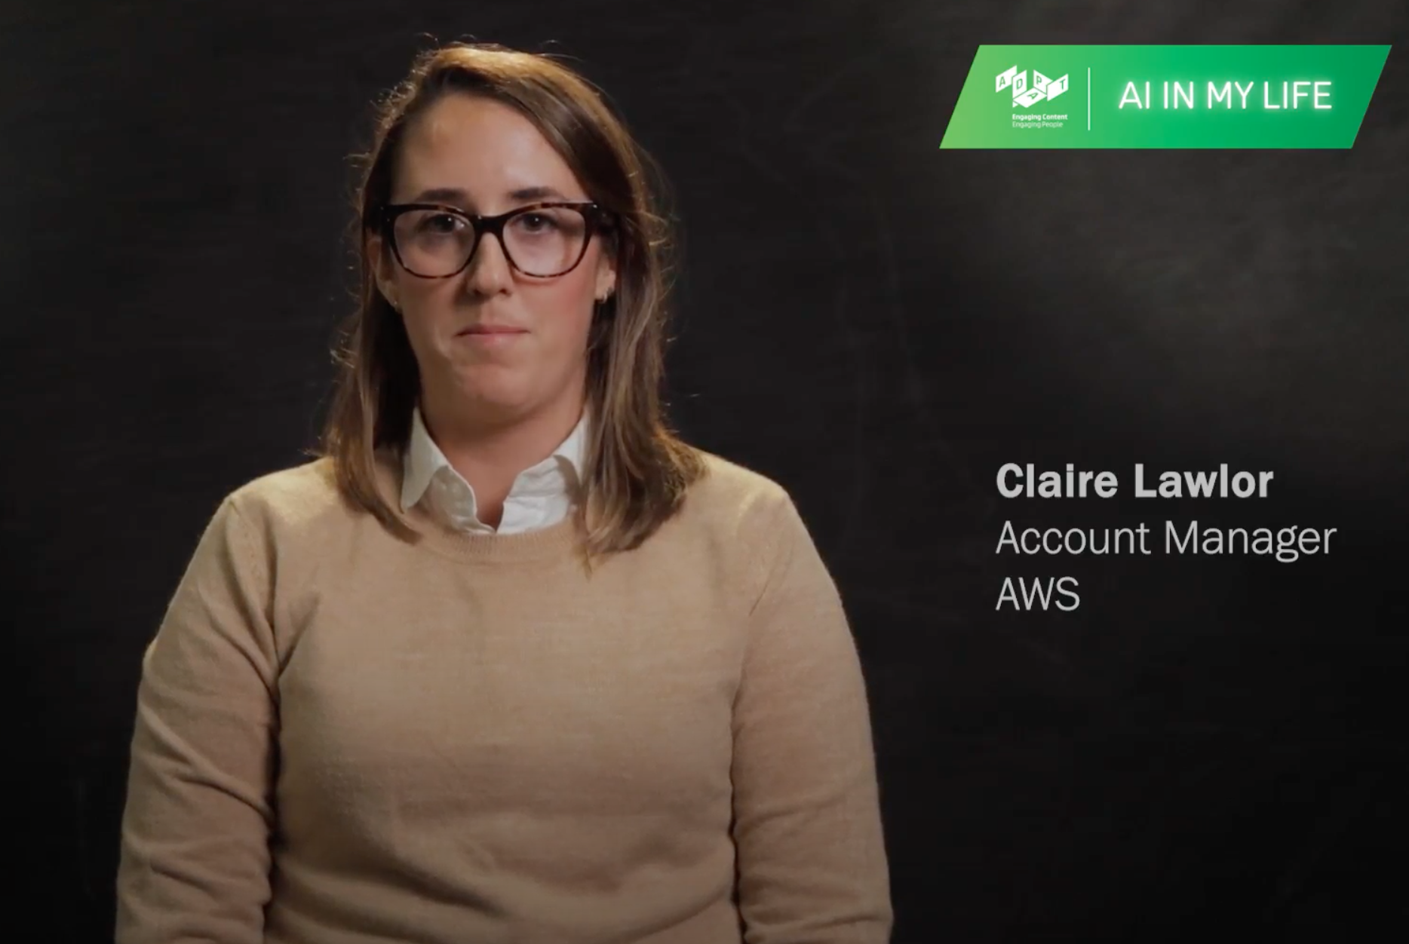
Industry Career Videos
How can we use AI to reduce food waste on flights?
How are humans and AI different?
How can AI help those with disabilities?
Can we use AI as a tool, like a spanner, to solve problems?
How can we imagine the jobs of the future?
This work is licensed under a Creative Commons Attribution-NonCommercial-ShareAlike 4.0 International License
This work is licensed under a Creative Commons Attribution-NonCommercial-ShareAlike 4.0 International License

Slide 15
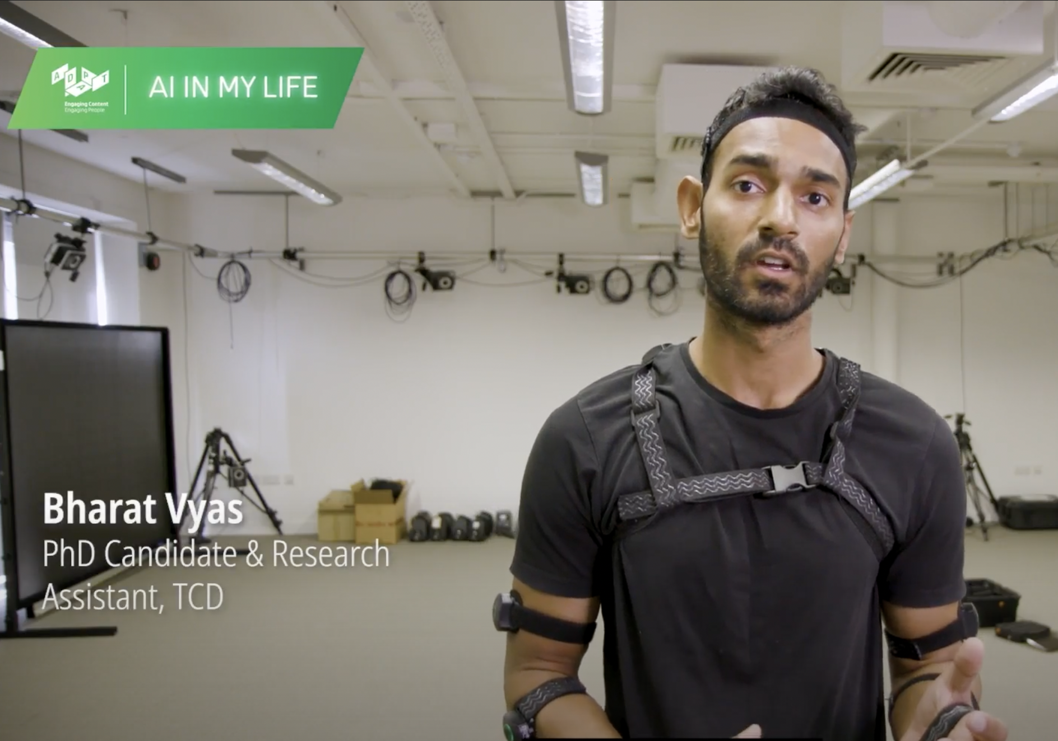
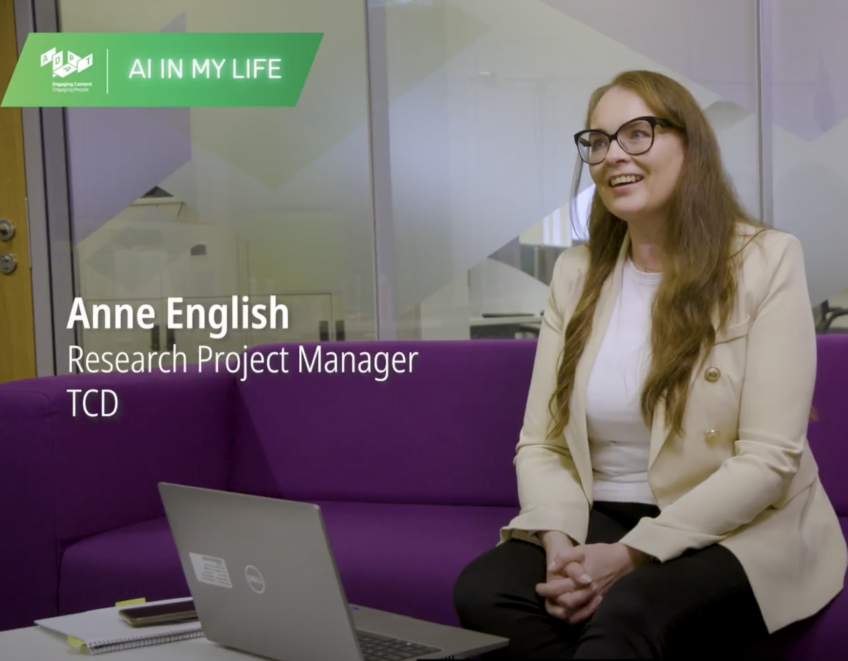
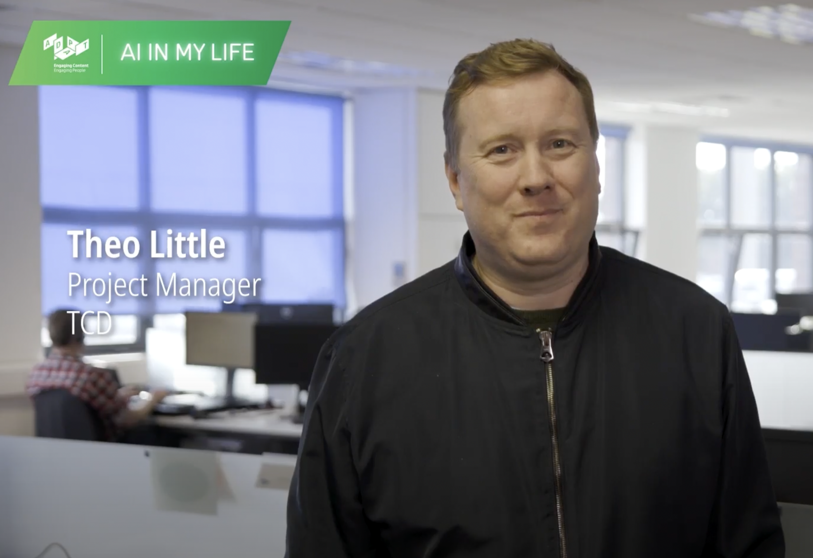
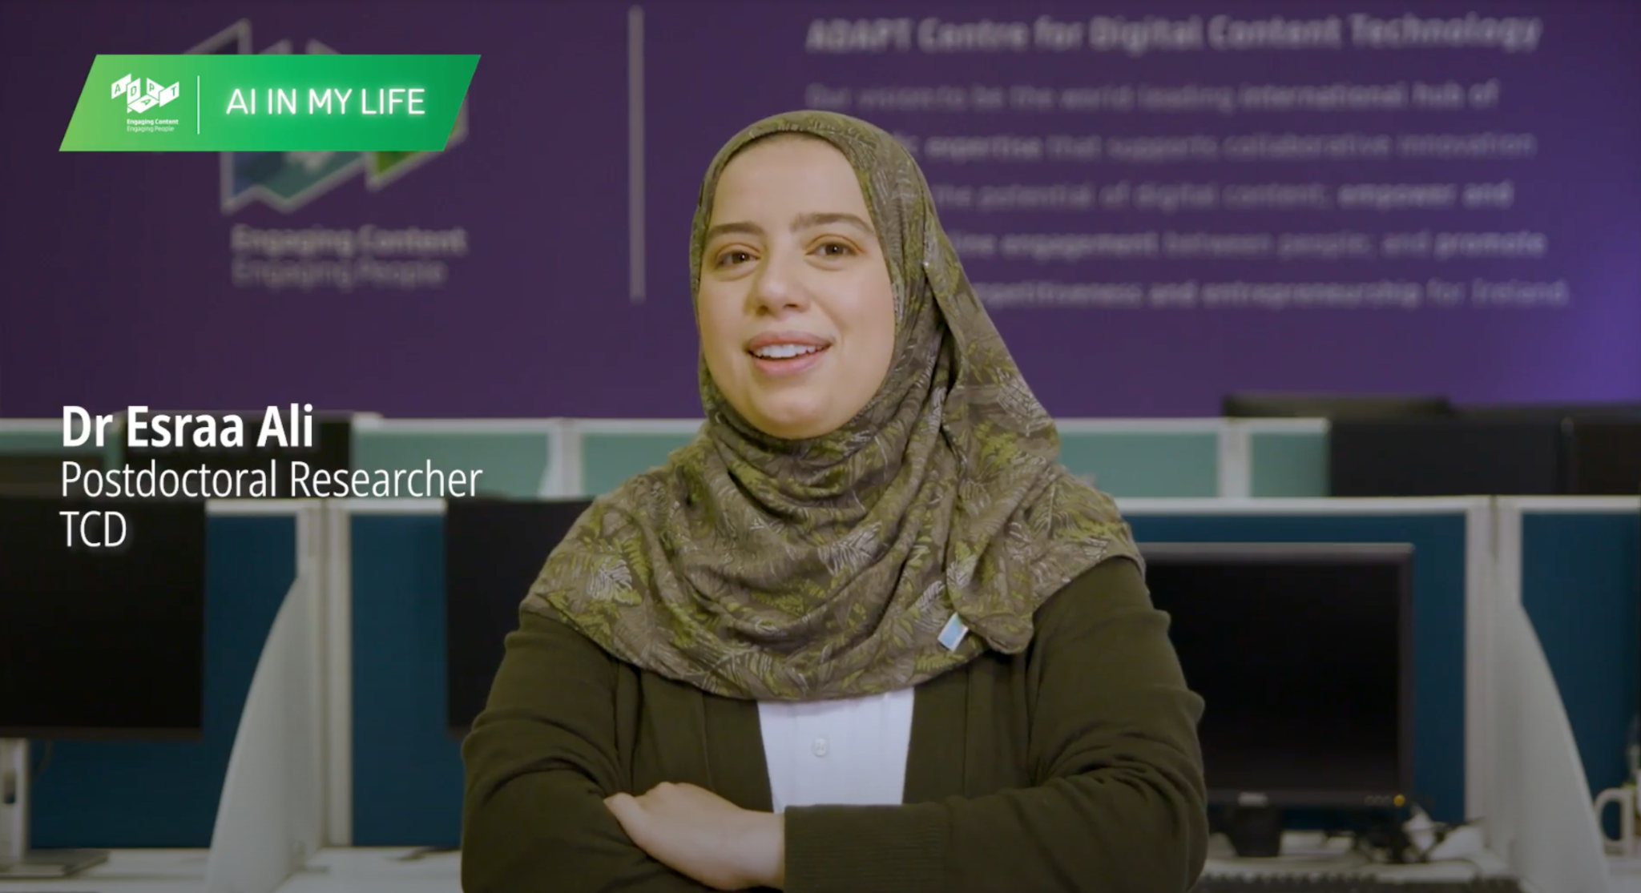
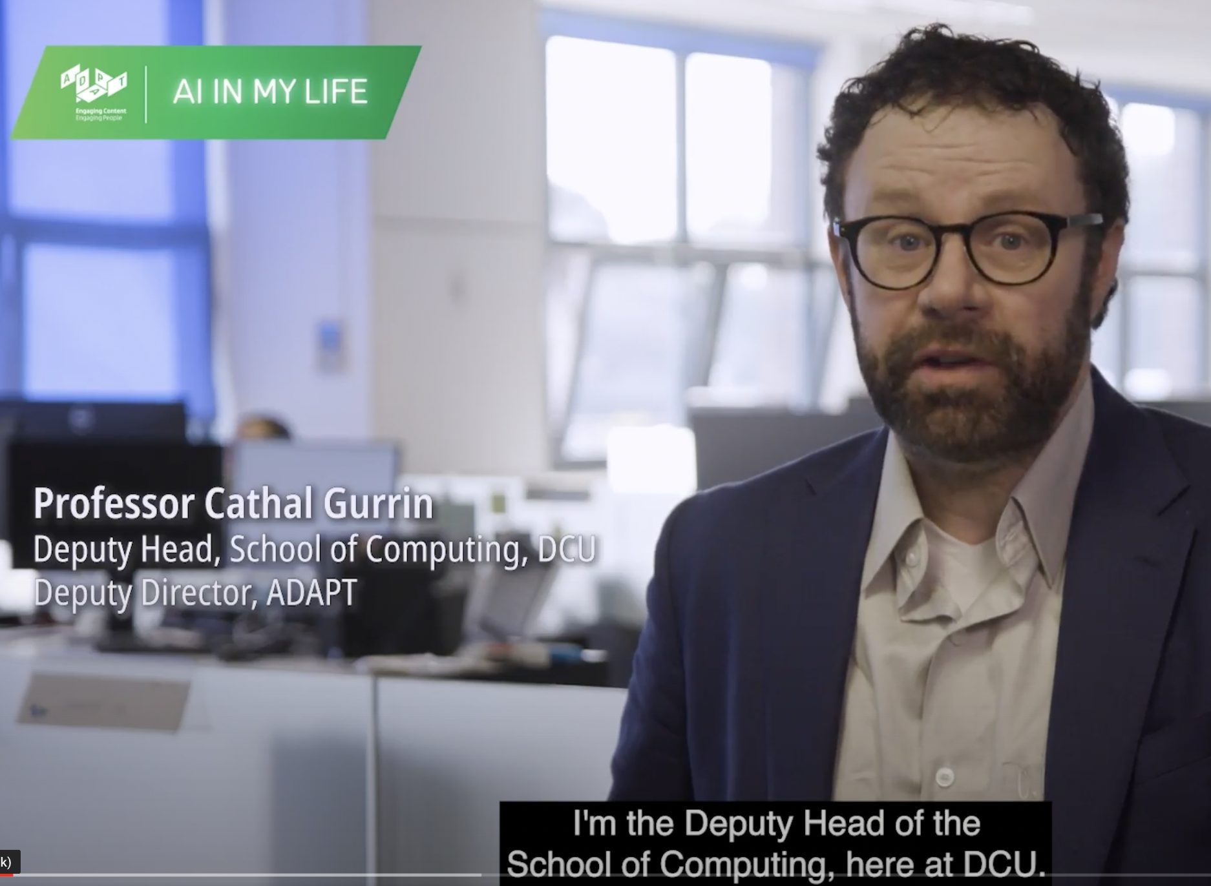
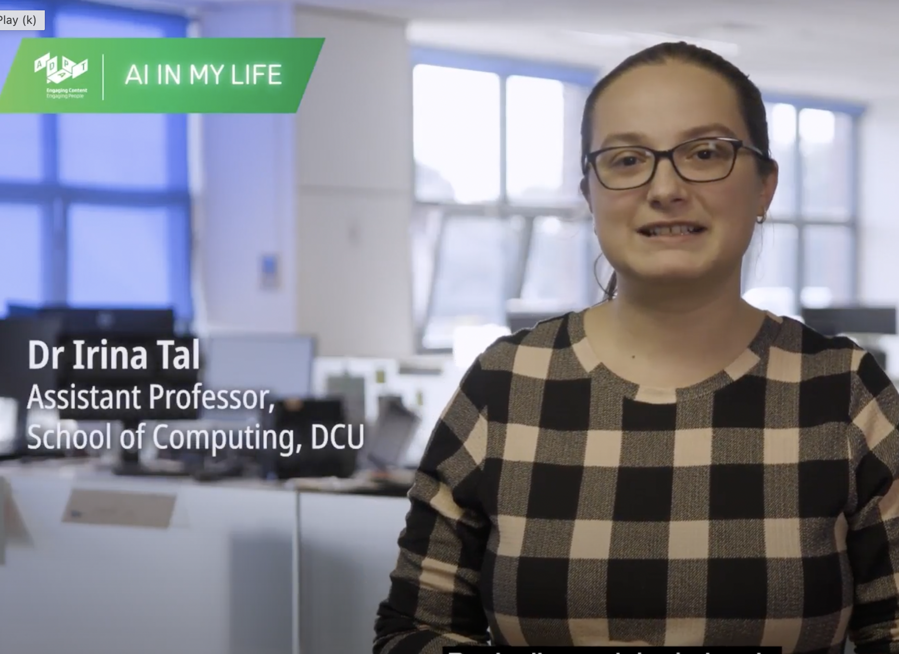
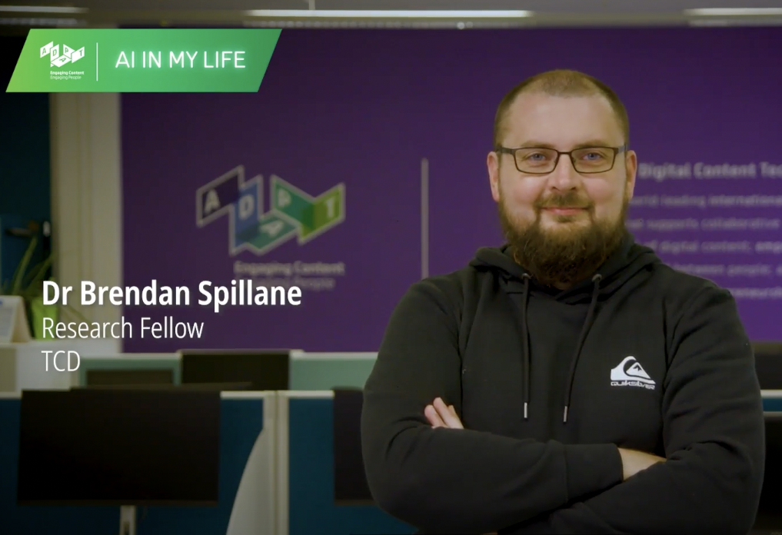
Research Career Videos
How does physics work in augmented reality?
How can AI help us find biodiversity solutions?
How can AI recover a lost history and recreate lost documents?
How AI can help us with preferences?
How can AI help people with Alzheimer's remember things?
What does a career around privacy in AI look like?
How can AI identify fake news?
This work is licensed under a Creative Commons Attribution-NonCommercial-ShareAlike 4.0 International License

Slide 16
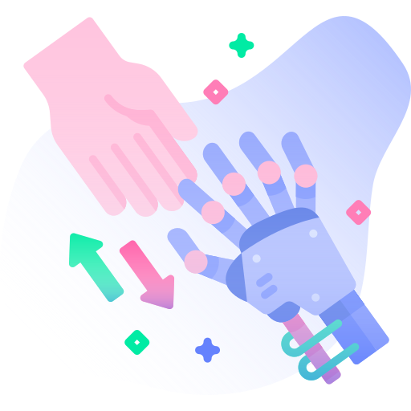
What did you think about these AI careers?
Were the profiles what you thought a career in AI might be like?
What key skills does it sound like these people have?
Do you think these people studied programming first in college? Or did they ‘dual skill’, gaining expertise in another area and then applying it to AI?
This work is licensed under a Creative Commons Attribution-NonCommercial-ShareAlike 4.0 International License

Slide 17
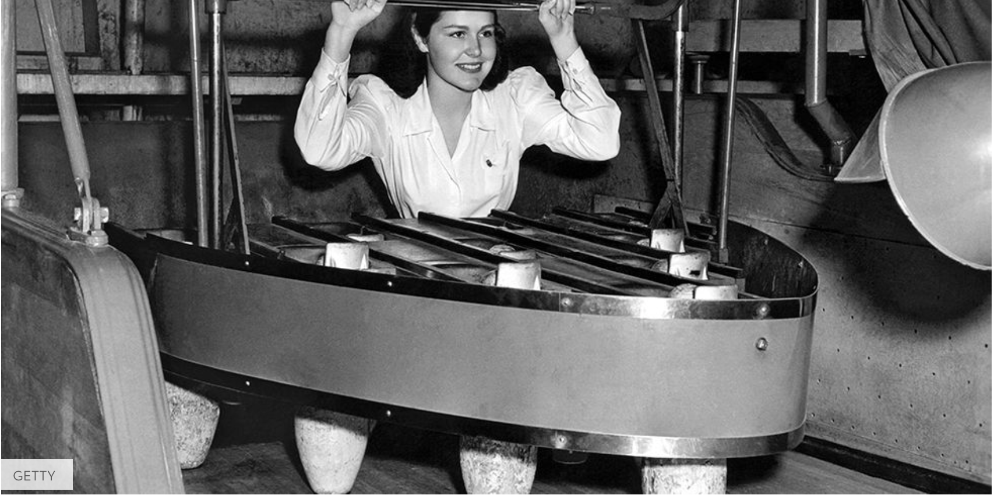
Many Careers of the Future are Unknown
Think you can identify jobs of the past?
Try our quiz at:
https://bit.ly/ObsoleteJobs
This work is licensed under a Creative Commons Attribution-NonCommercial-ShareAlike 4.0 International License

Slide 18
Many Careers of the Future are Unknown
Just as former jobs such as these disappeared, new roles appeared
Future advances in technology are hard to predict, so many careers are not yet known
This work is licensed under a Creative Commons Attribution-NonCommercial-ShareAlike 4.0 International License

Slide 19
What we do know now
AI is here to stay and its influence will continue to grow
Everyone will need some knowledge of AI
Resilience/adaptability will be key to make the most of the challenges and opportunities that arise
This work is licensed under a Creative Commons Attribution-NonCommercial-ShareAlike 4.0 International License

Slide 20
AI Careers
What should I study?
This work is licensed under a Creative Commons Attribution-NonCommercial-ShareAlike 4.0 International License

Slide 21
Back to ‘Dual Skilling’
AI combines multiple disciplines
Many people who develop AI systems have a background in IT or engineering
Others combine expertise in another area with knowledge of AI in order to apply it in their work - this is what we refer to as “Dual Skilling”
This work is licensed under a Creative Commons Attribution-NonCommercial-ShareAlike 4.0 International License

Slide 22
Want to develop AI systems?
Some tips:
It’s probably best to consider a specialist degree in AI, Data Analytics, Computing, Robotics, Language Technology, or a similar field.
This will provide you with the technical skills you need to succeed.
This work is licensed under a Creative Commons Attribution-NonCommercial-ShareAlike 4.0 International License

Slide 23
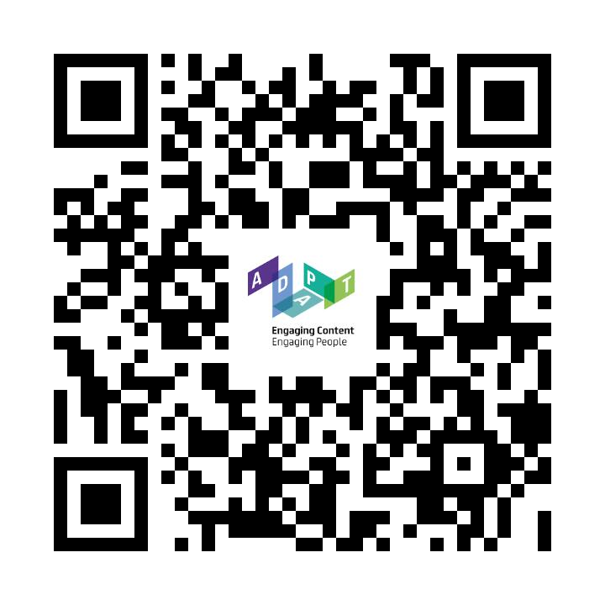
Want to develop AI systems?
Irish Higher Education Institutions offer 100+ courses, from Certificate to Masters level, in AI and related areas, such as Computer Science, Automation and Machine Learning.
You can see a list of these courses at*: https://bit.ly/AI_Courses_Ireland (Go to page 83)
*Links to a pdf of ‘AI Skills: A Preliminary Assessment of the Skills Needed for the Deployment, Management and Regulation of Artificial Intelligence’ [Appendix D].
This work is licensed under a Creative Commons Attribution-NonCommercial-ShareAlike 4.0 International License

Slide 24
Want to leverage AI?
Students who wish to work with AI – using it to enhance their area of work – have lots of study options.
For example, you could:
Select a course that allows you to focus on your favourite field but combine it with some modules (i.e. subjects) related to AI.
Most Irish higher education institutions have courses that allow you to combine disciplines like this and gain powerful “dual skills”.
E.g., DCU’s degree in Chemistry with Artificial Intelligence, or UCD’s degree in Biomedical Sciences – Artificial Intelligence for Medicine & Medical Research.
This work is licensed under a Creative Commons Attribution-NonCommercial-ShareAlike 4.0 International License

Slide 25
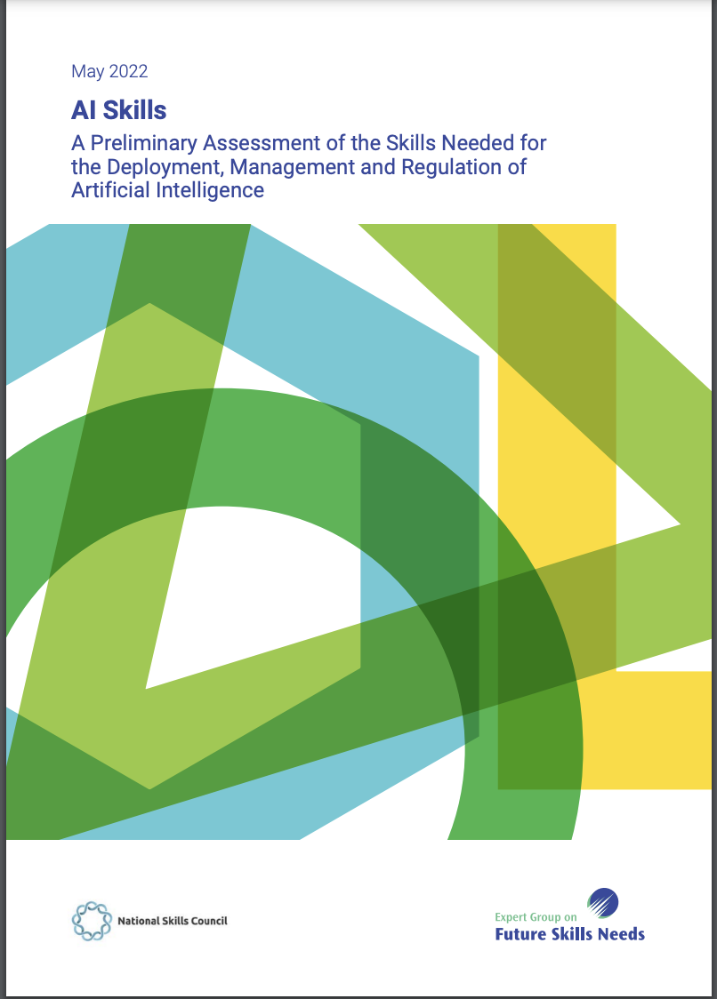
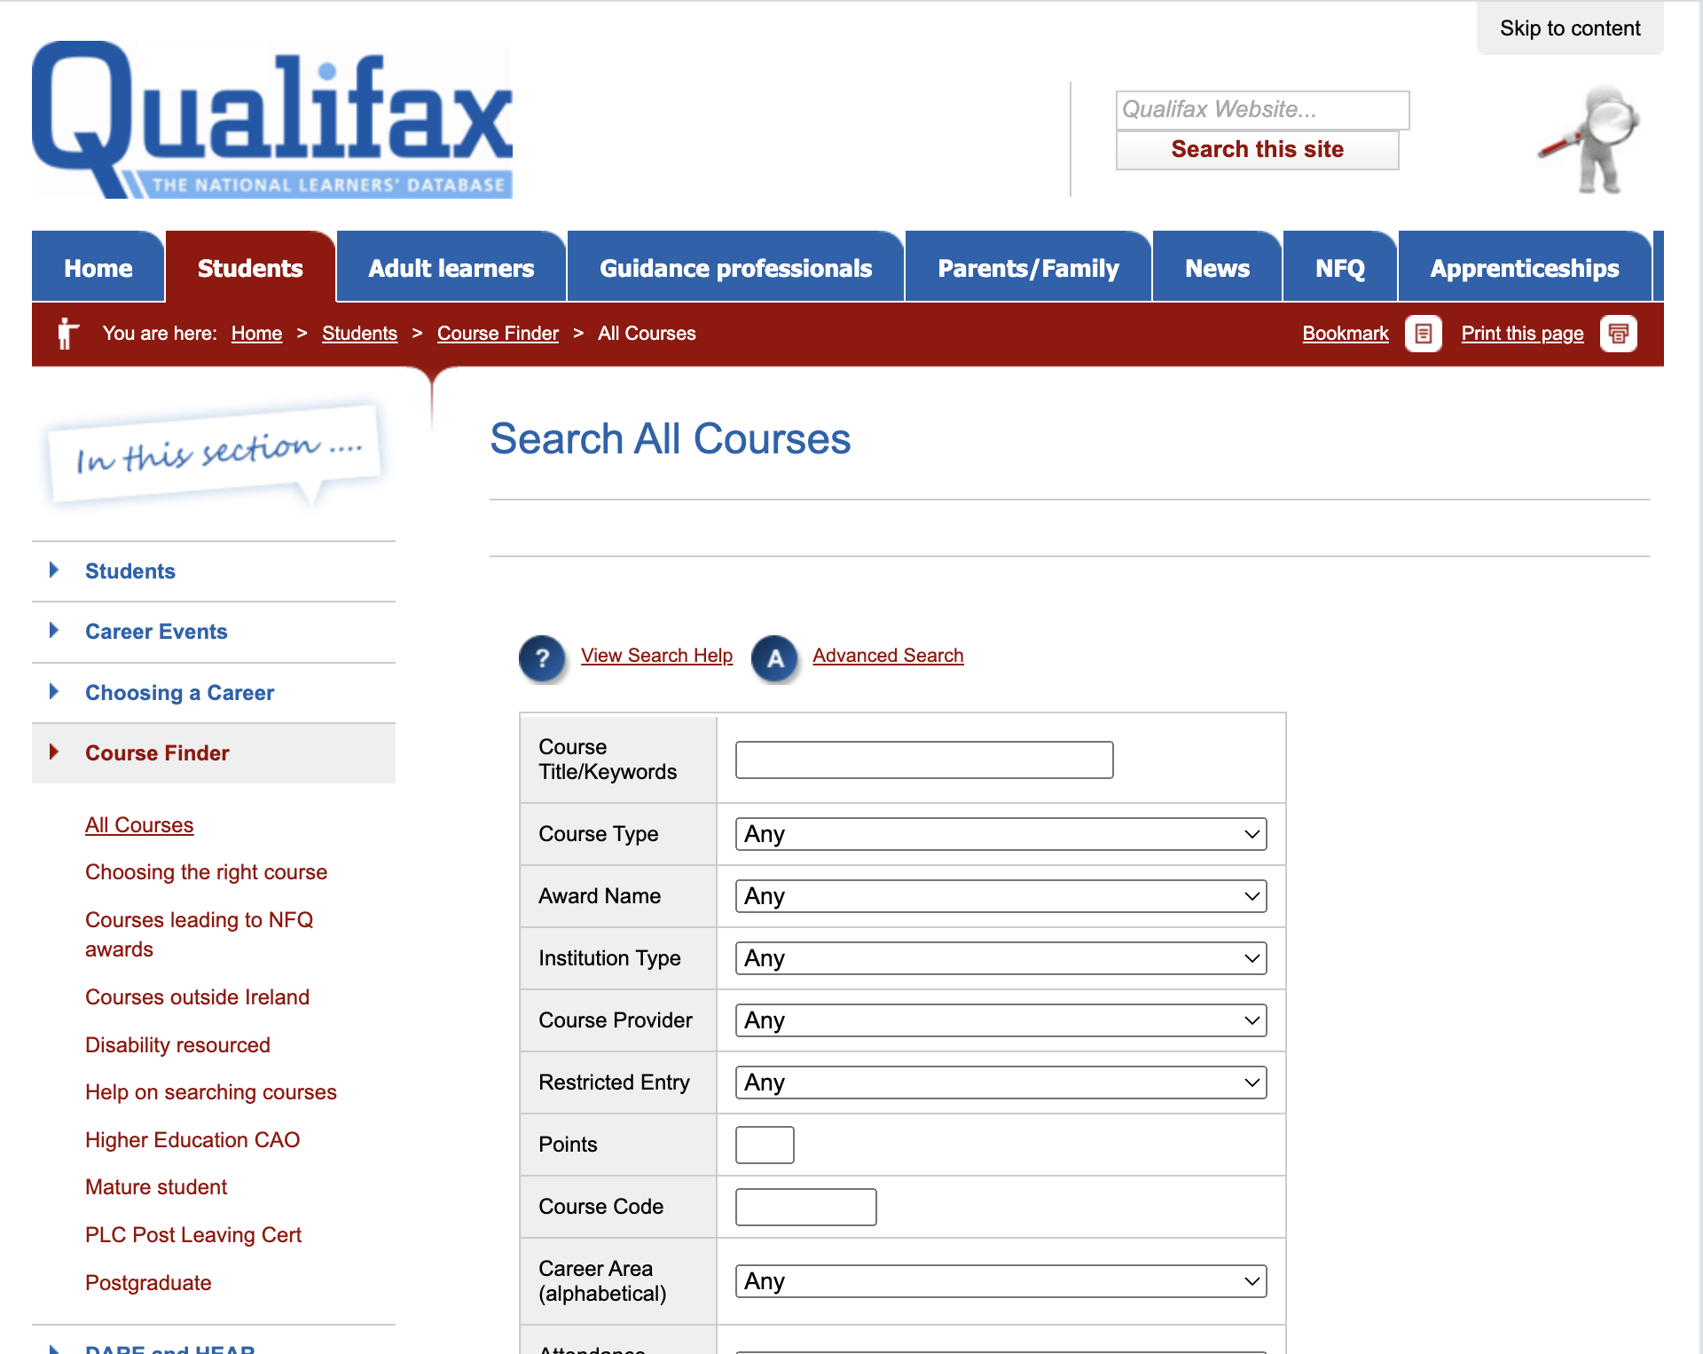
Where can I find out more?
Have a look at current courses available on AI. These are available in the AI Skills report. (AI Skills report, 2022, pg. 83-92).
There are many AI-related Post Leaving Certificate courses at Level 5 and Level 6 on the National Framework of Qualifications in areas such as robotics, automation and data analytics.
Search for these using the Qualifax - The National Learners’ Database course finder: https://www.qualifax.ie/index.php?option=com_wrapper&view=wrapper&Itemid=15.
Top tip: use full term “Artificial Intelligence” rather than “AI” to search
This work is licensed under a Creative Commons Attribution-NonCommercial-ShareAlike 4.0 International License

Slide 26
Got questions?
Talk to your guidance counsellor about course options
Attend college open days
Contact the Registry or Admissions offices of universities and colleges of further education
Don’t be afraid to reach out and ask questions!
This work is licensed under a Creative Commons Attribution-NonCommercial-ShareAlike 4.0 International License

Slide 27
What have we learned?
There’s a broad range of careers for those with an interest in AI
You could develop AI systems or ‘dual skill’
We don’t know many of the careers of tomorrow yet
Adaptability and AI knowledge will be key
This work is licensed under a Creative Commons Attribution-NonCommercial-ShareAlike 4.0 International License

Slide 28
Is AI the career for me?
Does the idea of a career in AI appeal to you?
This work is licensed under a Creative Commons Attribution-NonCommercial-ShareAlike 4.0 International License

Slide 29
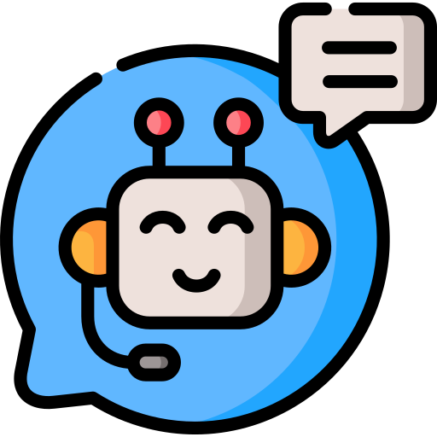
Thanks to our partners:
Want to find out more about AI?
Explore more AI in My Life modules at:
www.adaptcentre.ie/projects/ai-in-my-life/

Slide 30
AI Careers
Additional Resources:
A DCU Example
This work is licensed under a Creative Commons Attribution-NonCommercial-ShareAlike 4.0 International License

Slide 31
Want to develop AI systems?
Examples of relevant degree courses in DCU:
DC190 – Electronic and Computer Engineering
DC123 – Data Science
DC121 – Computer Science
This work is licensed under a Creative Commons Attribution-NonCommercial-ShareAlike 4.0 International License

Slide 32
Want to leverage AI?
Examples of relevant degree courses in DCU:
DC189 – Global Challenges
DC241 – Digital Business and Innovation
DC160 – Chemistry with AI
DC238 – Social Sciences and Cultural Innovation
DC210 – Psychology and Disruptive Technology
DC232 – BCL (Law and Society)
This work is licensed under a Creative Commons Attribution-NonCommercial-ShareAlike 4.0 International License

